Slide 1
LM27342 SW measurement
TI
11/22/2022

Slide 2
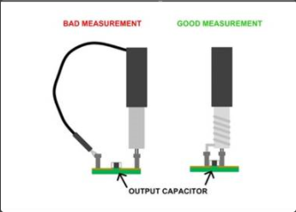
Switching node Measurement:

Slide 3
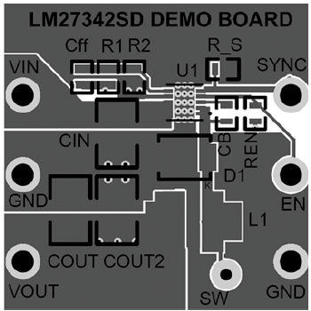
Switching node Measurement: Please measure at D1 positive and GND side. SW test point has a long loop which may pick up noise

Slide 4
Add a 0402 package 0.1uF or lower (2200pF) high frequency bypass capacitor as close as possible from PVin to GND

