Slide 1
UV LED Driver 진행 보고
2020. 08. 10
한국교통대학교

Slide 2
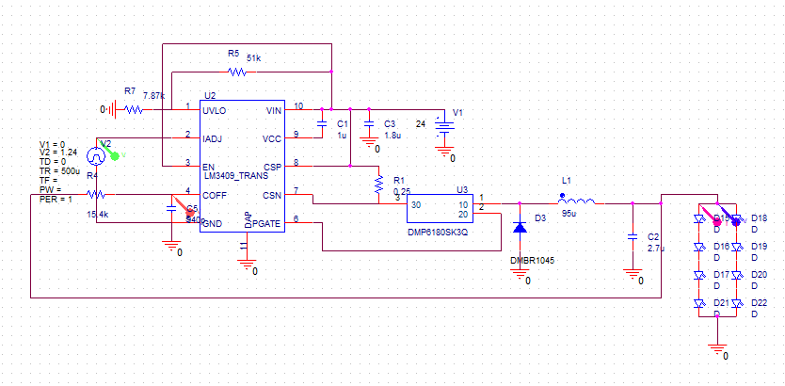
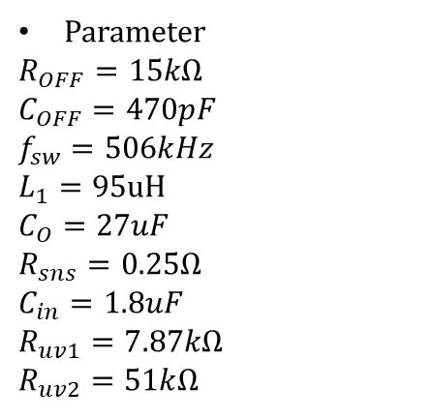
Pspice simulation circuit
Parameter
$R_{OFF}=15kΩ$
$C_{OFF}=470pF$
$f_{sw}=506kHz$
$L_{1}=95uH$
$C_{O}=27uF$
$R_{sns}=0.25Ω$
$C_{in}=1.8uF$
$R_{uv1}=7.87kΩ$
$R_{uv2}=51kΩ$

Slide 3
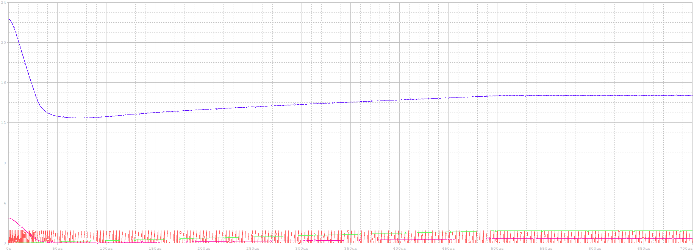
Simulation result
Running time : 700us
Rising time : 500us

Slide 4
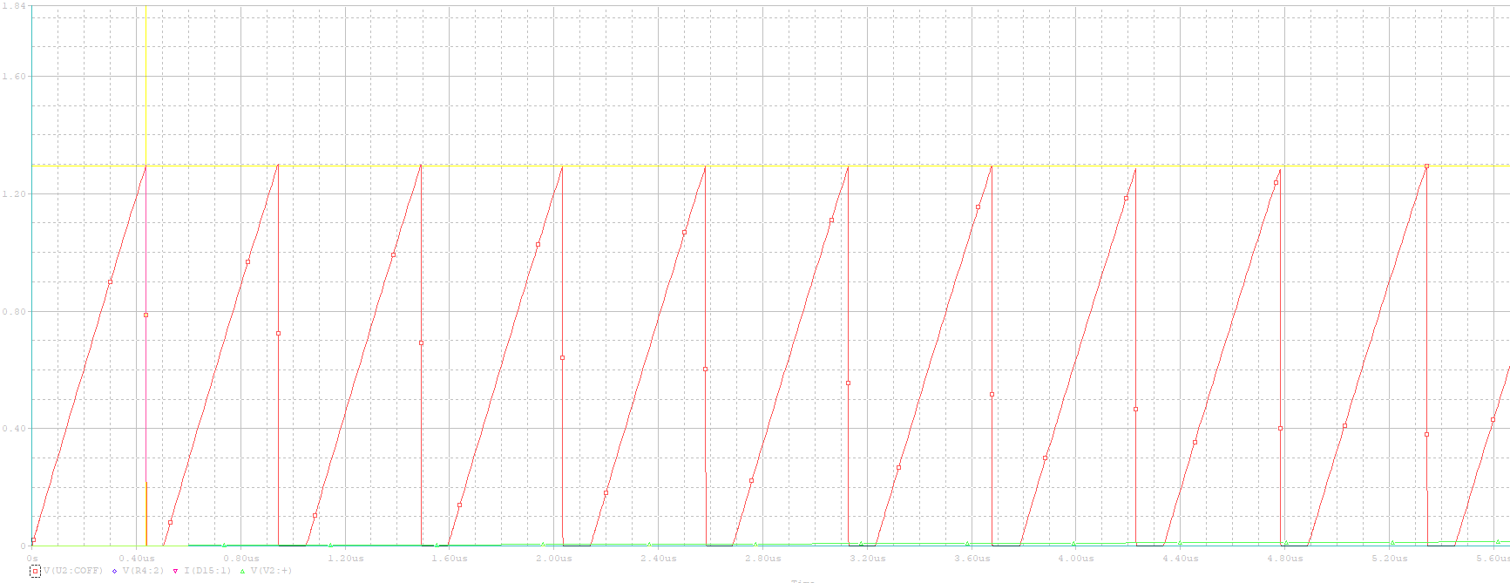
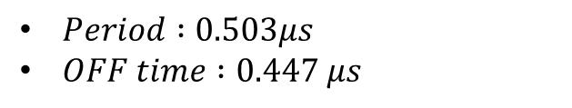
Simulation result
Time : 0s
$Period :0.503μs$
$OFF time :0.447 μs$

Slide 5
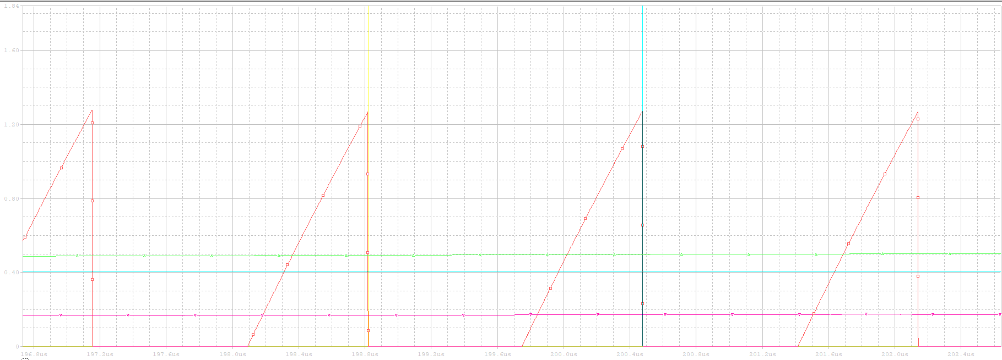

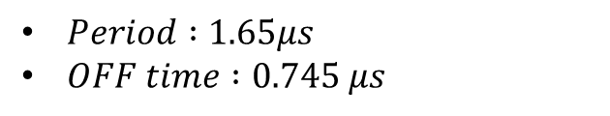
Simulation result
$Time : 200μs$
$Period :1.65μs$
$OFF time :0.745 μs$

Slide 6
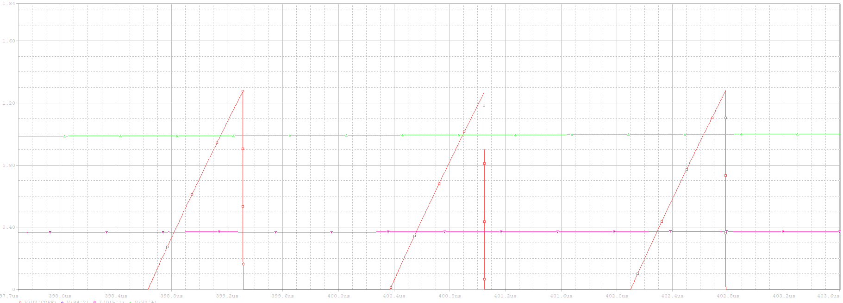

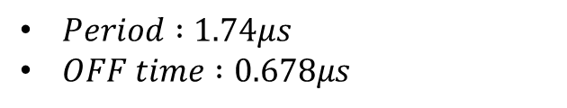
Simulation result
$Time :400μs$
$Period :1.74μs$
$OFF time :0.678μs$

Slide 7
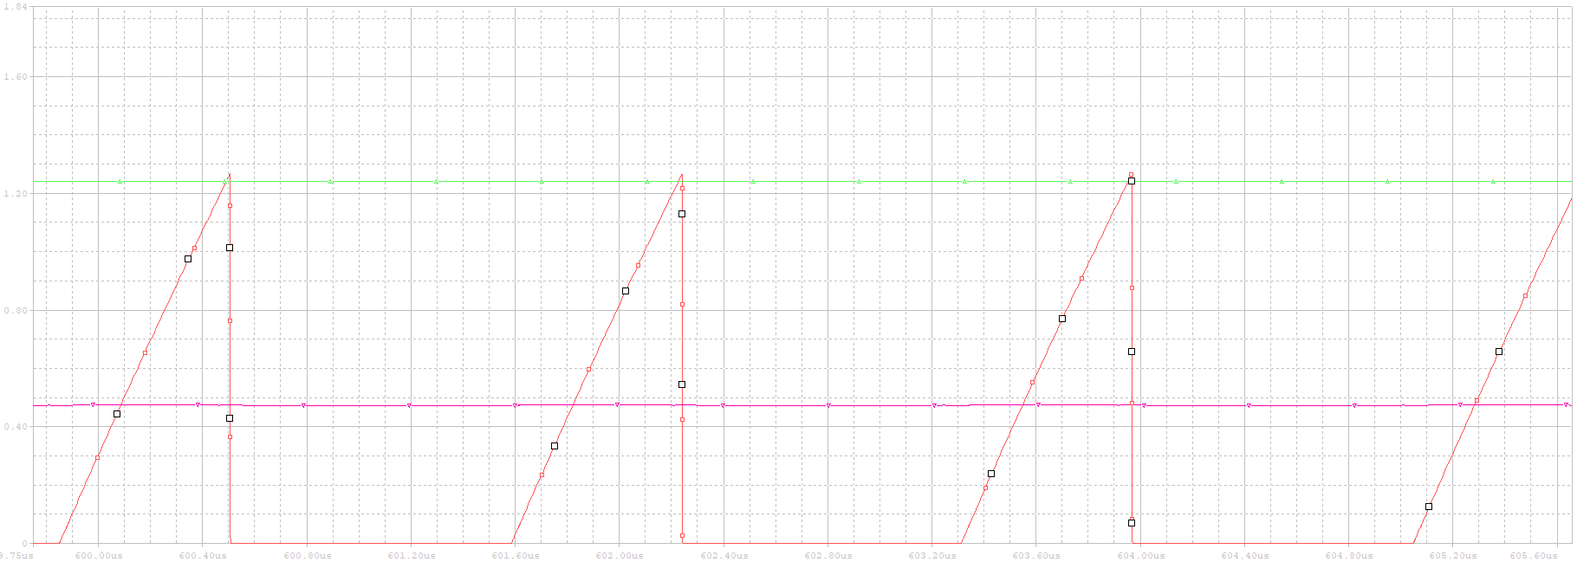

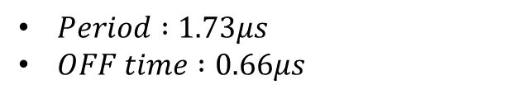
Simulation result
$Time :600μs$
$Period :1.73μs$
$OFF time :0.66μs$

