Slide 1
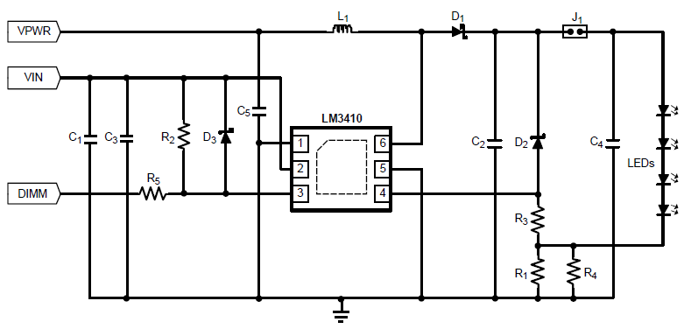
Schematics
4~7.2V
12V,300mA
10uH
3.3V
22uF
NM
NM
10uF
2.2uF
NM
100Hz, 10%
6.8k
100
NM
1.8*3 parallel

Slide 2
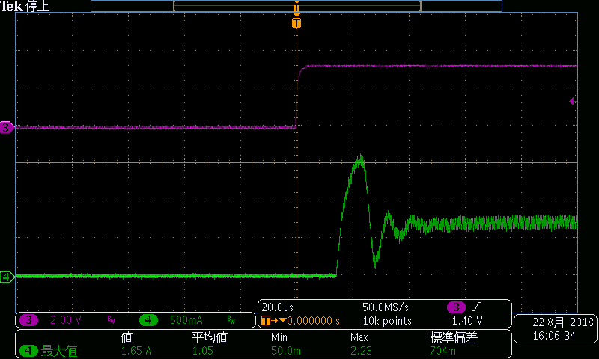
Question 1
DIM
Inductor Current
The inductor current overshoot occurs at the rising edge of DIM signal. It seems to be big as increasing the output capacitor. Therefore I assume the inrush current causes this phenomenon. Is this my understanding correct? If there are other solution except for decreasing the output capacitor, please give us the solution.

Slide 3
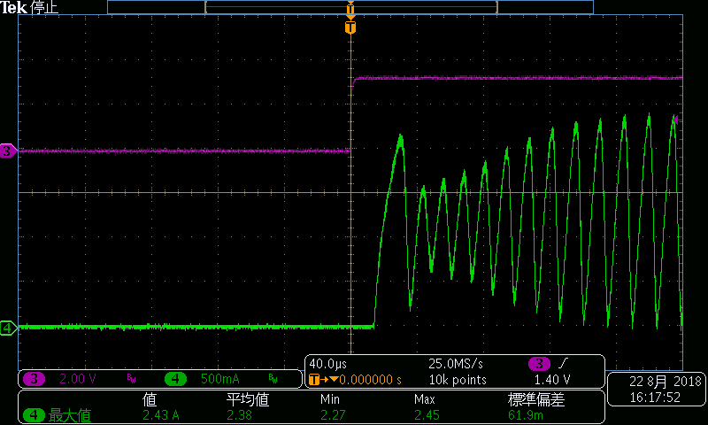
Question 2
DIM
Inductor Current
When the input voltage is 4V, the inductor current reaches the current limit and the big ringing occurs. Are there any solution for improving the stability?

Slide 4
Question 3
Could you provide an information of the best IC under the following condition?
Vin=4~7.2V
Vf=11V typ
ILED=350mA
Dimming=Analog or PWM

