Slide 1
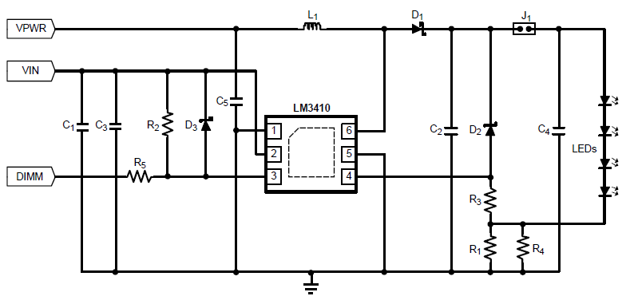
Schematics
LED current measured
4~7.2V
12V,350mA
6.8uH
3.3V
22uF
NM
2.2uF
Or
2.2uF+4.7uF
NM
10uF
NM
100Hz, 10%
6.8k
100
NM
1.6*3 parallel

Slide 2
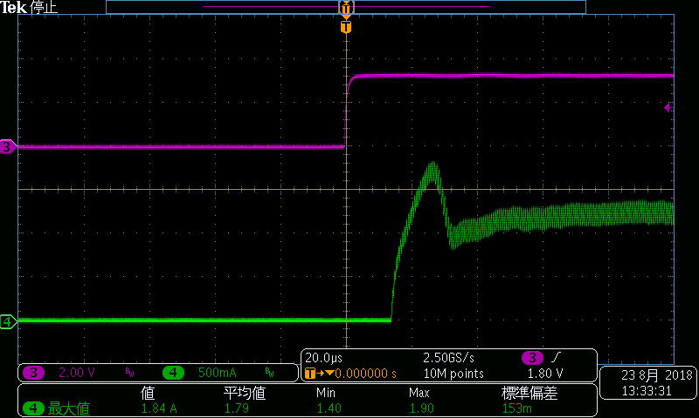
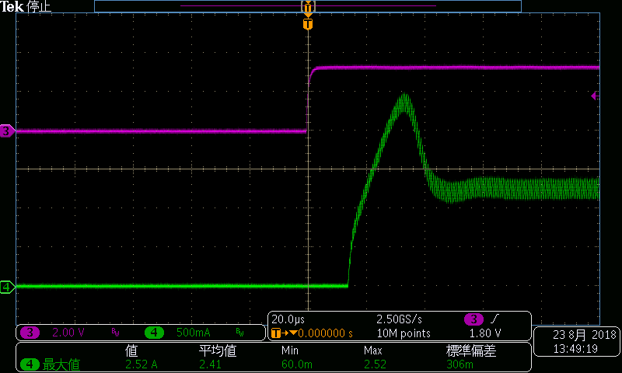
Inductor Current at Vin=4V
DIM
DIM
Inductor Current
Inductor Current
Cout=2.2uF
Cout=2.2uF+4.7uF
The inductor current overshoot becomes bigger as increasing the output capacitor. This phenomenon occurs every cycle of dimming. I assume the rush current into the output capacitor causes this phenomenon.

Slide 3
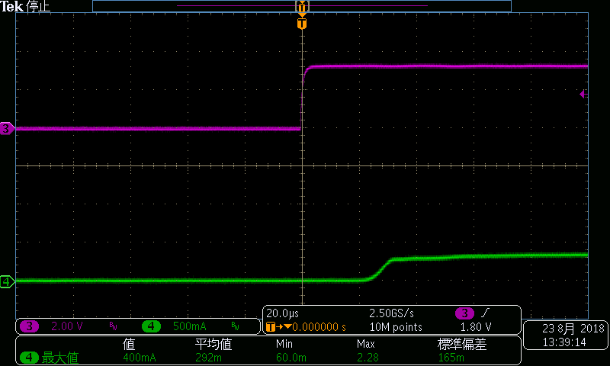
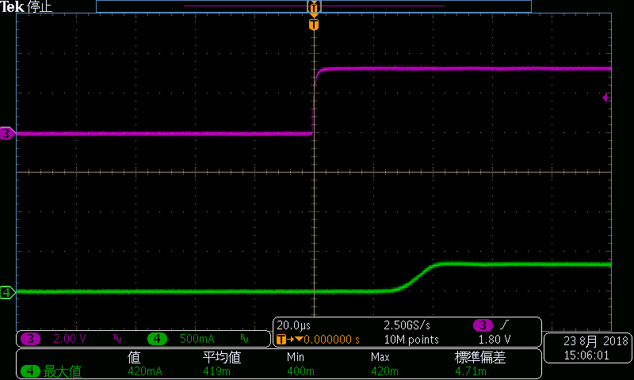
LED Current at rising edge of DIM signal at Vin=4V
DIM
DIM
LED Current
LED Current
Cout=2.2uF
Cout=2.2uF+4.7uF
The LED current seems the stable current.

Slide 4
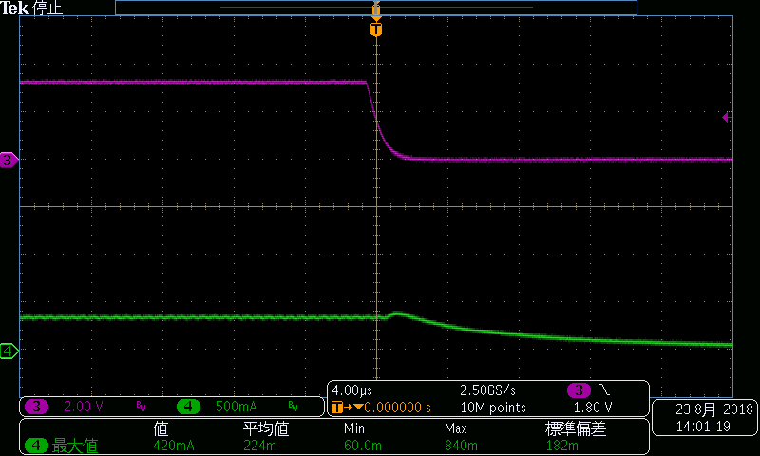
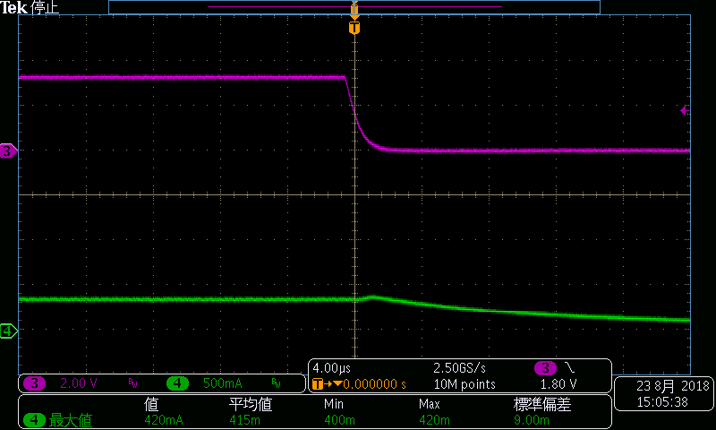
LED Current at falling edge of DIM signal at Vin=4V
DIM
DIM
LED Current
LED Current
Cout=2.2uF
Cout=2.2uF+4.7uF
The LED current seems the stable current.

