Slide 1
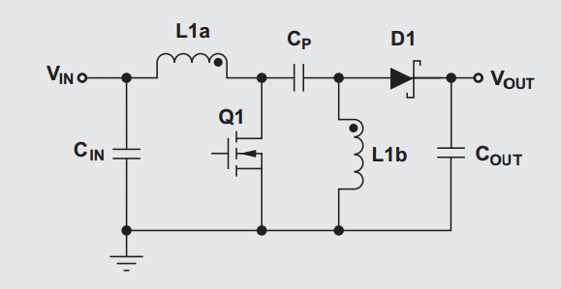
High Frequency path
High Current path (when boosting)
High frequency path highlighted will see large swing in current when the FET switches ON and OFF.
High frequency path length needs to be minimized to reduce noise generation.
Coupled inductor are preferred but using two inductors (L1 and L2 instead of L1a and L1b) is possible.
When the SEPIC converter is used in a high ratio boost application, the input and switch path can see a high current. Traces need to be sized accordingly

Slide 2
Keep the current sense path short.
It is recommended to add a placeholder for a small capacitor (100pF typical) at the input of the ISEN pin in case switching noise is an issue. Likewise, insert a placeholder resistance (0Ω) between the sense resistor and the ISEN pin to increase noise filtering capability or for the potential need to increase slope compensation.
Keep VCC capacitor close to the VCC pin.
Don’t create a long trace for the high impedance feedback node: Keep the feedback resistors close to the FB pin.
Keep the feedback resistors and paths away from the switch node and the inductors.
Keep the path from the DR pin to the gate of the FET short. A placeholder for a gate resistor can be added between the DR pin and the gate of the FET in order to tune the speed of the FET turn ON/turn OFF.
A decoupling capacitor next to the VIN pin is beneficial (100nF - 1µF).

