Slide 1
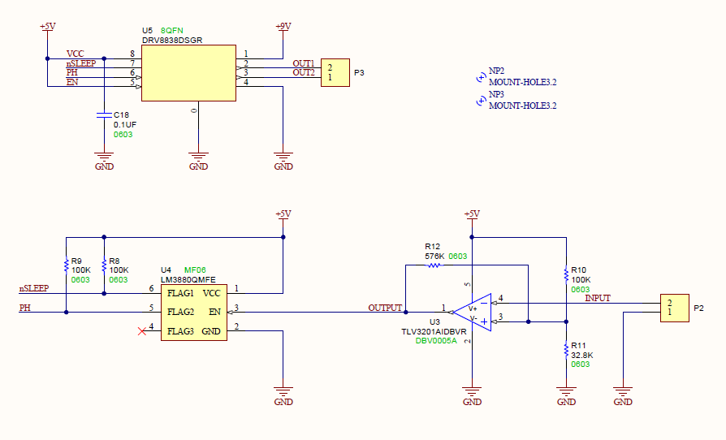
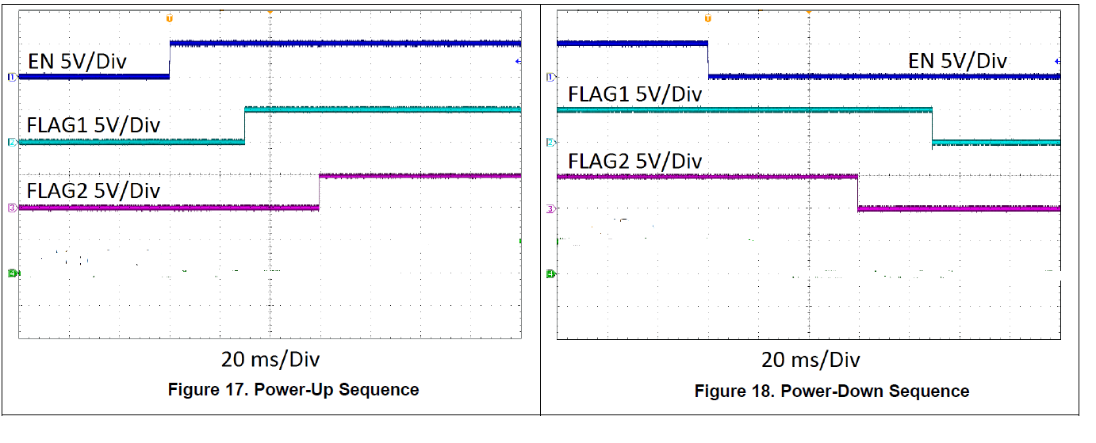
30mS delay timing
60mS
30mS
60mS
90mS

