Slide 1
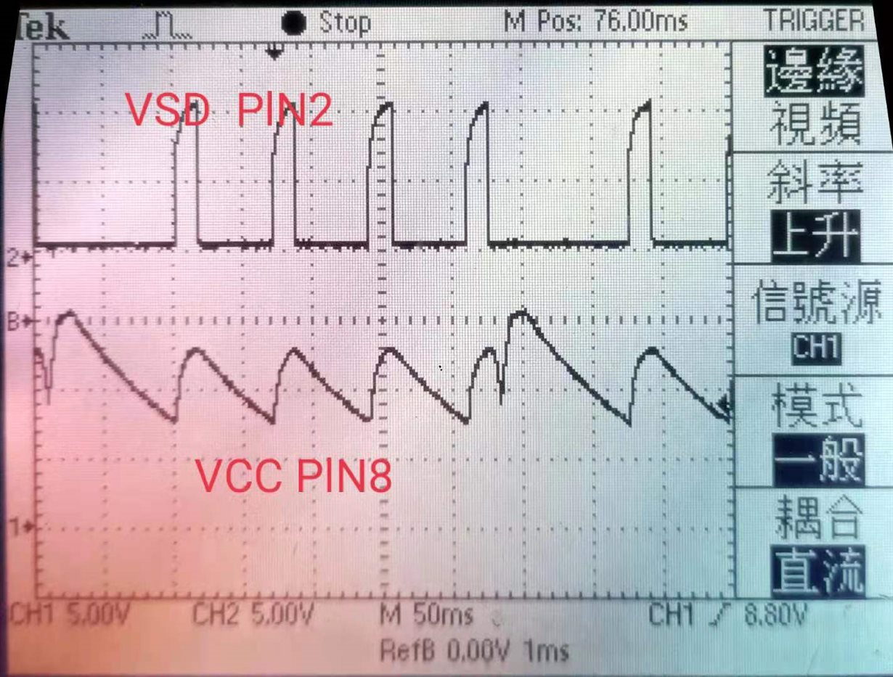
SD pin only can tell us
In here , it maybe triggered output OVP
Vcc(on)
Vcc(off)
In here , AUX winding take over VCC supply , so VCC is rising
We need to know what happens during this period, why VCC voltage didn’t taken over by AUX winding, Zoom in this region

Slide 2
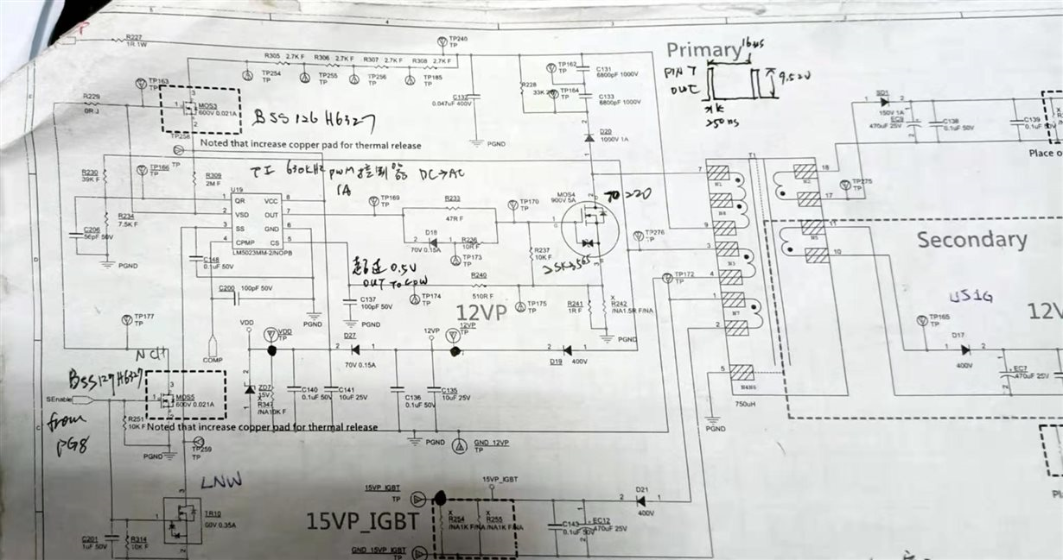
Here is the mosfet Vds
Not shows outputs circuit
Not shows feedback circuit
Missed some circuit.
This is not a complete and clear schematic
Transformer : n1 : 47 turns , n2 : 4 turns(Vo=?V ) ,n3: 9 turns (Vo=?V ) , n5 : 9 turns , n7 : 10 turns , n6: 41 turns
What are the windings corresponding voltage ?
Please capture the VCC voltage, Vout (feedback path, please let us know which output is feedback path) , Mosfet Vds . in the same screen.

