Slide 1
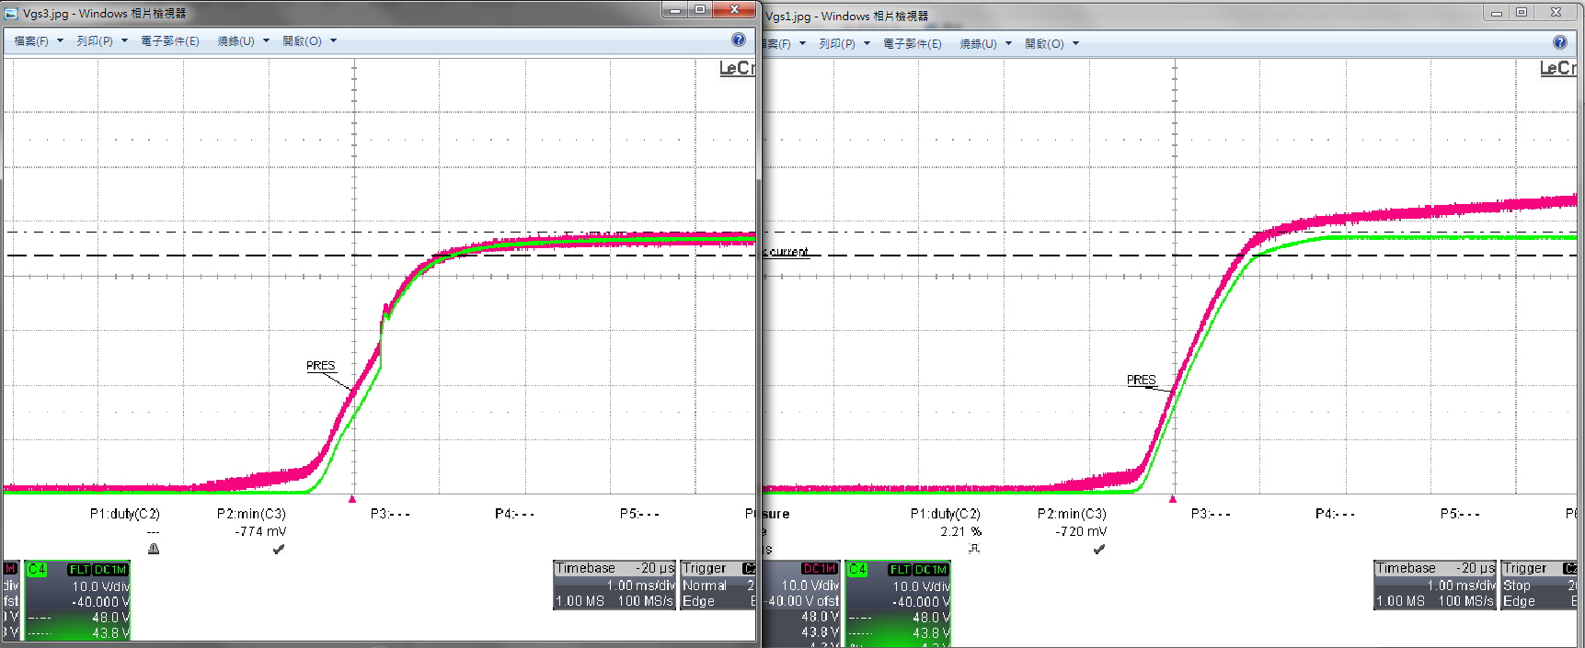
With load
MOSFET damaged
Without load
Ch3 (PINK): Vg
Ch4 (GREEN): Vs

