Slide 1
LM5069
PGood

Slide 2
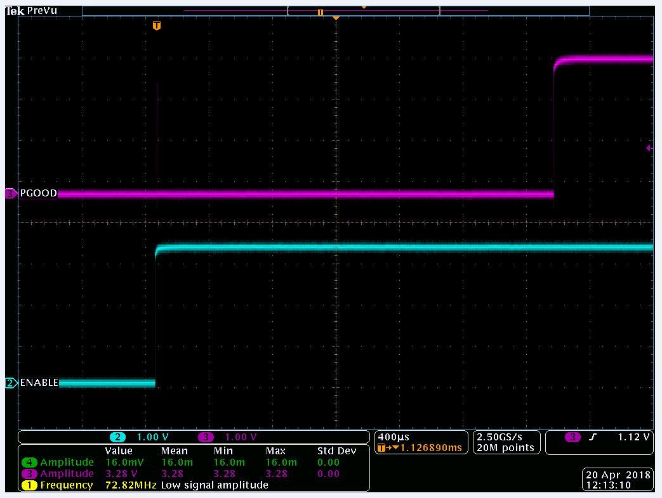
PGOOD BEHAVIOR – CUSTOM DESIGN
PGOOD MOMENTARILY REGISTERS
HIGH AFTER DEVICE IS ENABLED.
NOTE: VIN ALREADY AT REGUALTION

Slide 3
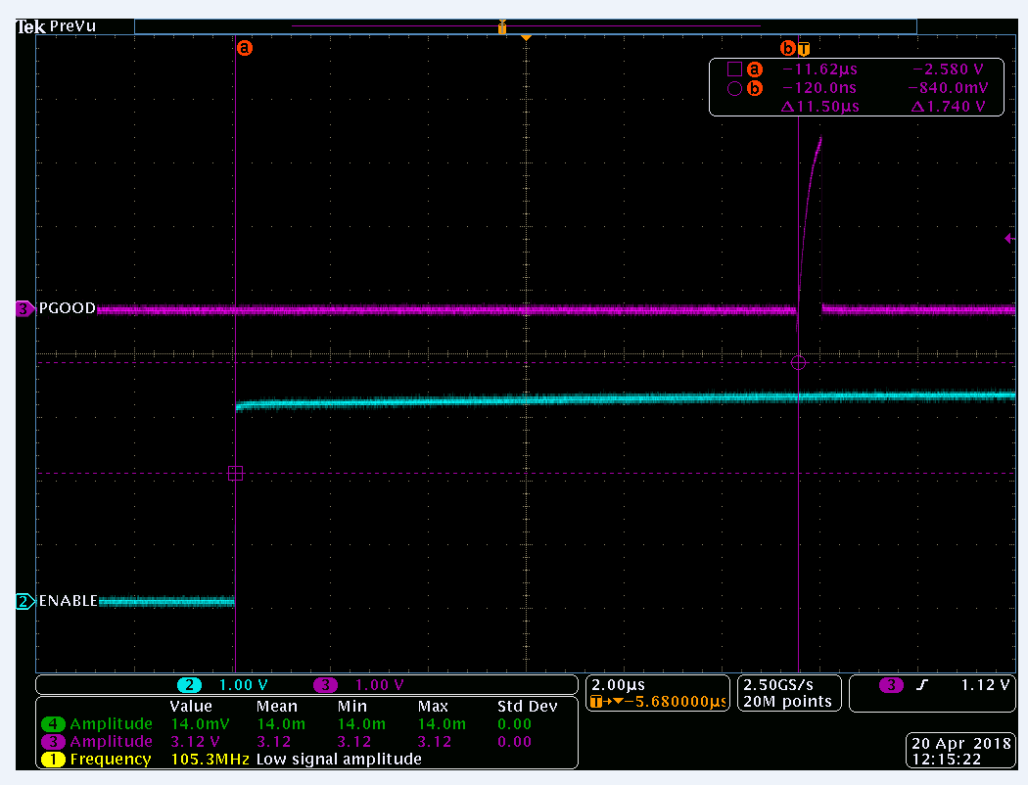
PGOOD BEHAVIOR – CUSTOM DESIGN
PGOOD MOMENTARILY REGISTERS
HIGH 11.5uS AFTER DEVICE IS
ENABLED

Slide 4
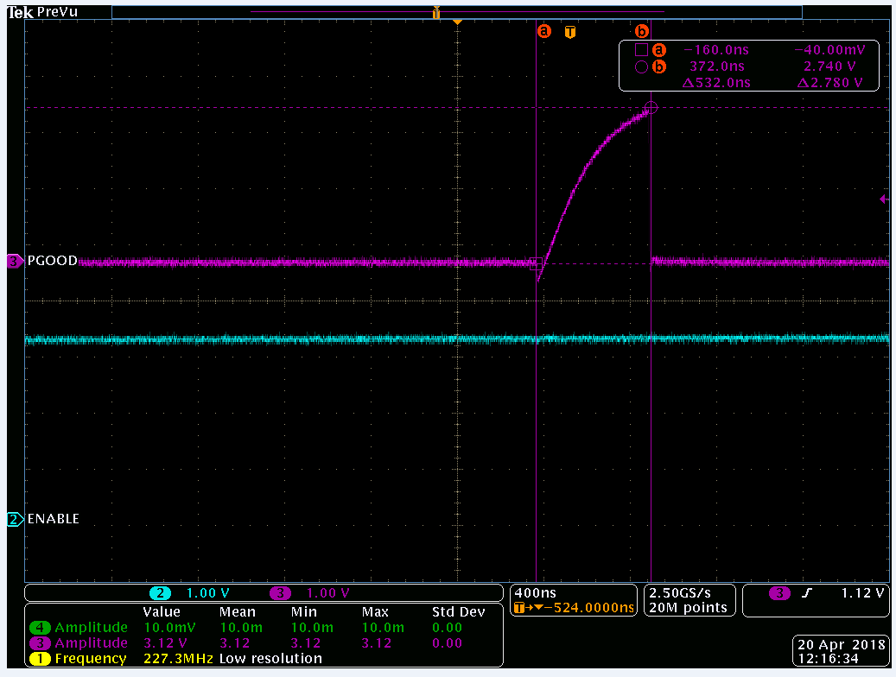
PGOOD BEHAVIOR – CUSTOM DESIGN
PGOOD MOMENTARILY REGISTERS
HIGH FOR 532nS AFTER DEVICE IS
ENABLED

Slide 5
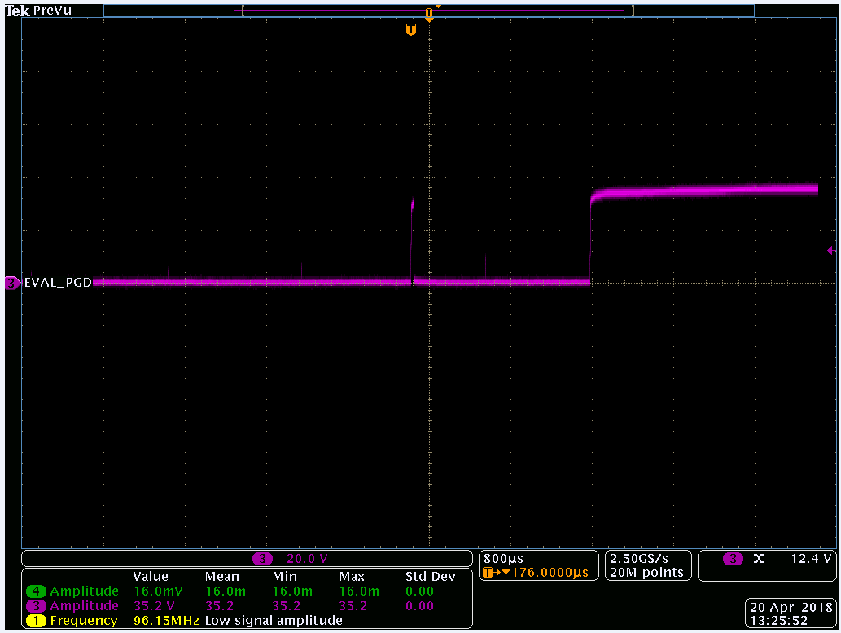
PGOOD BEHAVIOR – EVAL BOARD
PGOOD MOMENTARILY REGISTERS
HIGH AFTER DEVICE IS ENABLED VIA SW1

Slide 6
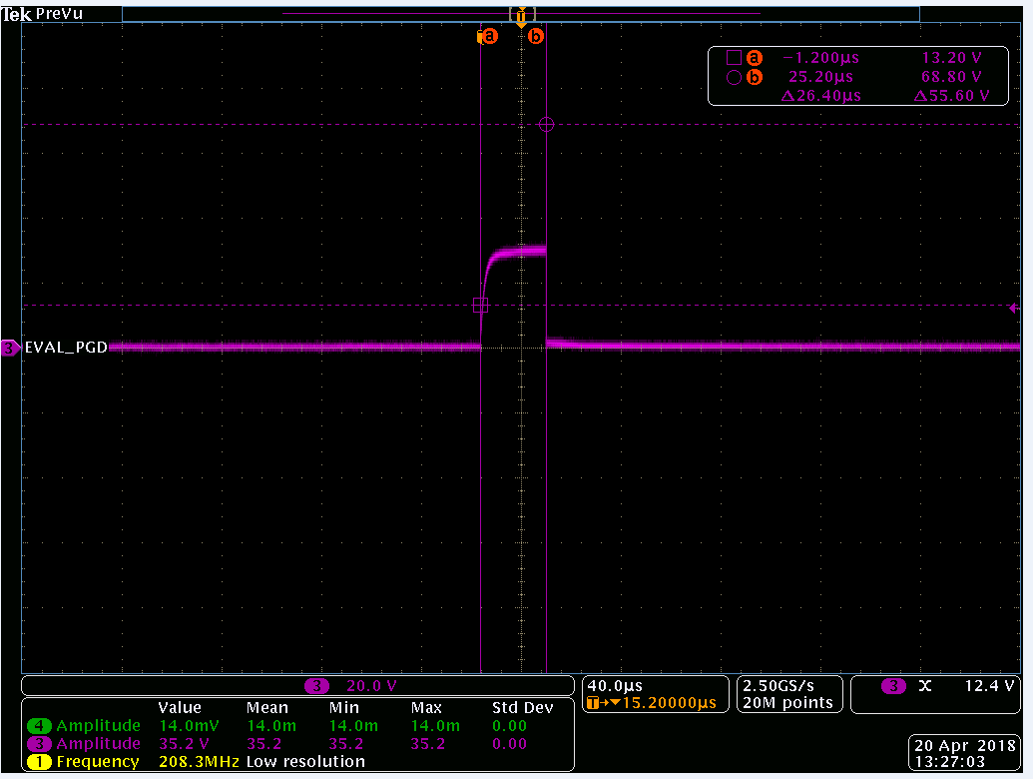
PGOOD BEHAVIOR – EVAL BOARD
PGOOD MOMENTARILY REGISTERS HIGH FOR
26.4uS AFTER DEVICE IS
ENABLE

Slide 7
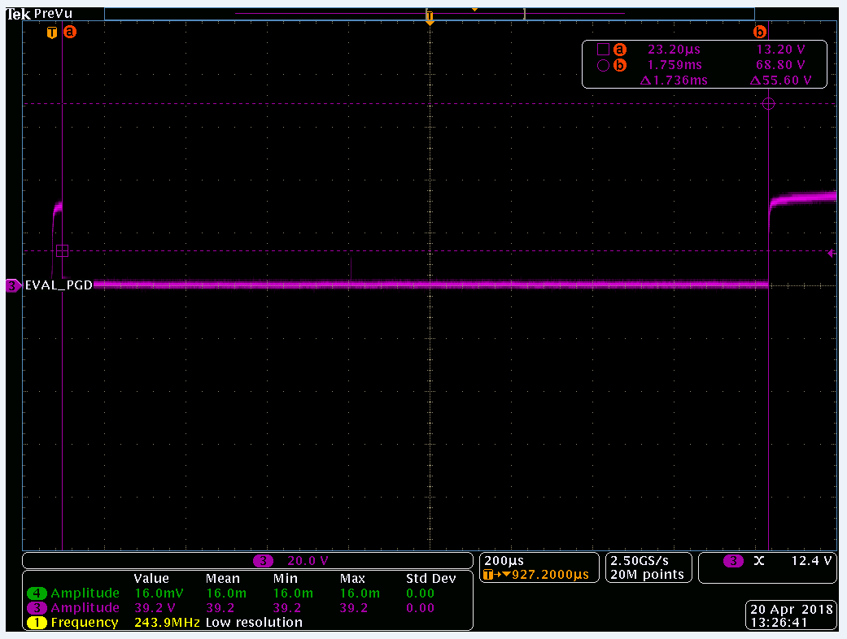
PGOOD BEHAVIOR – EVAL BOARD
PGOOD REGISTERS HIGH FOR 26.4uS AFTER DEVICE IS ENABLE. FOLLOWED BY BEING HELD LOW FOR 1.736mS. AFTER 1.736mS PGOOD REMAINS HIGH UNTIL CIRCUIT IS DEPOWERED OR FAULT CONDITION IS PRESENT.

