Slide 1
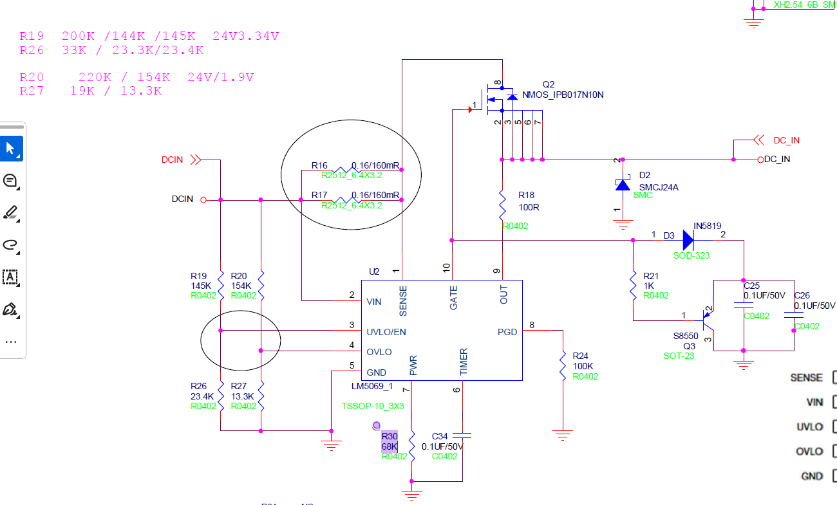


Remove all and replace with RC only.
R = 49.9 ohms
C = 22nF

Slide 2
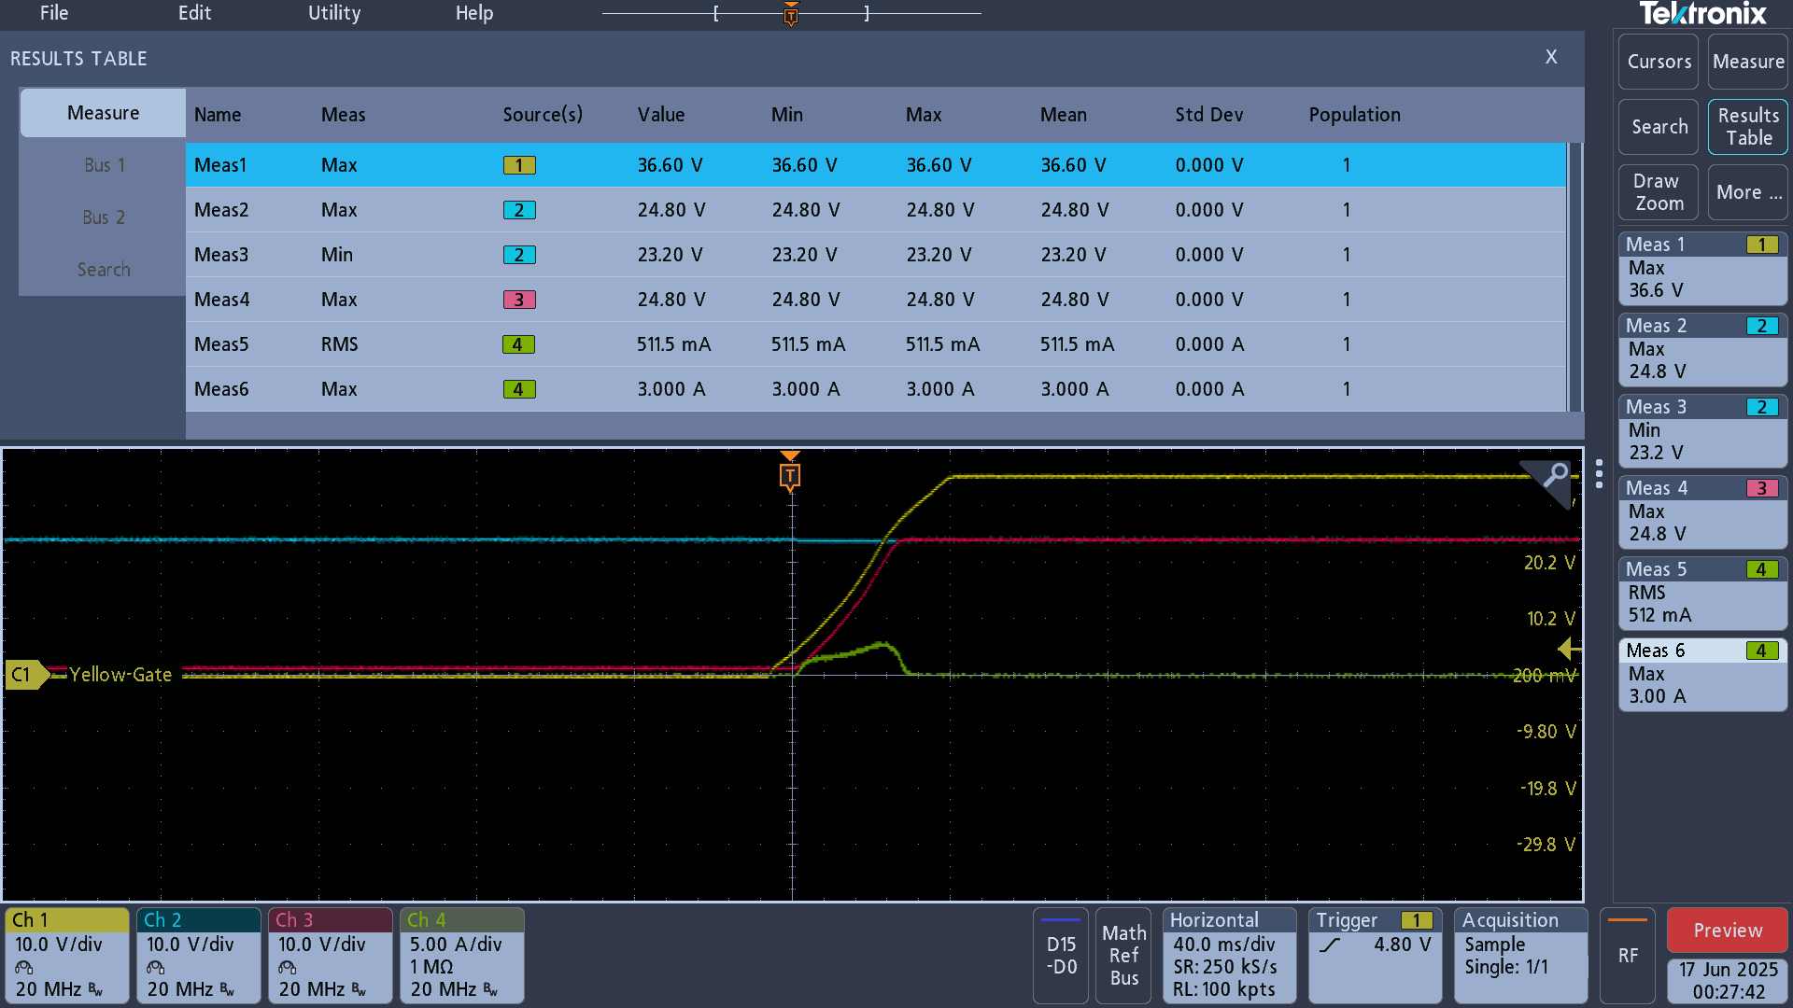
Results with RC
V_gate
V_input
V_output
I_output

Slide 3
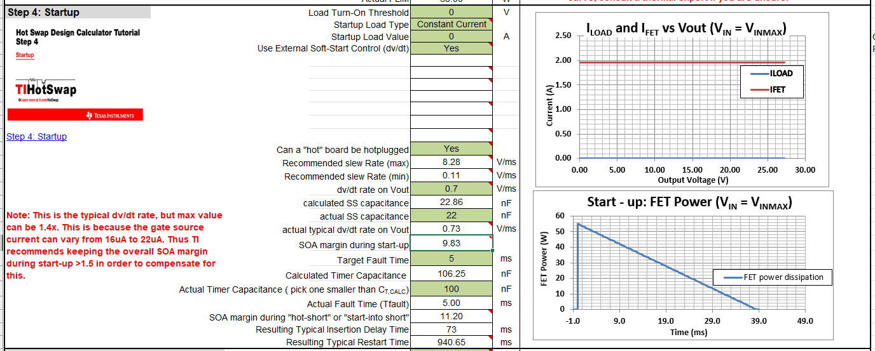
Soft Start Capacitance = 22nF (per calculator), as specified in slide 2
With C_timer = 100nF, we have a fault timer of 5ms. No action here but something to keep in mind

