Slide 1
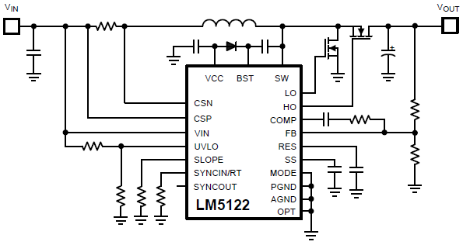

LM5122-Q1 switching Frequency Setting
ON/OFF
My customer want to change switching frequency by SYNC external resistor and small FET. Please show figure. There is two case, 1 phase and 2 phase configuration. Is there any problem?

