Slide 1
LM5122
Start-up Test
Niklas Schwarz
Feb 2025
Notes:
Note: Use this PowerPoint template if your presentation contains information classified as TI Information – Selective Disclosure. Details at cip.ti.com.

Slide 2
Summary
LM5122 EVM 1PH
  SS cap (C24) tested with 100nF (default) and 1nF
  Startup with discharged and pre-charged VOUT

Slide 3
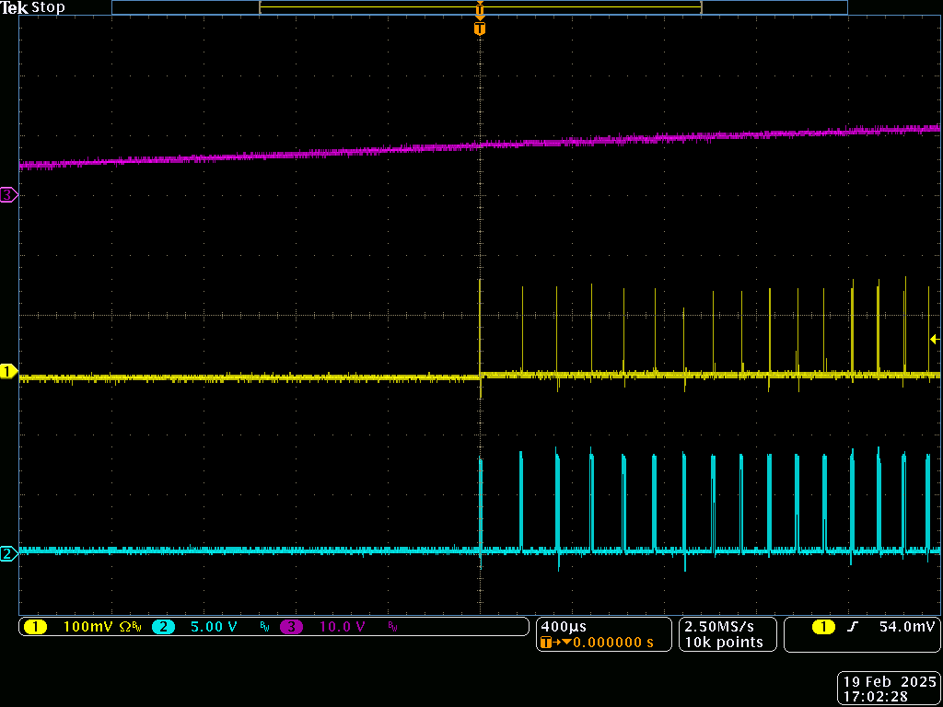
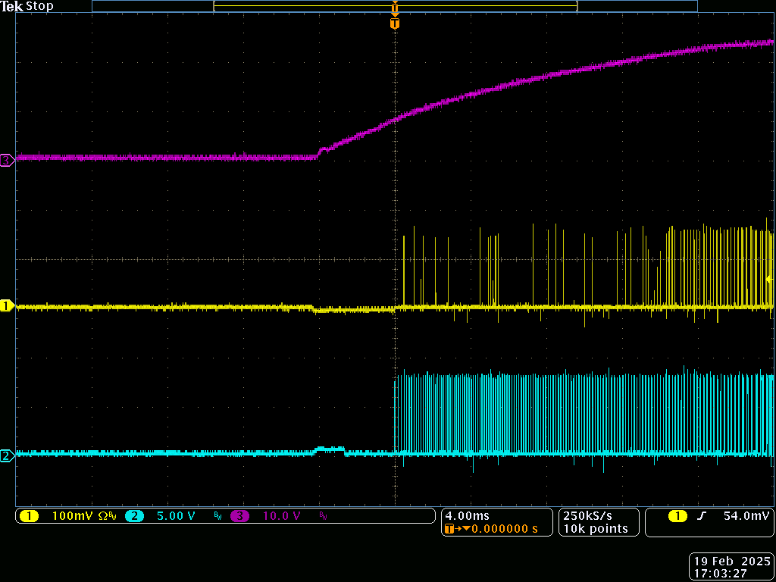
Vin 12V, no Load
SS cap 1nF
400us/div
4ms/div
Vout
No delay between HO and LO
HO (to SW)
LO (to GND)
5.00V
5.00V

Slide 4
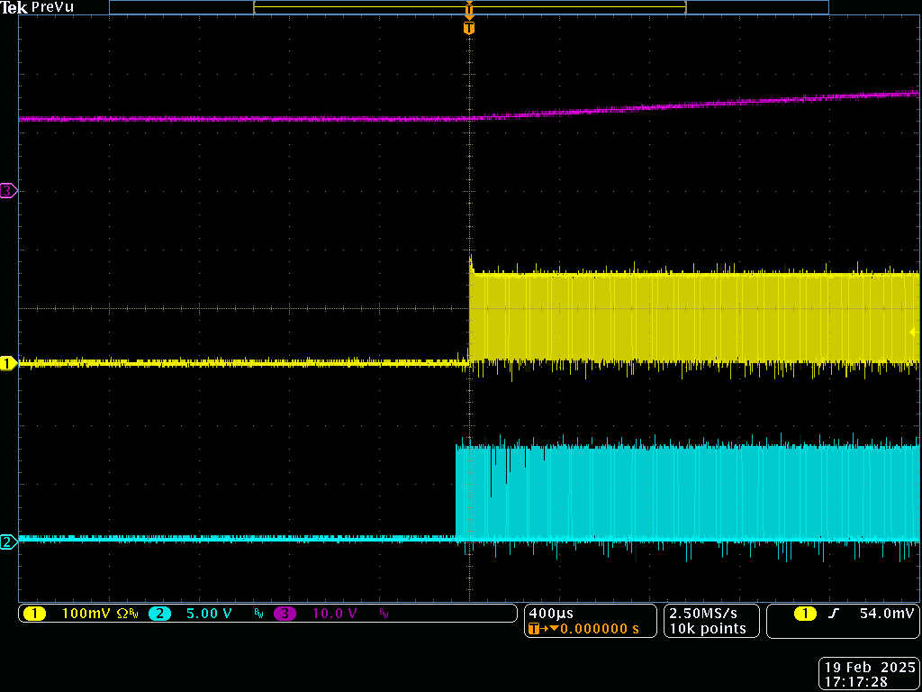
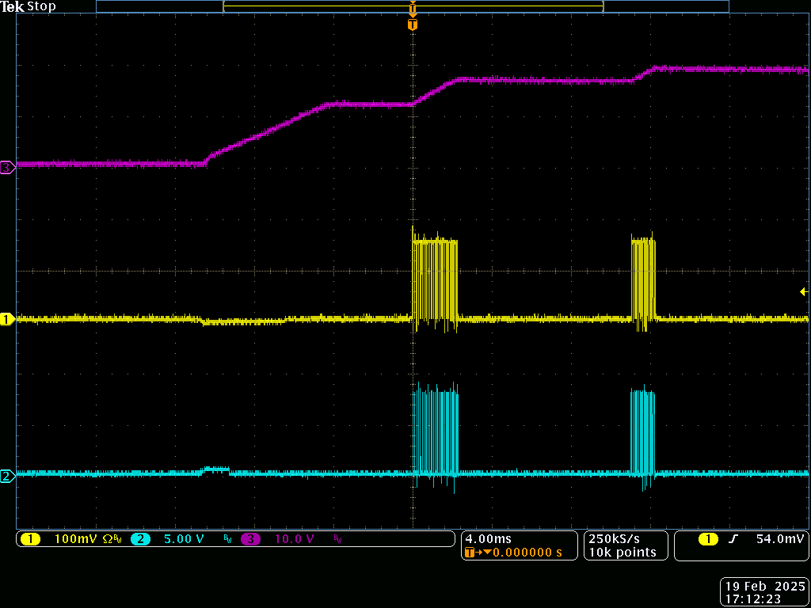
Vin 12V, no Load
SS cap 100nF
400us/div
4ms/div
Vout
LO switches first
Ramp-up in steps, following
softstart curve
HO (to SW)
LO (to GND)
5.00V
5.00V

Slide 5
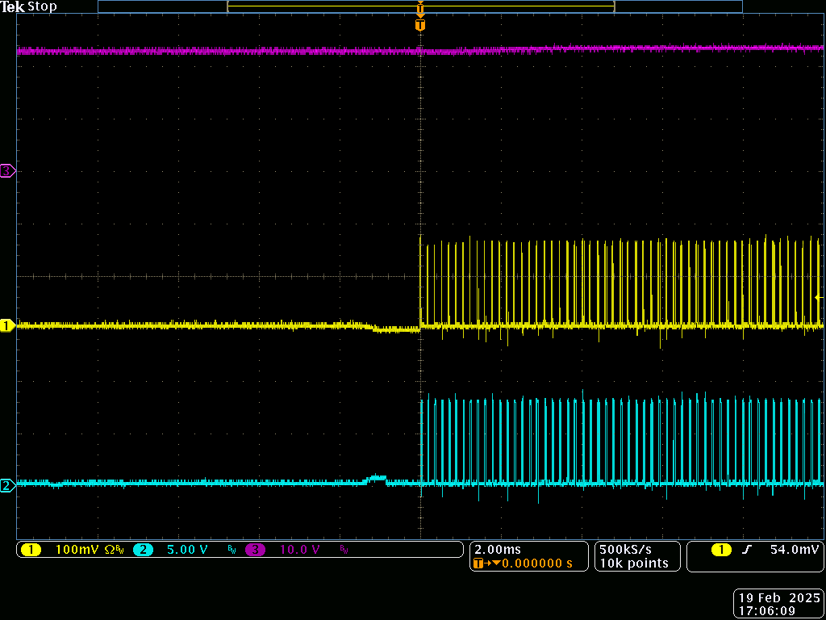
Vin 12V, no Load, Output pre-charged
SS cap 1nF
Vout
HO (to SW)
LO (to GND)
5.00V

Slide 6
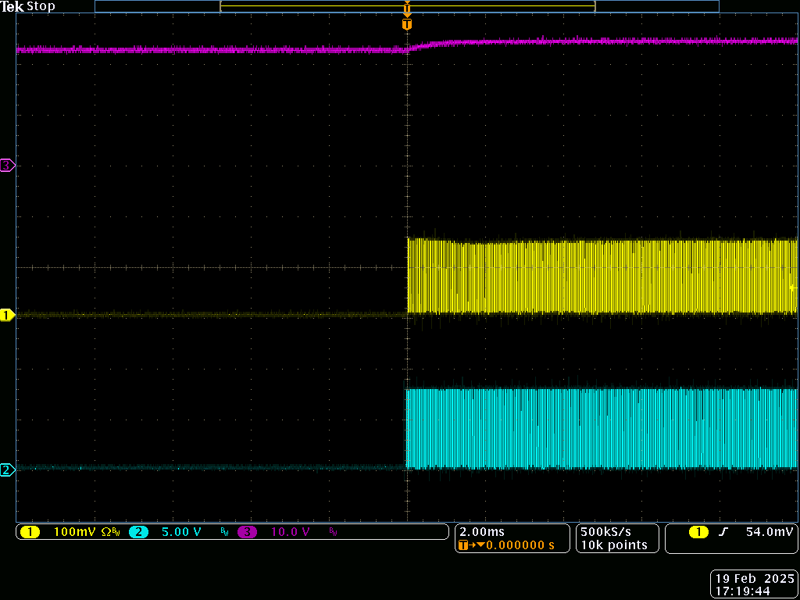
Vin 12V, no Load, Output pre-charged
SS cap 100nF
No switching delay between HO and LO in both tests
Vout
HO (to SW)
LO (to GND)
5.00V

