Slide 1
LM5140EVM 440kHz DEMB Operation

Slide 2
LM5140EVM Set up for 440kHz Operation
Vin=12V
R35=0ohm was moved to R36
(changing the oscillator frequency to 440kHz)
C23=1uF
<Vout1=3.3V>
L2=4.7uH
FB1 is tied to VDDA(3.3Vout)
R16=5.6k
C14=22nF
<Vout2=8V>
L3=22uH
FB2 is tied to GND(8Vout)
R18=8.2k
C26=15nF
C25=22pF

Slide 3
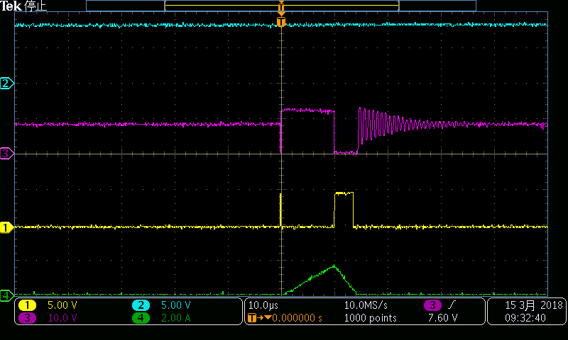
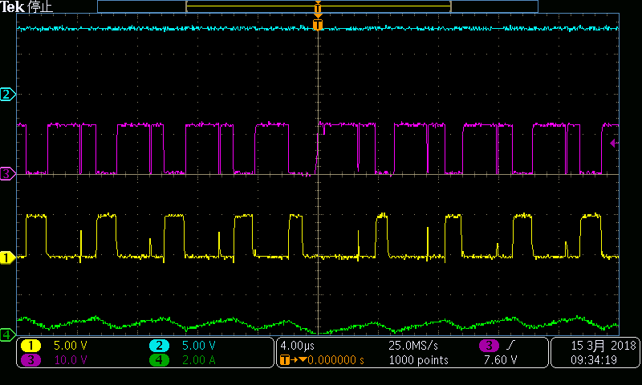
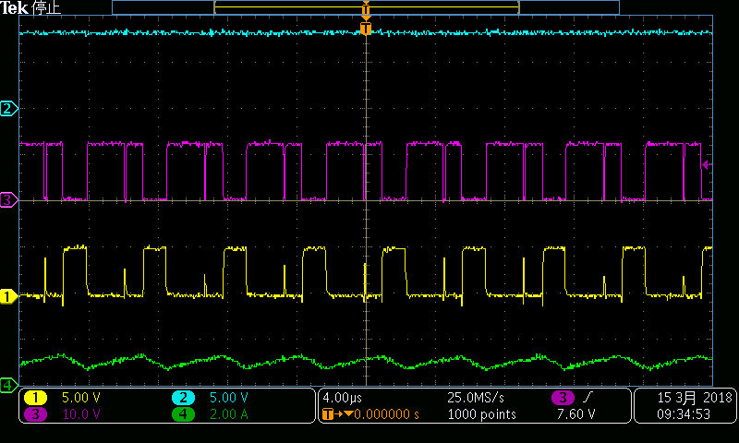
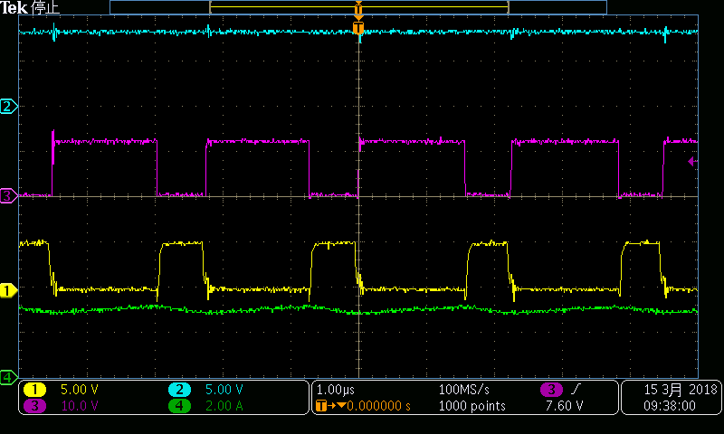
HO/LO Vout2=8V
Ch1: Gate of Low side FET, Ch2: Vout, Ch3: SW, Ch4: Inductor current
Operating PFM mode in spite of CCM mode.
Short pulse is occurred
Short pulse is occurred
0A Diode Emulation Mode
500mA Diode Emulation Mode
Operating PFM mode in spite of CCM mode.
stable
Short pulse is occurred
1A Diode Emulation Mode
3A Diode Emulation Mode

Slide 4
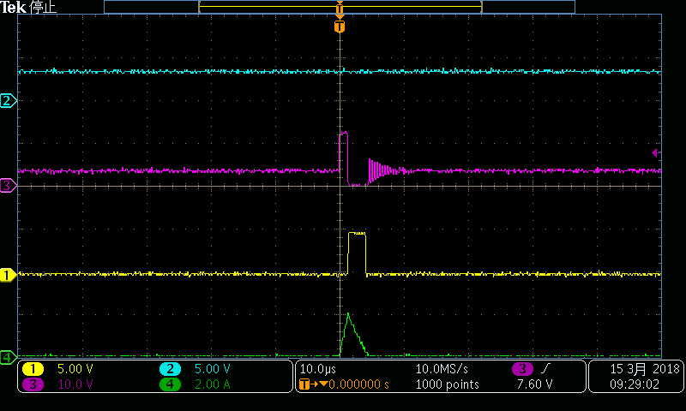
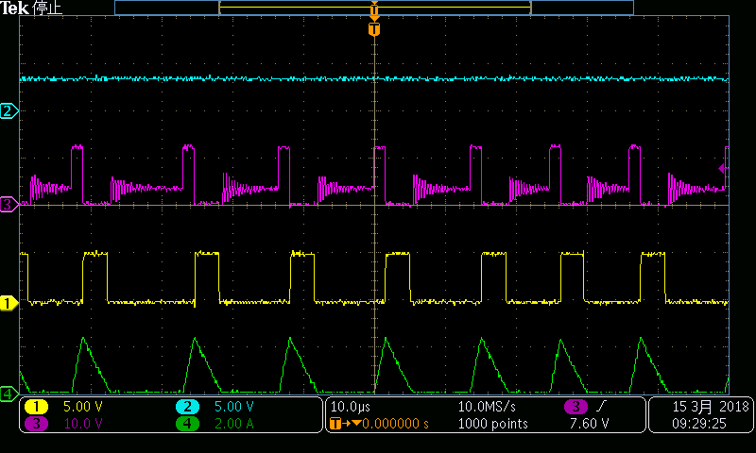
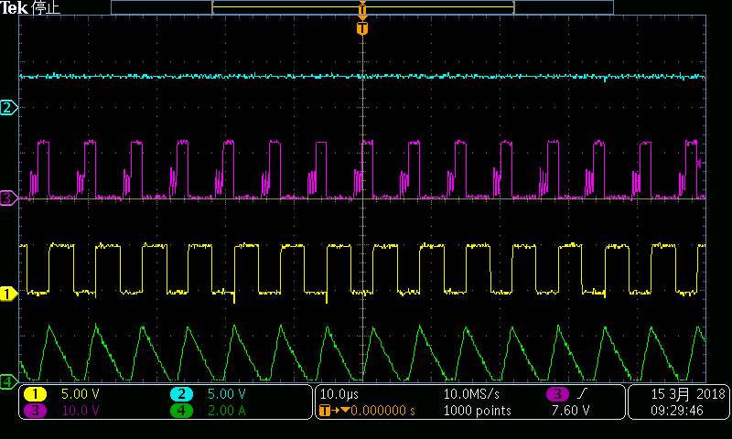
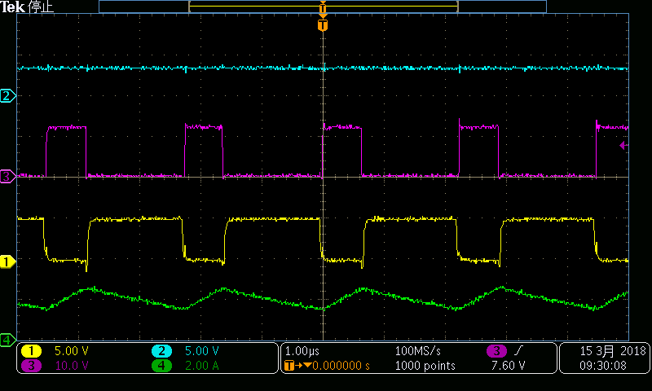
HO/LO Vout1=3.3V
Ch1: Gate of Low side FET, Ch2: Vout, Ch3: SW, Ch4: Inductor current
stable
stable
0A Diode Emulation Mode
500mA Diode Emulation Mode
stable
stable
1A Diode Emulation Mode
2A Diode Emulation Mode

