Slide 1
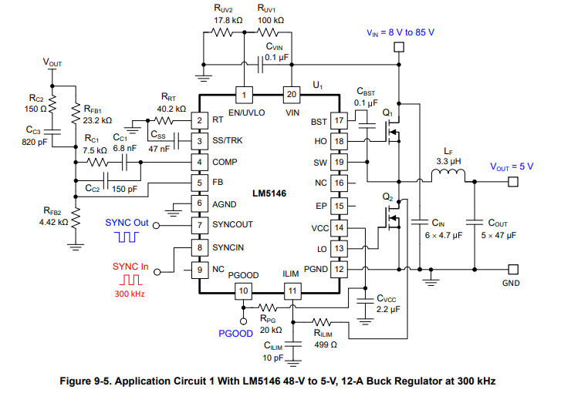
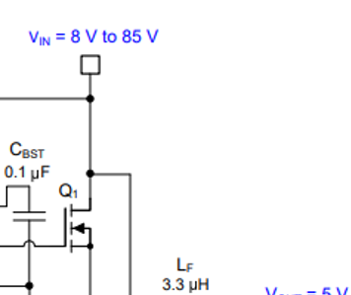
200V
200V
Low side driver
Vsup
0.1uF
OUT
IN
GND
GND
0~200V

Slide 2
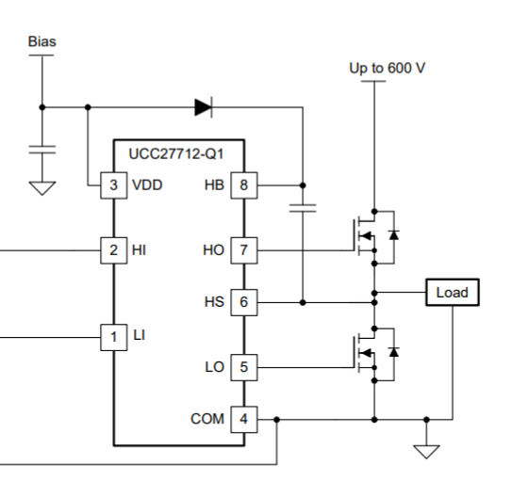
How design this part to handle 200V? (VIN pin)
7.5-V bias
200V
HI
H
???
7.5-V bias
LI
LO

