Slide 1
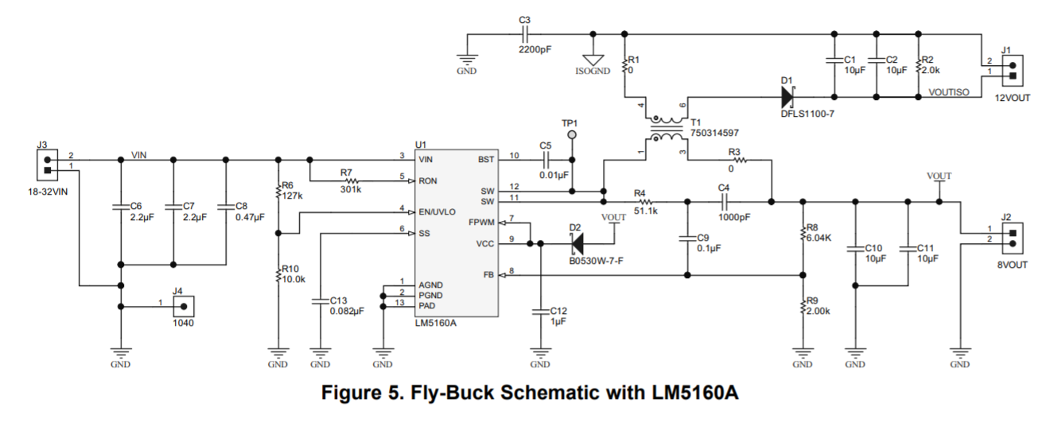
WURTH
744873680
(Coupled inductor, 68uH)
12Vout, 1A
24Vin
470k
10k
12Vout
No Load

