Slide 1
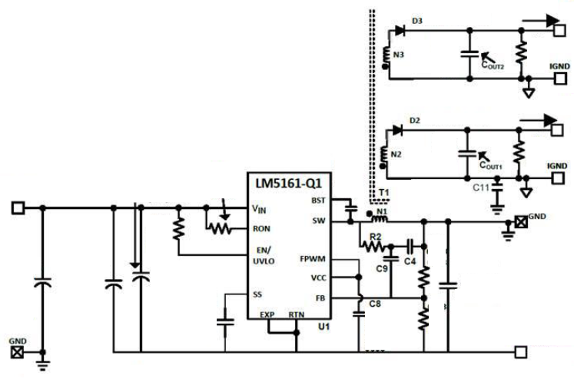
Schematics Fly-Buck-Boost
Vsec1=16.5V
Lpri=17uH
Vsec2=8V
0.01uF
100k
1nF
270k
50k
0.1uF
10uF*3pcs
270uF
0.1uF
7.1k
2.2uF*2pcs
1uF
2.4k
0.022uF
Vpri=-7.9V

Slide 2
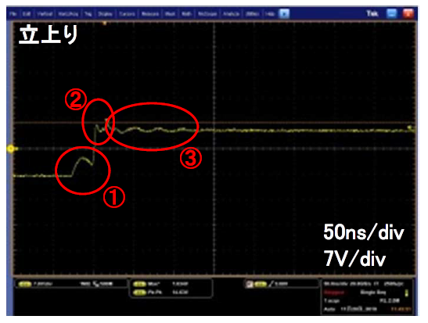
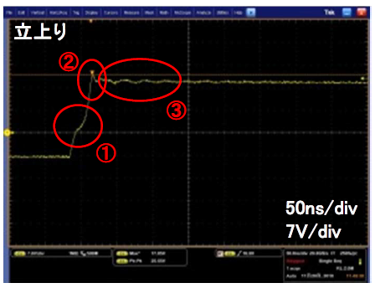
SW node waveform
Vin=6V
Vin=16V
Question
Why does the distortion(which is marked with No 1) occur at the rising edge of SW node waveform? This distortion is bigger as decreases Vin. I assume the reverse recovery of the internal body diode on low side FET causes this phenomenon. Is this my understanding correct?

