Slide 1
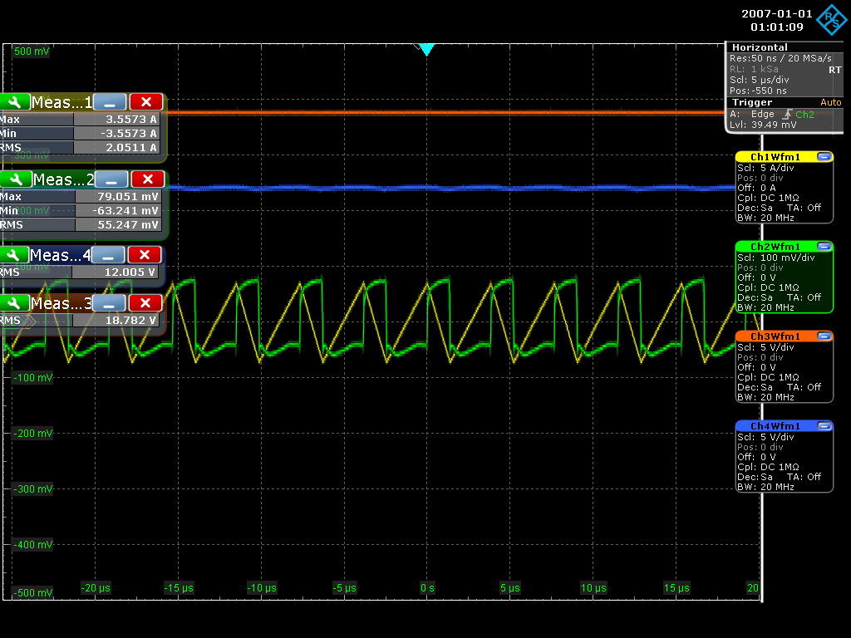
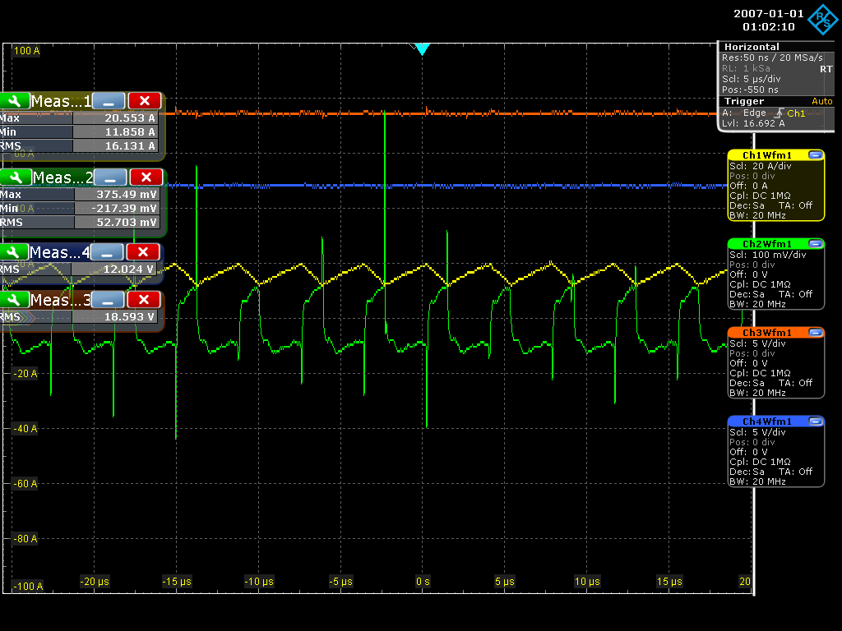
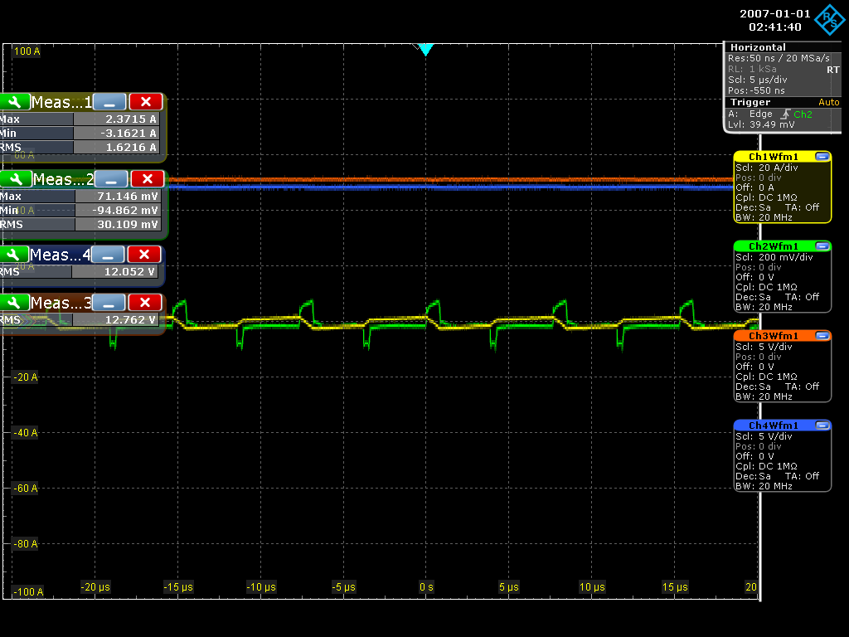

1. Steady State
1) Vin = 19V, Vout = 12V, Iout = 0A
2) Vin = 19V, Vout = 12V, Iout = 16.5A
Vin
Vout
Vsense
I_L
3) Vin = 13V, Vout = 12V, Iout = 0A
4) Vin = 13V, Vout = 12V, Iout = 11A

Slide 2
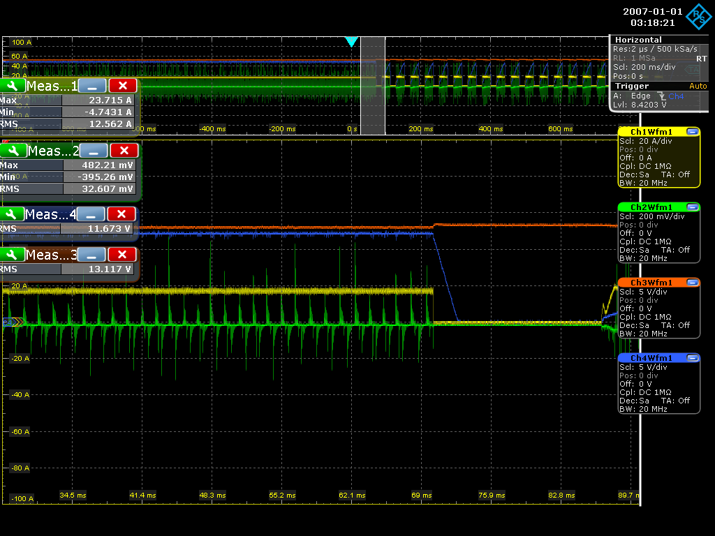
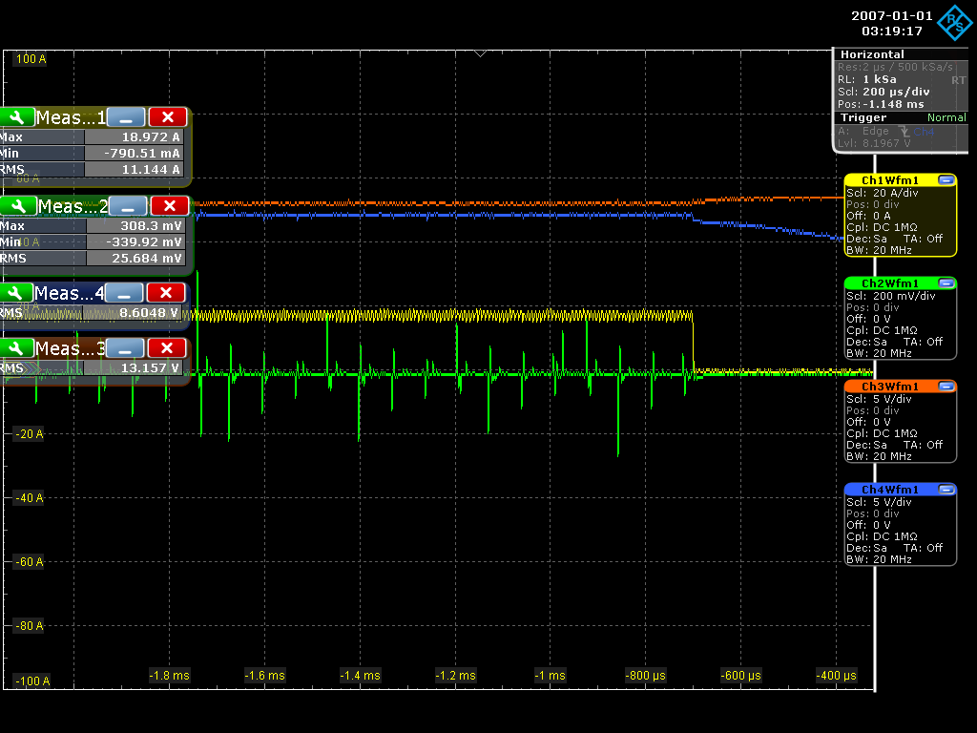
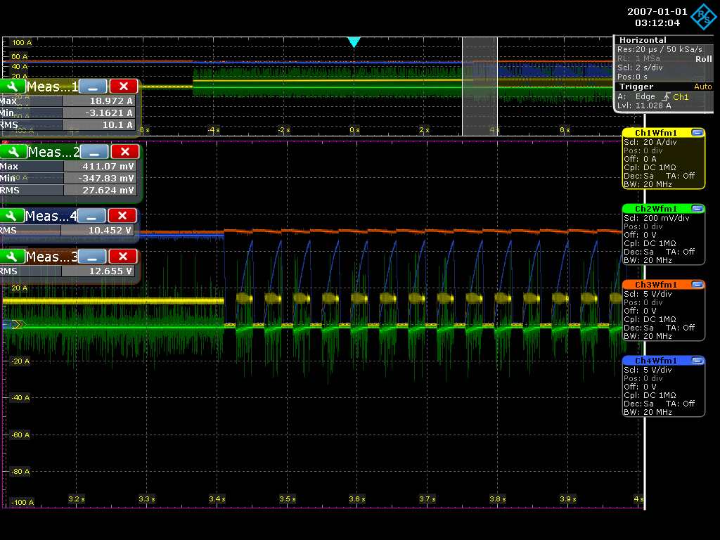

2. OCP
1) Vin = 13.5V, Vout = 12V, I_ocp : 16.5A
2) Vin = 13V, Vout = 12V, I_ocp : 12.2A

