Slide 1
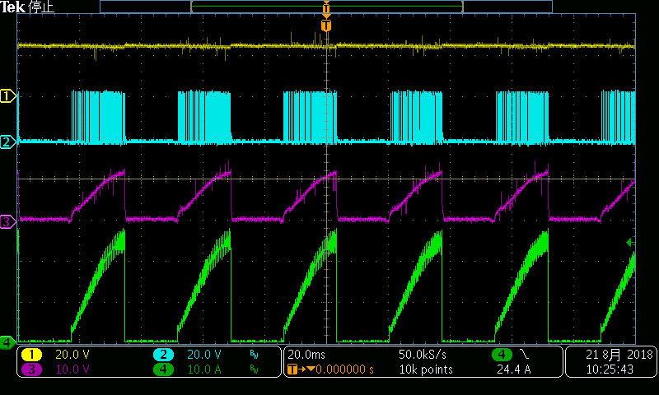
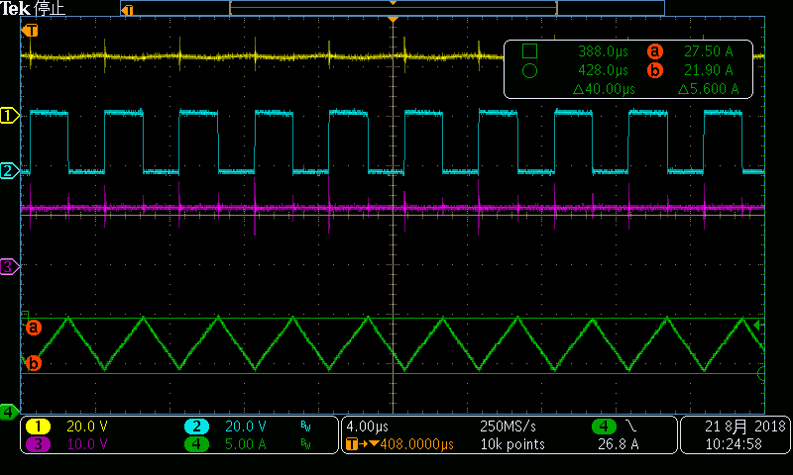
Hiccup in Buck Mode 24Vin 12Vout Rsense=0.004
CH1: Vin
CH2: SW1
CH3: SW2
CH4: Inductor Current

Slide 2
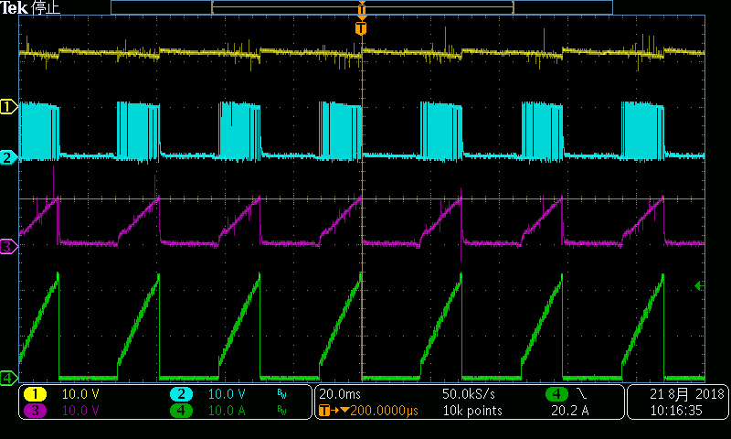
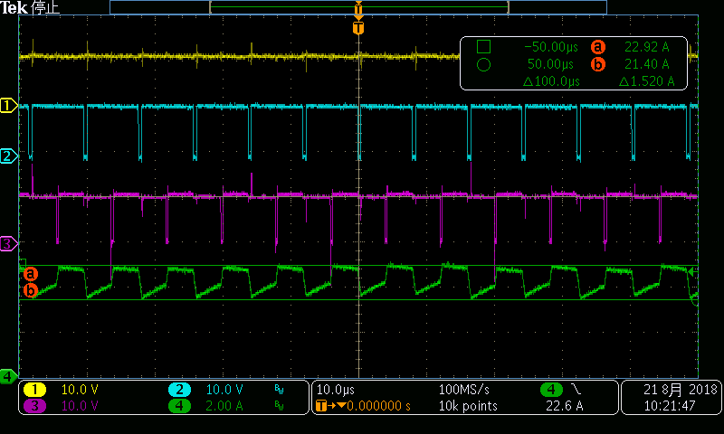
Hiccup in Buck-Boost Mode 12Vin 12Vout Rsense=0.004
CH1: Vin
CH2: SW1
CH3: SW2
CH4: Inductor Current

