Slide 1
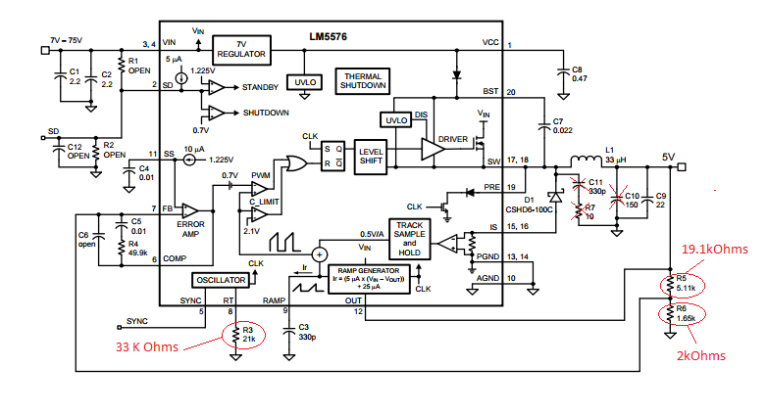
LM5576 Evaluation Board Schematic
To generate 12V/3A output, we changed some of the components as shown in the above figure.

Slide 2
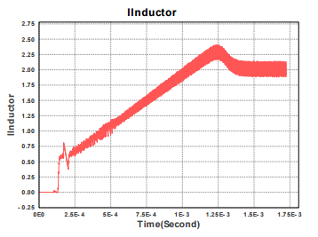
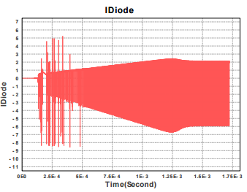
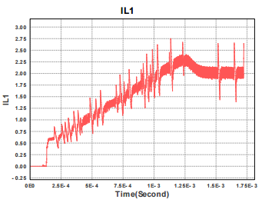
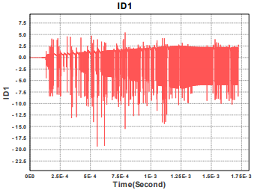
The snubber network ( R7 and C11 )
Inductor current without R7 and C11
Diode current without R7 and C11
Inductor current with R7 and C11
Diode current with R7 and C11
Simulation Results

Slide 3
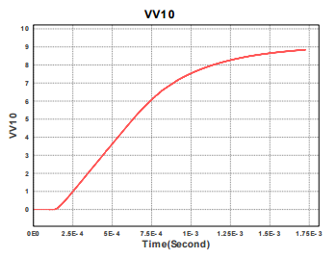
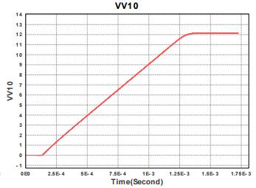
The Output capacitor C10 is removed during testing
VOUT with C10, 150uF
VOUT without C10, 150uF
Simulation result with and without C10

