Slide 1
LM61460Q1 Short-To-Battery Test Results

Slide 2
Test Methodology
VIN, EN, and IOUT applied to circuit using external supplies
External SYNC signal (2.1MHz) to force device into FPWM
VIN is shorted to VOUT using external FET
First set of oscilloscope waveforms are captured (“Short Applied”)
Short is released
Second set of oscilloscope waveforms are captured (“Short Released”)
VIN, EN, IOUT, SYNC supplies disengaged from test board
Test repeats across TEMP

Slide 3
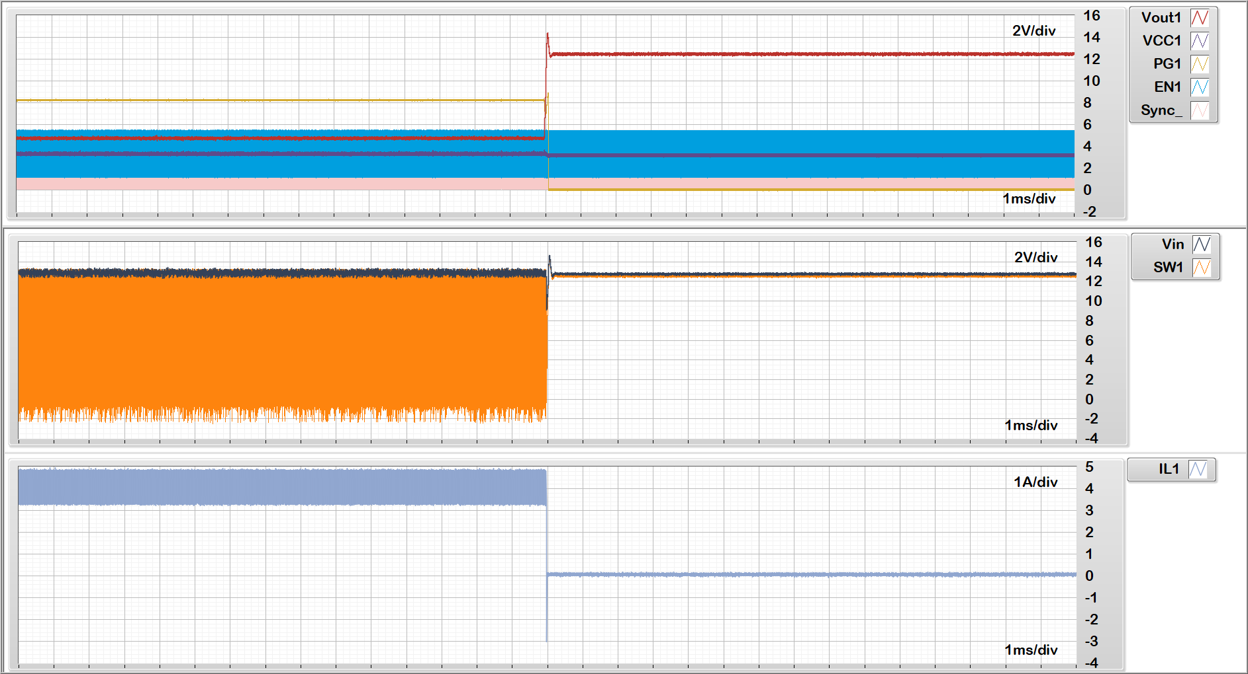
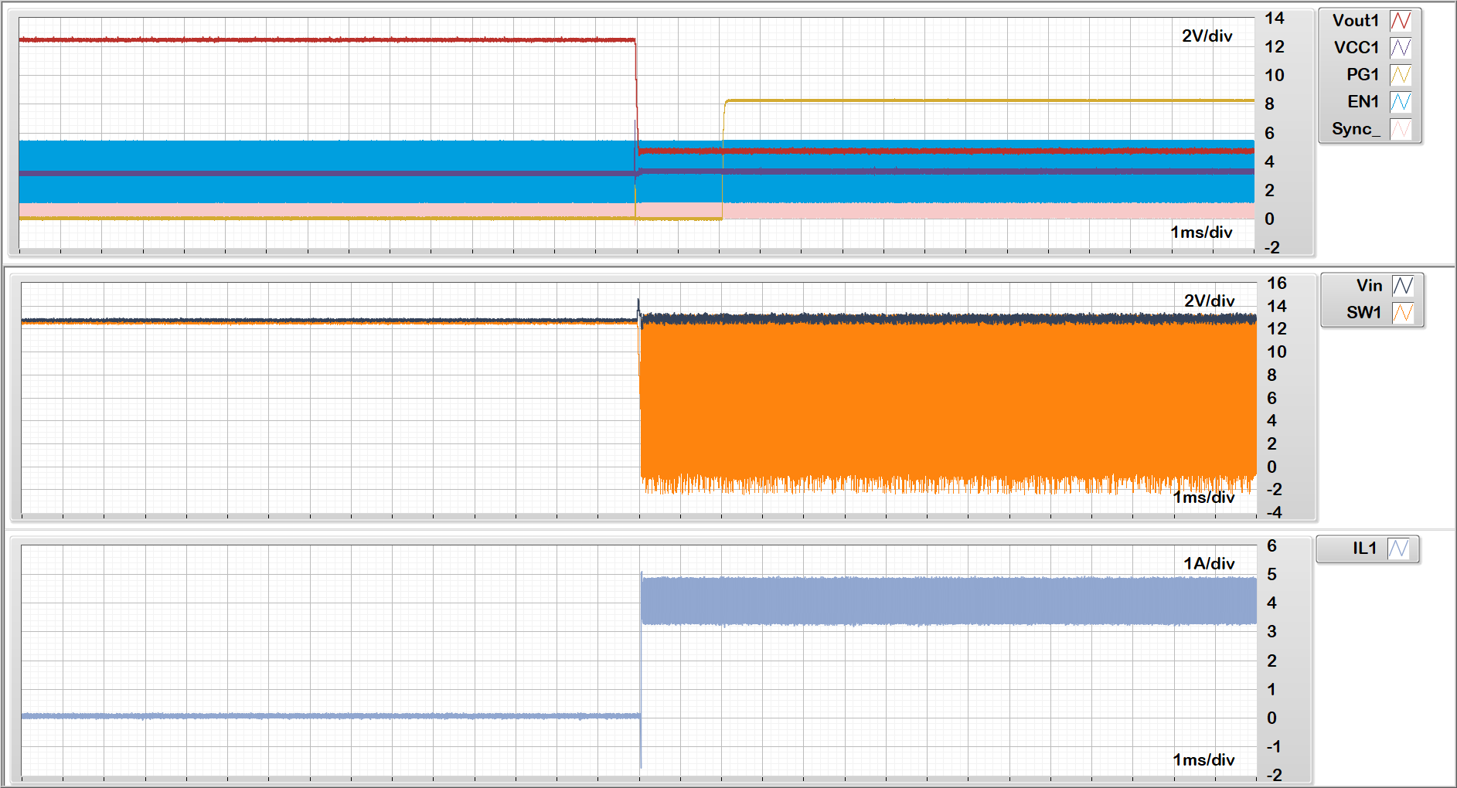
VIN=13.5V, VOUT=5V, FSW=2.1MHz, IOUT=4A, Ta=-40degC
VOUT
VIN
SW
IL
Short Applied
Short Released

Slide 4
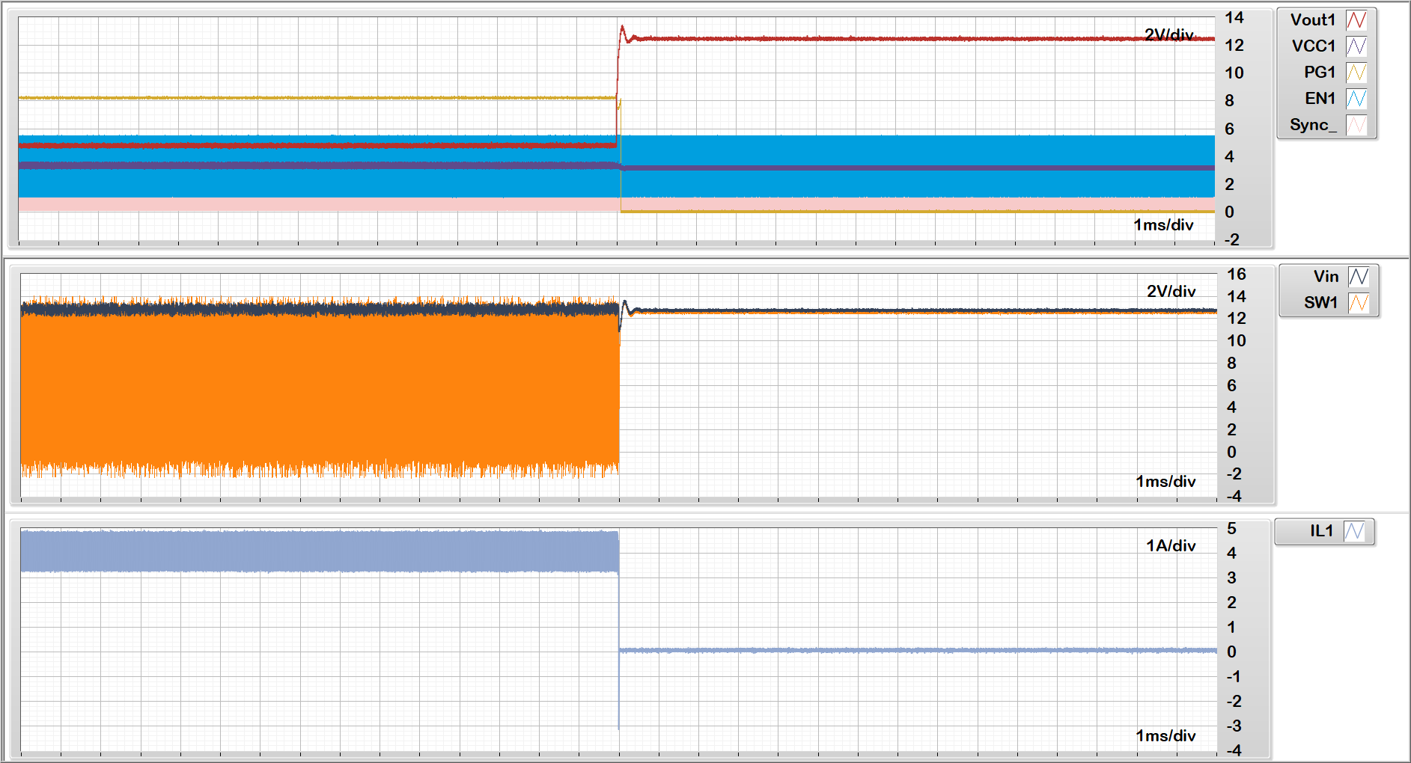
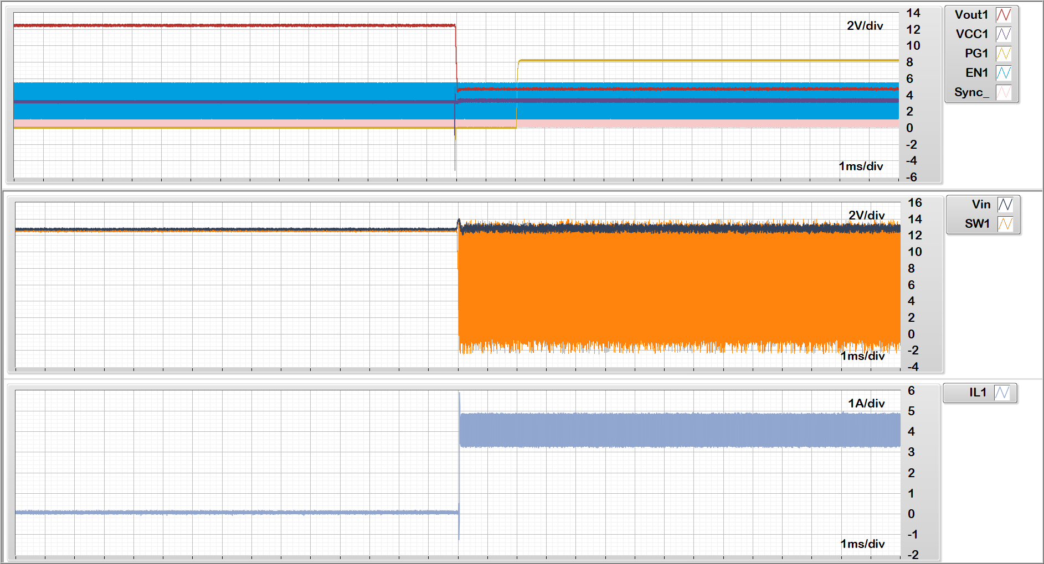
VIN=13.5V, VOUT=5V, FSW=2.1MHz, IOUT=4A, Ta=105degC
VOUT
VIN
SW
IL
Short Applied
Short Released

Slide 5
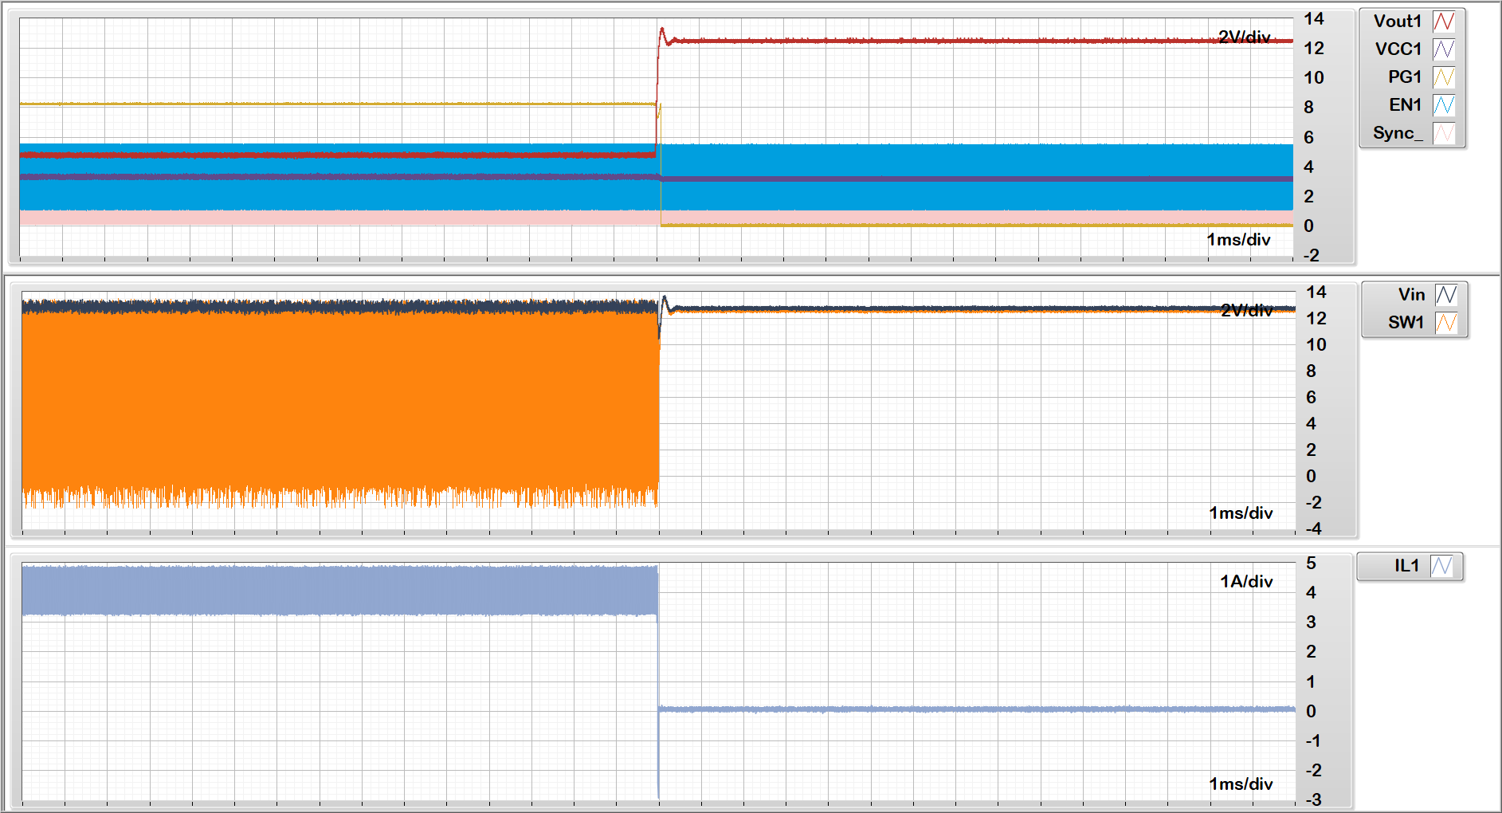
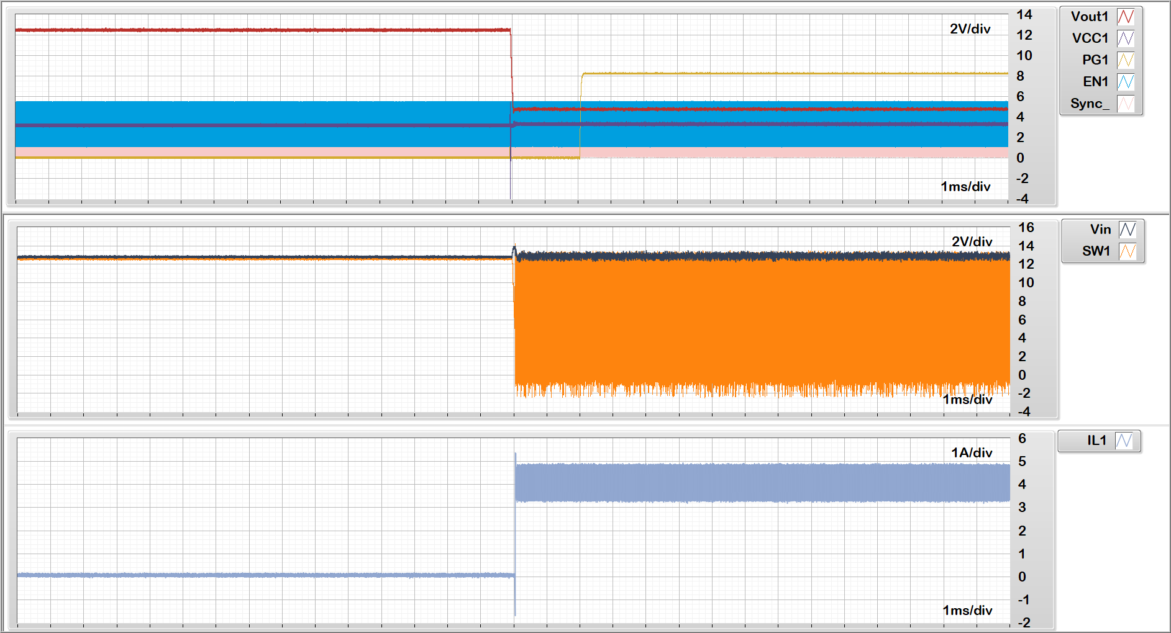
VIN=13.5V, VOUT=5V, FSW=2.1MHz, IOUT=4A, Ta=25degC
VOUT
VIN
SW
IL
Short Applied
Short Released

