Slide 1
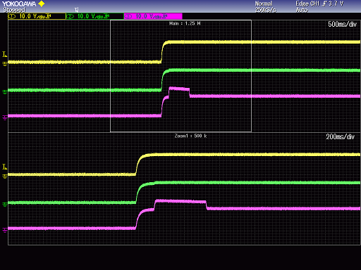
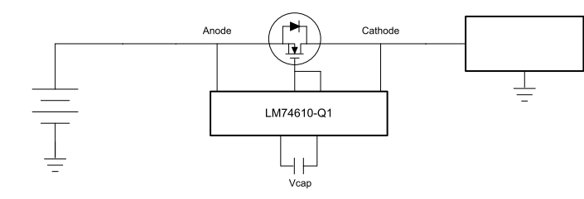
1) Start up waveform
Vin
Vout
S
D
Motor
G
DC13.5V
Vg
Vin(10V/div)
Ceramic condenser
2.2uF
Vout(10V/div)
Evaluation circuit
Vg(10V/div)
Problem
→Vg drops after start up.
Does the charge pump stop to operate?

