Slide 1
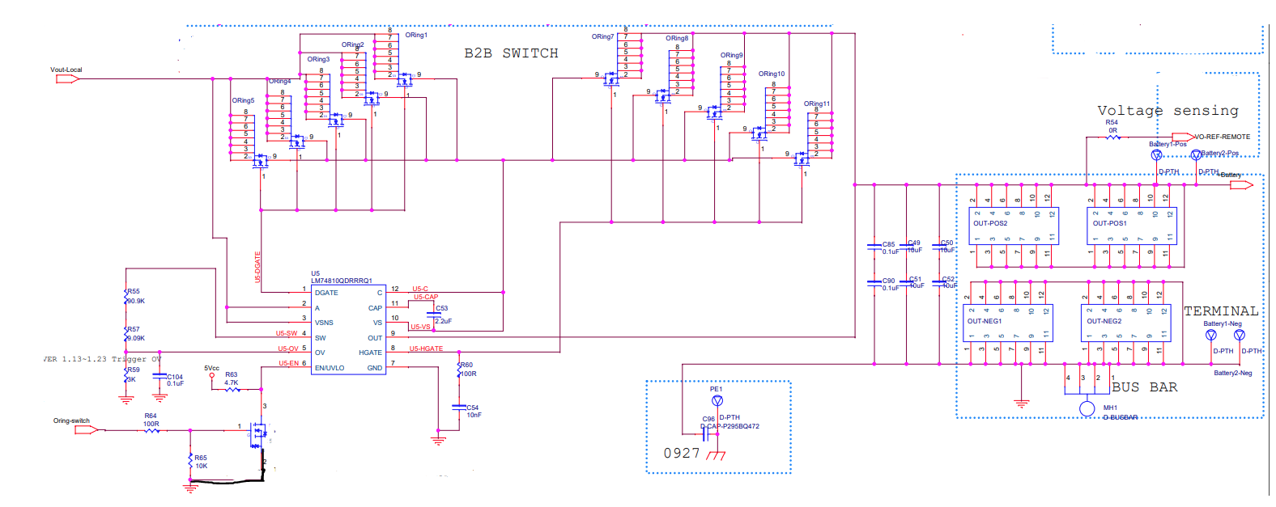
LM 74810 Schematics

Slide 2
Test setup and conditions
Delivery sequence 1
DC Source 24V
(Battery )
DC Source 26V
(Vout-local)
EN/UVLO
Pull up to 5V
LM74810
Normal work
Delivery sequence 2
DC Source 24V
(Battery )
PSFB Converter 26V
(Vout-local)
EN/UVLO
Pull up to 5V
LM74810
Charge pump voltage 5.4V

Slide 3
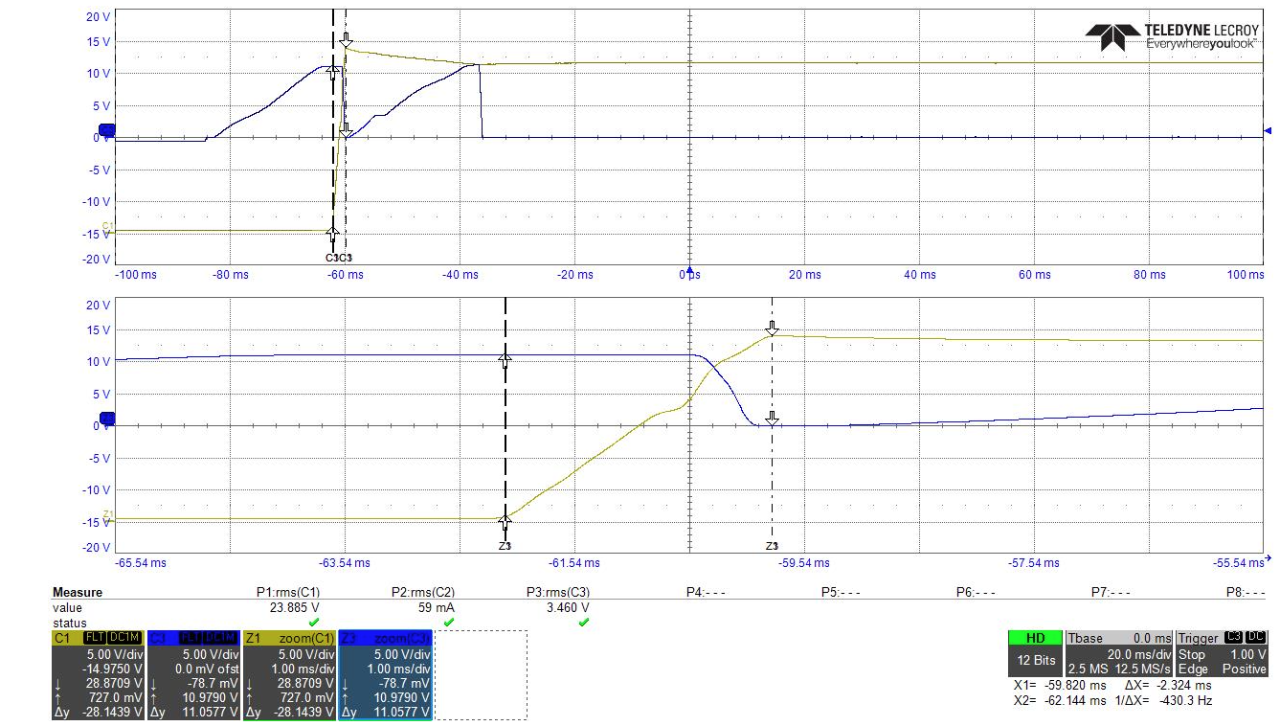
Delivery sequence 2
CH1 : Vout-local
CH2 : HGATE

