Slide 1
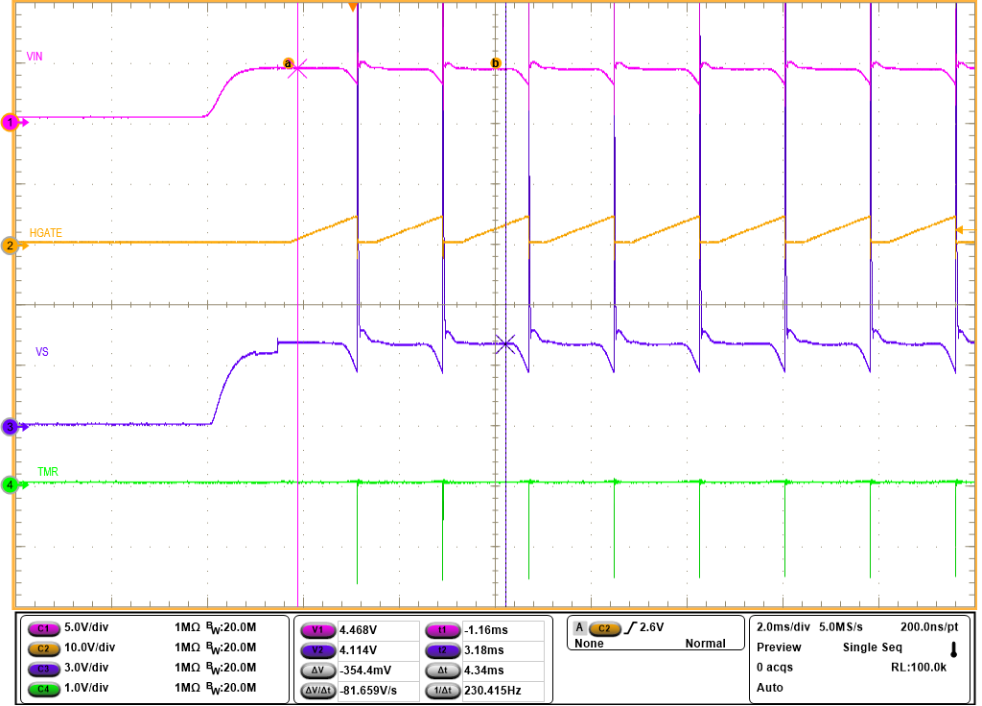
VIN 4.5 wakeup into short failed.

Slide 2
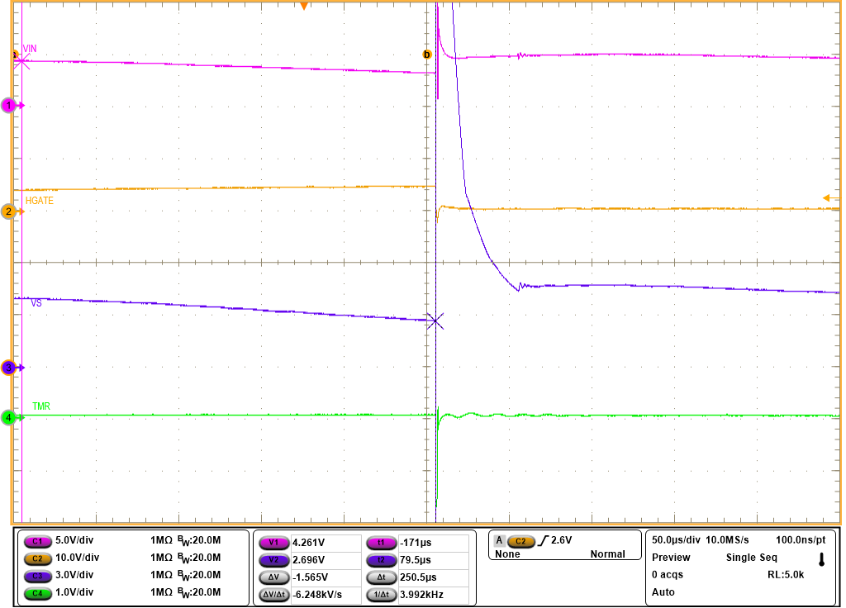
VS drops to 2.7V, HGATE turns off due to VS_PORR

Slide 3
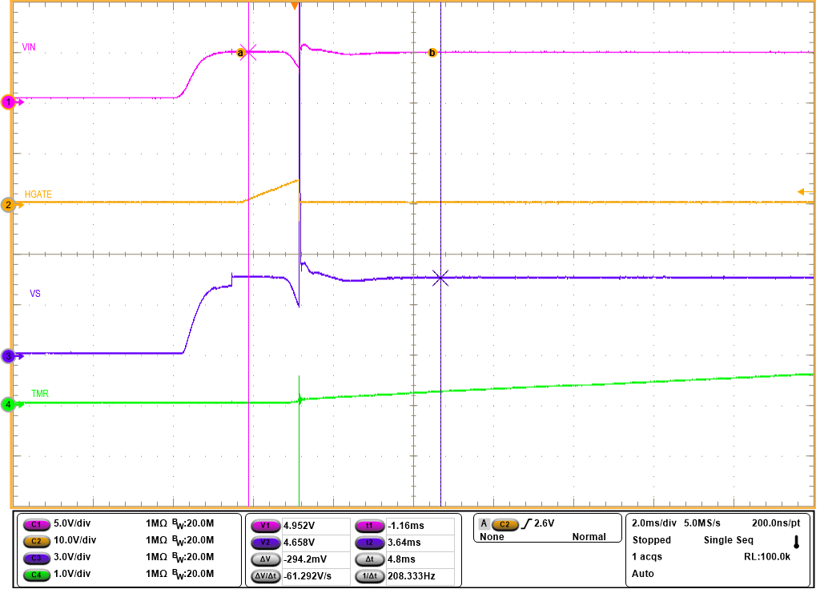
VIN 5V wakeup into short passed.

Slide 4
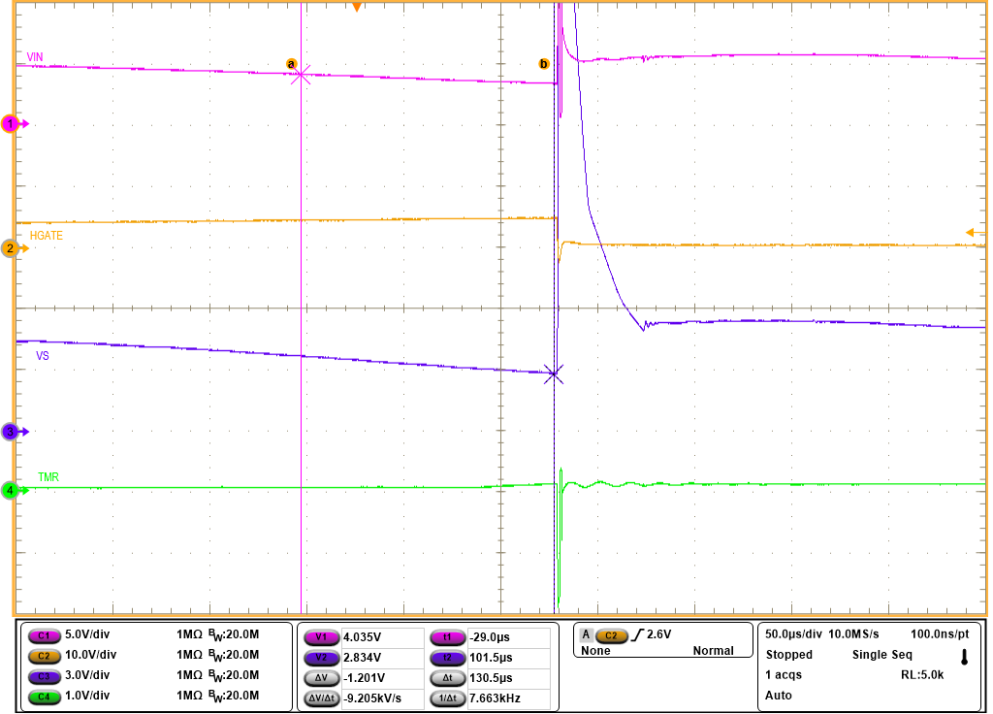
VS falls to 2.83V, HGATE turns off due to SCP.

