Slide 1
LM749x0-Q1 Power Mux Test Results
1st Feb, 2022
LP-PS

Slide 2
Priority Power Mux Schematic

Slide 3
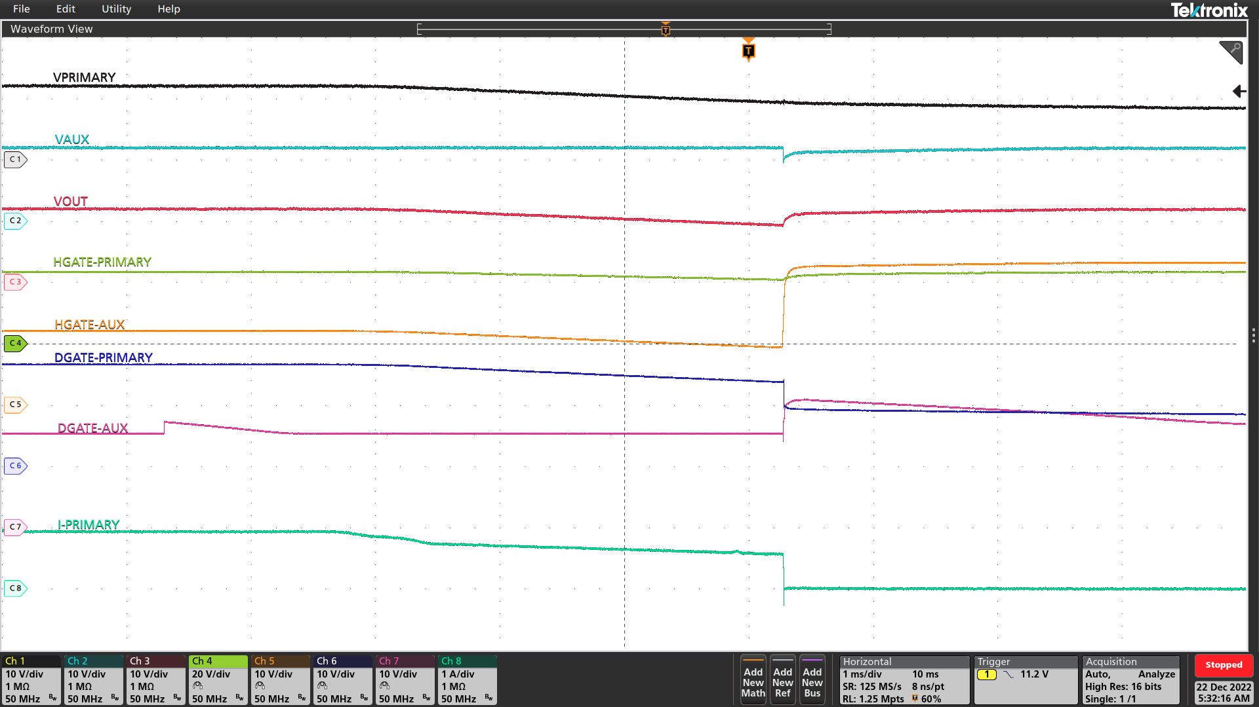
Test Condition -1
Test Condition:
Initial Condition:
V_{PRIMARY} =12V
V_{AUX} = 12V
Primary to Aux transition set at 9.2V
V_{PRIMARY} drops below transition voltage
Observation:
As V_{PRIMARY} drops below VOVF threshold, HGATE of AUX rail LM749x0-Q1 pulls high within 20us and starts powering the load
VOUT is powered from V_{PRIMARY}
VOUT is powered from V_{AUX}
HGATE and DGATE of AUX rail LM749x0-Q1 are enabled
when V_{PRIMARY} drops below 9.2V
V_{AUX} starts supplying load

Slide 4
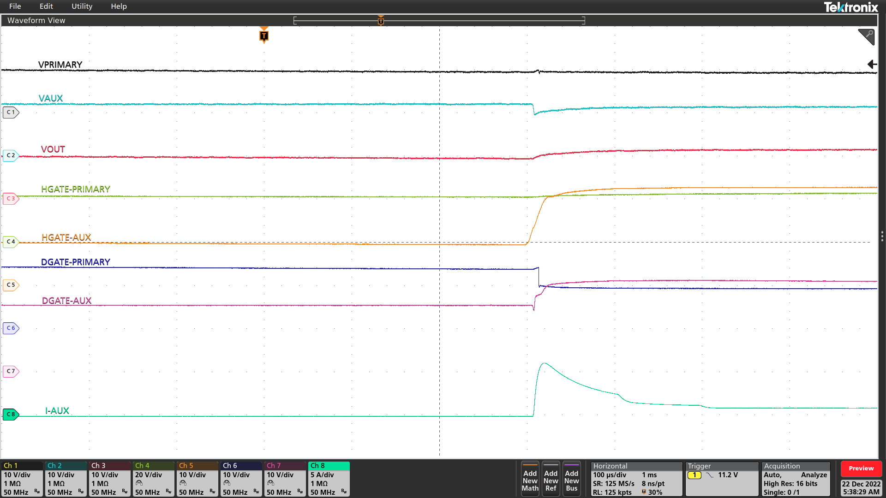
Test Condition -1 Zoom in
Test Condition:
Initial Condition:
V_{PRIMARY} =12V
V_{AUX} = 12V
Primary to Aux transition set at 9.2V
V_{PRIMARY} drops below transition voltage
Observation:
As V_{PRIMARY} drops below VOVF threshold, HGATE of AUX rail LM749x0-Q1 pulls high within 20us and starts powering the load
VOUT is powered from V_{PRIMARY}
VOUT is powered from V_{AUX}
HGATE of AUX rail LM749x0-Q1 turns ON within 20us
minimizing the VOUT voltage drop
V_{AUX} starts supplying load

Slide 5
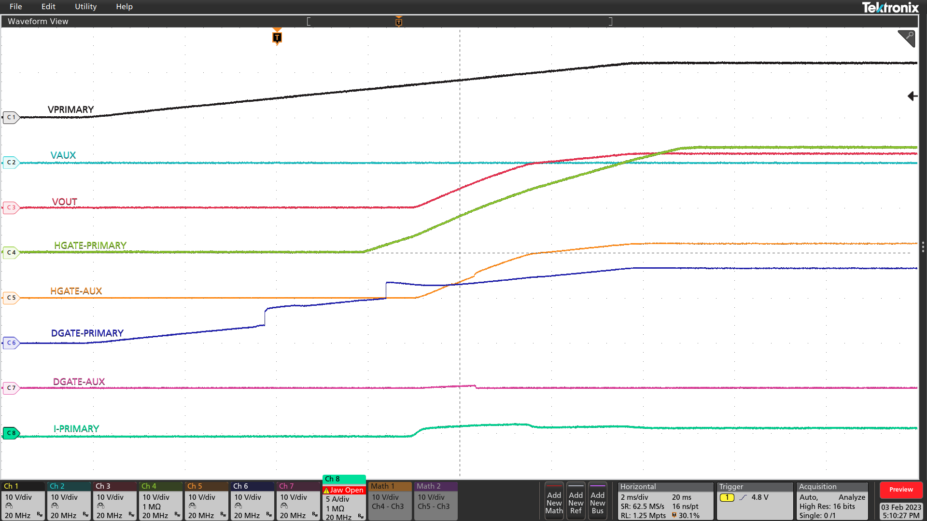
Test Condition -2
Test Condition:
Initial Condition:
V_{AUX} = 0V
V_{PRIMARY} =0V
V_{PRIMARY} ramps up from 0V to 12V
Observation:
VOUT is powered from V_{PRIMARY}
HGATE of PRIMARY path LM749x0-Q1 ramps up with inrush current control
VOUT is powered from V_{PRIMARY}
HGATE of PRIMARY rail LM749x0-Q1 z
ramps up with dvdt control
V_{PRIMARY} starts supplying load

Slide 6
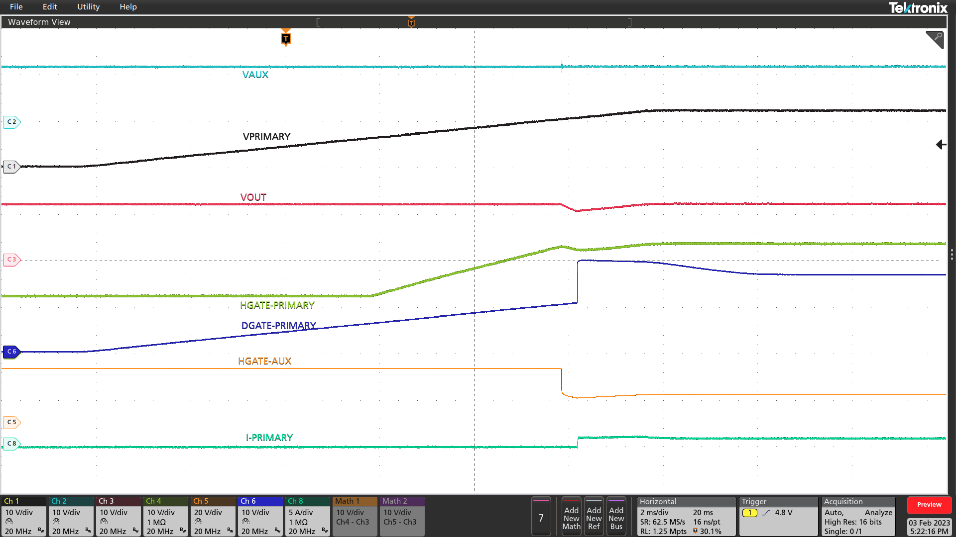
Test Condition -3
Test Condition:
Initial Condition:
V_{AUX} = 12V
V_{PRIMARY} =0V
V_{PRIMARY} ramps up from 0V to 12V
Observation:
As V_{PRIMARY} ramps up, VOUT is powered from V_{PRIMARY}
HGATE of LM749x0-Q1 in AUX path is disabled when V_{PRIMARY} ramps above V_{OVR} threshold
VOUT is powered from V_{AUX}
VOUT is powered from V_{PRIMARY}
HGATE of AUX rail LM749x0-Q1 is disabled
when V_{PRIMARY} goes above 10V
V_{PRIMARY} starts supplying load

