Slide 1
LMR38010 Output Capacitor Selection
Frank De Stasi
Allen Wachter
6/26/2023

Slide 2
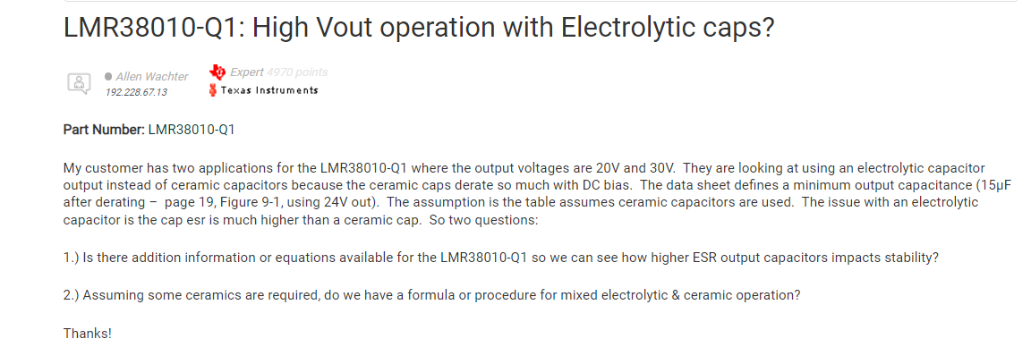
Customer E2E Post

Slide 3
Customer Inputs
LMR38010
Vin = 56V (fixed)
Vout = 28V and 30V
Iout = 1A
Fsw = 500kHz
Cout = mix of ceramic and Al. electrolytic

Slide 4
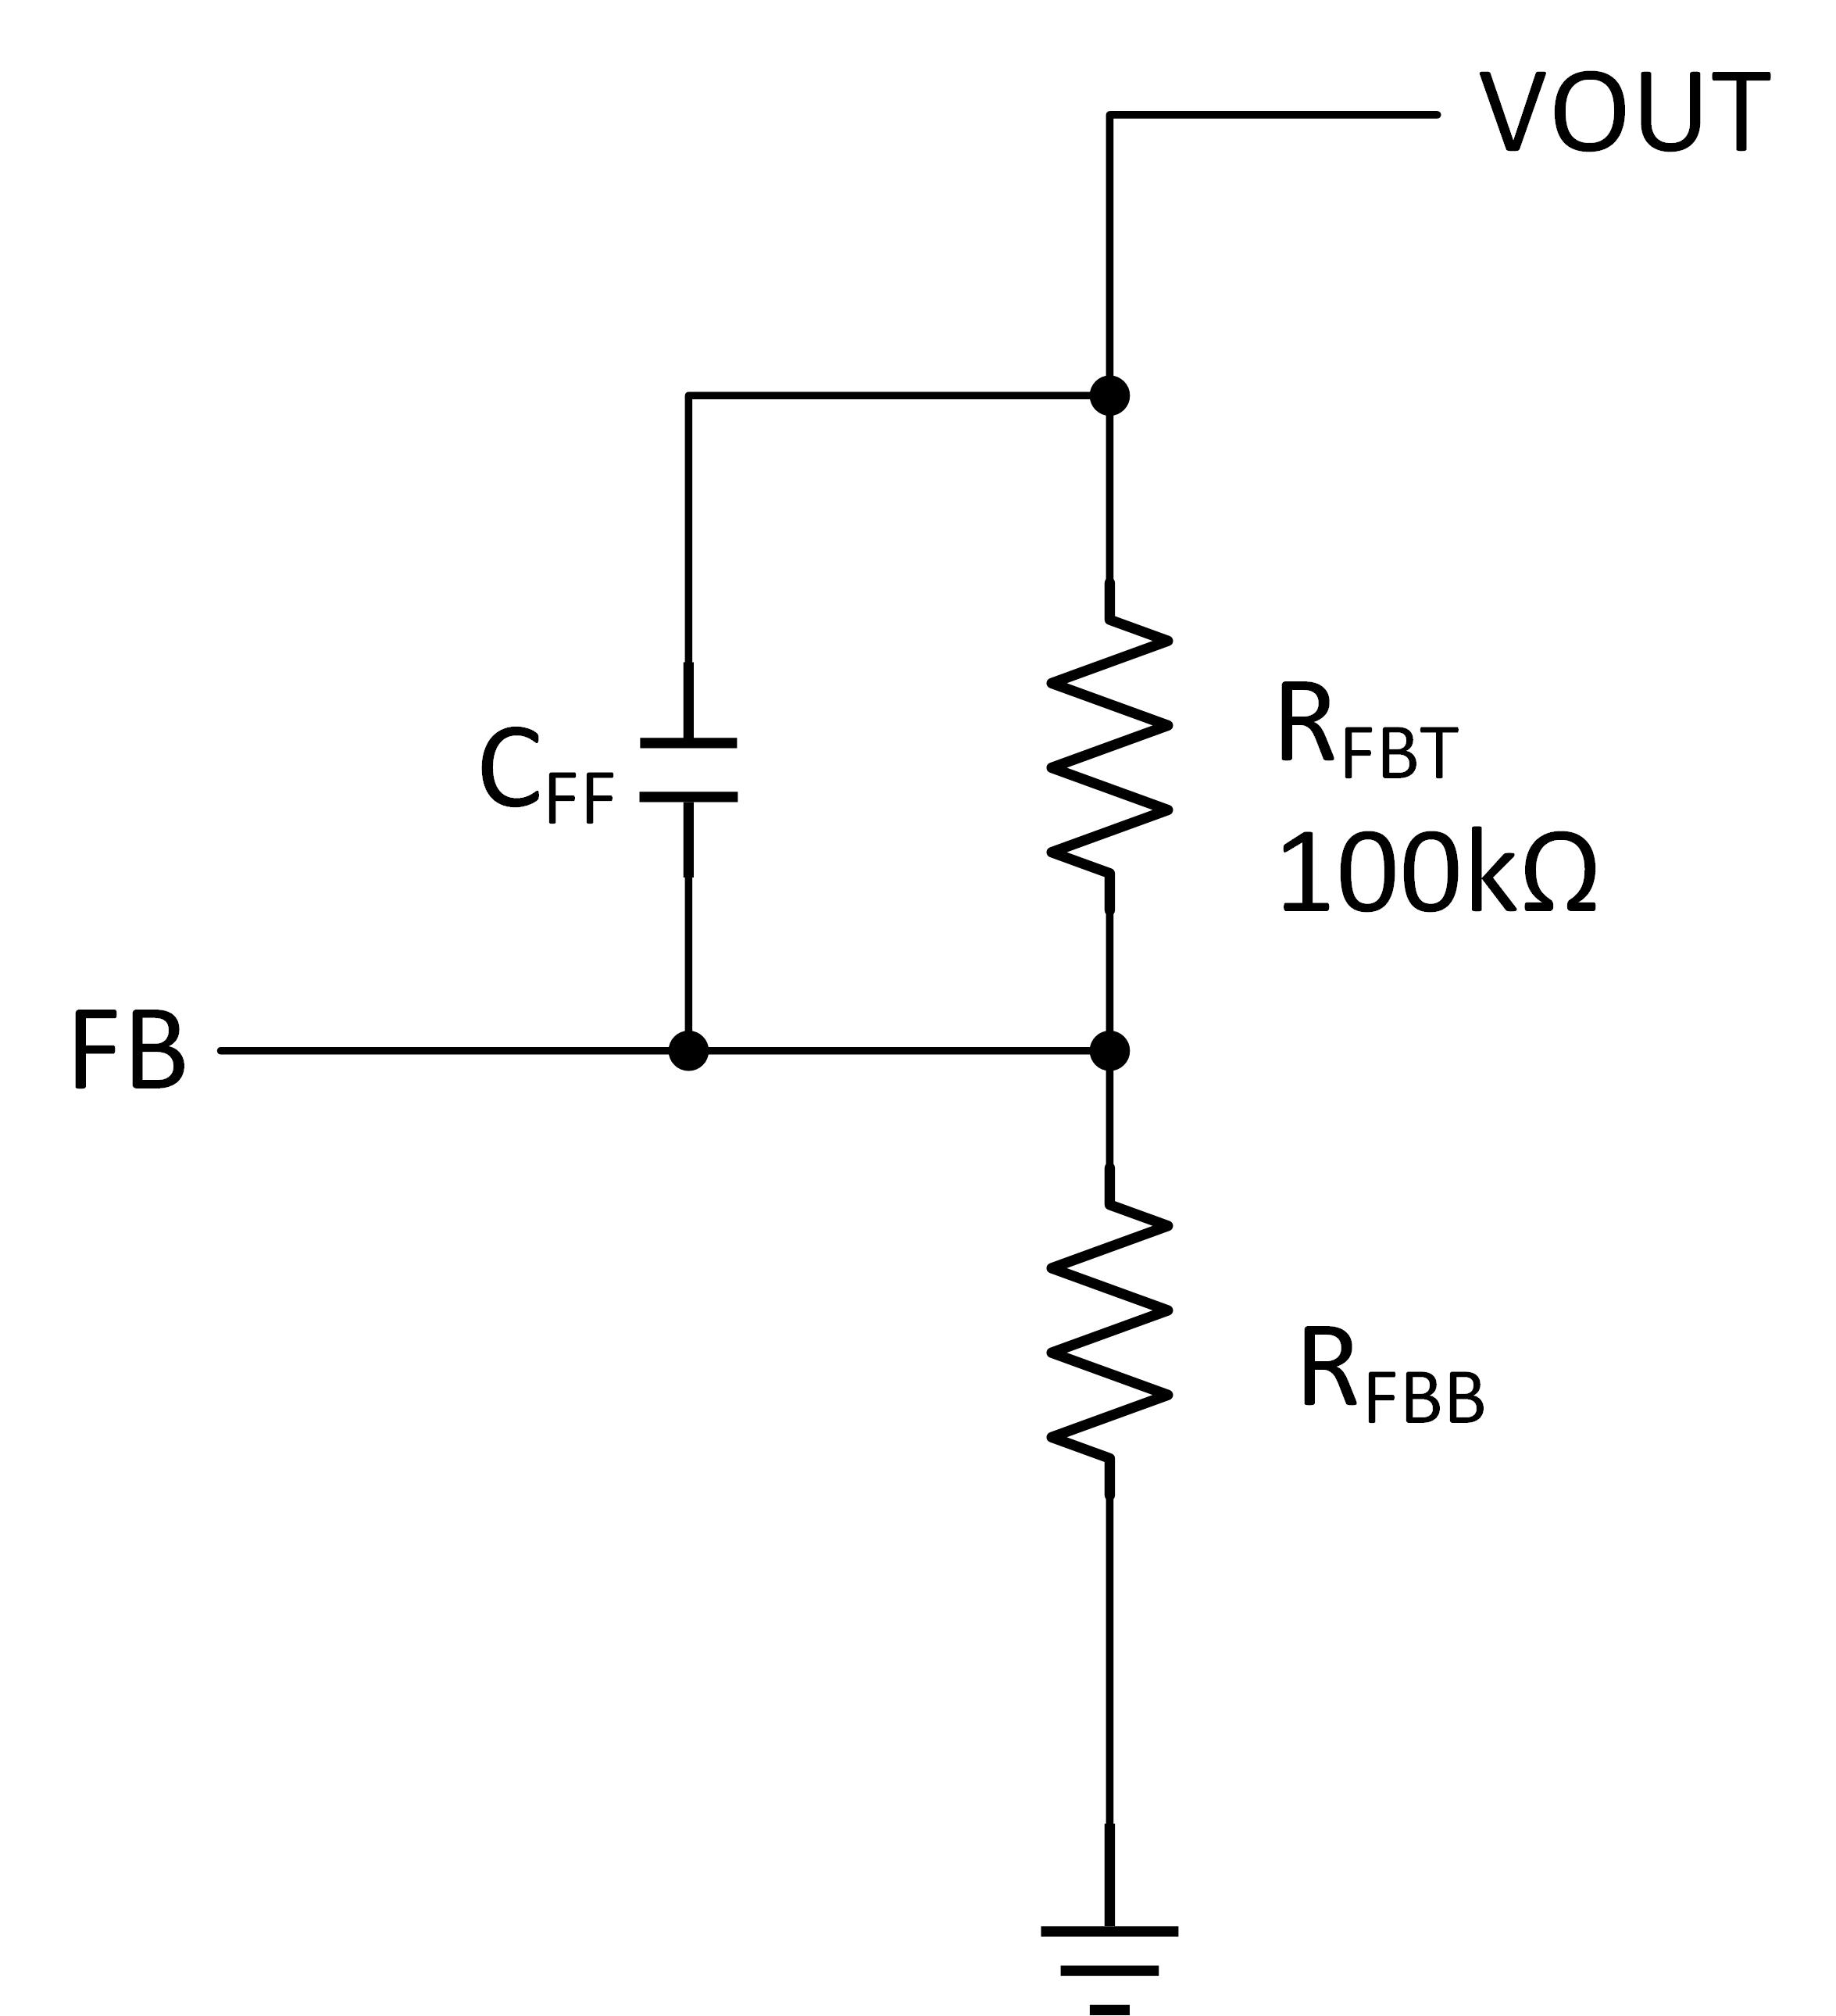
Simulation Assumptions
Vin = 56V
Iout = 1A
Fsw = 500kHz
L = 100µH, 2A
FPWM
Load current step = 0.5A to 1A; Tr = Tf = 1µs
Cout
5µF ceramic; after all de-rating
22µF Aluminium electrolytic
ESR = 0mΩ, 10mΩ, 20mΩ, 50mΩ, 100mΩ
R_{FBT} = 100kΩ

Slide 5
Simulation Results = Vout = 28V
Al. Elect. ESR | C_{FF} | Bandwidth / Phase Margin | Output Voltage Transient | Output Voltage Ripple
0mΩ | 100pF | 5.4kHz / 68° | +320mV / -340mV | 2.6mV (p-p)
10mΩ | 100pF | 5.4kHz / 69° | +320mV / -340mV | 3.1mV (p-p)
20mΩ | 100pF | 5.4kHz / 69° | +319mV / -340mV | 4.4mV (p-p)
50mΩ | 100pF | 5.4kHz / 71° | +314mV / -330mV | 8.2mV (p-p)
100mΩ | 100pF | 5.4kHz / 72° | +316mV / -330mV | 11.5mV (p-p)

Slide 6
Simulation Results = Vout = 30V
Al. Elect. ESR | C_{FF} | Bandwidth / Phase Margin | Output Voltage Transient | Output Voltage Ripple
0mΩ | 120pF | 5.3kHz / 71° | +324mV / -340mV | 2.6mV (p-p)
10mΩ | 120pF | 5.3kHz / 72° | +320mV / -340mV | 3.1mV (p-p)
20mΩ | 120pF | 5.3kHz / 72° | +320mV / -340mV | 4.4mV (p-p)
50mΩ | 120pF | 5.3kHz / 73° | +314mV / -340mV | 8.2mV (p-p)
100mΩ | 120pF | 5.3kHz / 74° | +320mV / -340mV | 11.5mV (p-p)

Slide 7
Summary
Tested Cout combination is typical
Other combinations are possible.
Value of C_{FF} can be used to optimize performance
Place for C_{FF} should be left on PCB layout
ESR of aluminium electrolytic capacitor
Should be chosen as low as possible

Slide 8
Important notice and disclaimer
TI PROVIDES TECHNICAL AND RELIABILITY DATA (INCLUDING DATASHEETS), DESIGN RESOURCES (INCLUDING REFERENCE DESIGNS), APPLICATION OR OTHER DESIGN ADVICE, WEB TOOLS, SAFETY INFORMATION, AND OTHER RESOURCES “AS IS” AND WITH ALL FAULTS, AND DISCLAIMS ALL WARRANTIES, EXPRESS AND IMPLIED, INCLUDING WITHOUT LIMITATION ANY IMPLIED WARRANTIES OF MERCHANTABILITY, FITNESS FOR A PARTICULAR PURPOSE OR NON-INFRINGEMENT OF THIRD PARTY INTELLECTUAL PROPERTY RIGHTS.
These resources are intended for skilled developers designing with TI products. You are solely responsible for (1) selecting the appropriate TI products for your application, (2) designing, validating and testing your application, and (3) ensuring your application meets applicable standards, and any other safety, security, or other requirements.
These resources are subject to change without notice. TI grants you permission to use these resources only for development of an application that uses the TI products described in the resource. Other reproduction and display of these resources is prohibited. No license is granted to any other TI intellectual property right or to any third party intellectual property right. TI disclaims responsibility for, and you will fully indemnify TI and its representatives against, any claims, damages, costs, losses, and liabilities arising out of your use of these resources.
TI’s products are provided subject to TI’s Terms of Sale or other applicable terms available either on ti.com or provided in conjunction with such TI products. TI’s provision of these resources does not expand or otherwise alter TI’s applicable warranties or warranty disclaimers for TI products.

