Slide 1
LMZ31503 Switching frequency calculation equation
TI
1/28/2022

Slide 2
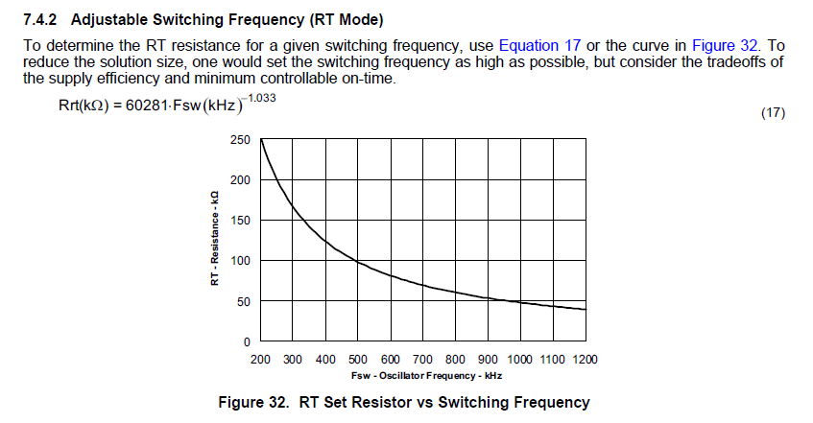
LMZ31503 Internal IC used TPS54320. So the switching frequency setting equation is on the datasheet of TPS54320 as below

Slide 3
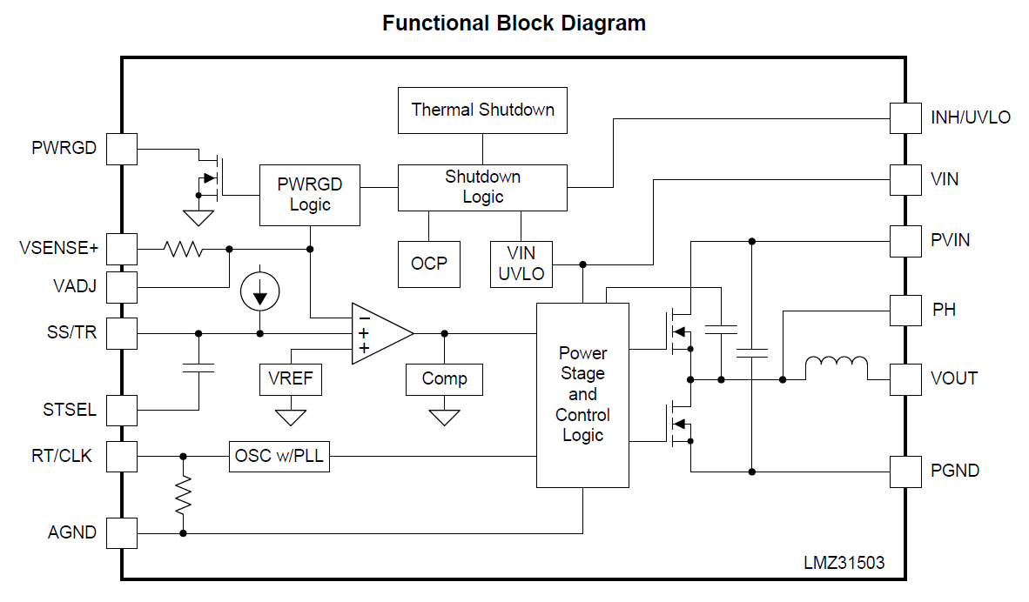
LMZ31503 has an internal 147k resistor from RT/CLK pin to GND. Must be parallel with this 147k resistor when using
TPS54320 equation in previous slide
147k

