Slide 1
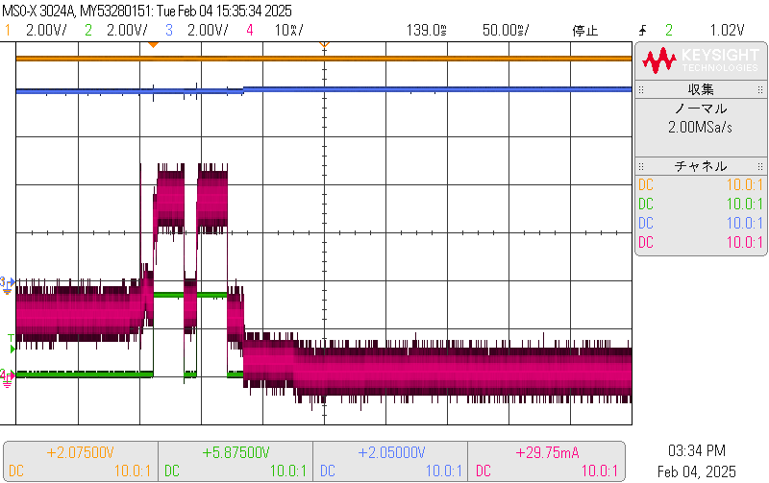
Normal operation (Desired behavior)
Vin : 9.5V
Vout : 8.0V
<Turn on relay>
Iin : About 40 mA
Iout : About 40 mA
Iin : 4.5 mA
Iout : 4.5mA
Trigger signal
Iin : About 400uA
Iout : 2.5uA
< Enter standby >
* The Iout value was measured with a digital multi-meter because it was very small.

Slide 2
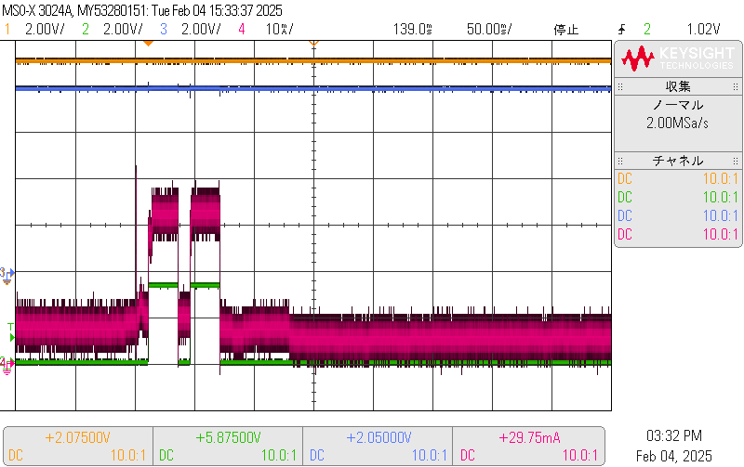
Error operation
Vin : 9.3V
Vout : 8.0V
The yellow highlight shows the input current during normal operation.
<Turn on relay>
Iin : About 40 mA
Iout : 30mA
Iin : 4.5 mA
Iout : 4.5mA
Iin : About 4.5mA
Iout : 2.5uA
Trigger signal
The output current is 2.5uA, the same as normal operation, but the input current is high at 4.5mA.
< Enter standby >
* The Iout value was measured with a digital multi-meter because it was very small.

Slide 3
Measurement method
Digital multi-meter
Vin
Vout
Iout
Power Module
LMZM23601SIL
+
-
Vin
Vout
Load
(Relay)
Relay_On
Iin
Trig

