Slide 1
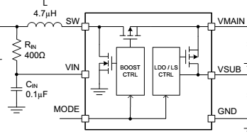


MCU
MODE
I2C
OPT3001
1.5V or 3V
LORA
Wake up
TX
RX

Slide 2
MCU
MODE
I2C
OPT3001
1.5V or 3V
LORA
Wake up
TX
RX

