Slide 1
LP5813EVM User’s Guide
Ives Li

Slide 2
Overview
LP5813 Introduction
Autonomous Animation Control
LP5813EVM Key Connector
Hardware set up for GUI
GUI Installation
How to use the LP5813 GUI

Slide 3
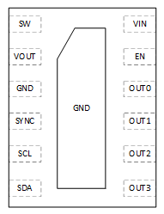
LP5811/3 Introduction
Development
Sampling in 3Q22
4/12 LED Dots I²C Synchronous Boost RGB LED Driver With Autonomous Control
Features
Benefits
Supply voltage range: 0.5V – 5.5V (Powering up from 1.8V)
Vout up to 5.5V for Boost
Time-cross-multiplexing (TCM) dot matrix
Up to 12 LEDs (4 RGB LEDs) with individual control
Current source/sink capability: 50mA when Vcc > 3.3V
Average LED current: 4-dot: 50mA(Max.), 12-dot: 12.5mA(Max.)
6kHz multiplexing frequency to avoid visual flicker
Ultra-low power consumption
Shutdown current: 0.2uA(Typ.), 2uA(Max.)
Standby current: 3uA(Typ.), 5uA(Max.)
Operation current in normal mode: 0.9mA(Typ.)
Flexible dimming control
PWM dimming: 8-Bit, Gamma correction: 256 steps, 24kHz Freq.
Analog dimming: 8-Bit
1MHz I²C interface, 4 P/N to support up to 4 devices used with one I²C bus
Logic pin power rail: 1.8V / 3.3V / 5V
Autonomous control: Auto breathing and blinking
LED open/short detection
Operating temperature range: -40°C ~ +85°C
Package: QFN-12, 1.5 mm × 2.5 mm
Low supply voltage and Boost enable battery-powered applications (AA battery, Coin cell, Li-ion)
Time-cross-multiplexing(TCM) scheme saves total system PCB size and PCB traces
Ultra-low Iq saves system power and extends battery life
Flexible dimming control for smooth LED lighting patterns
Autonomous control offloads MCU bandwidth
Applications
Battery powered applications: E-tag, Smart watch, E-Cigarettes, Wearables
Smart speaker
Router and switches
Internet-of-Things (IOT)
Handheld device
3

Slide 4

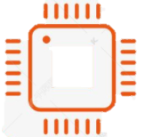

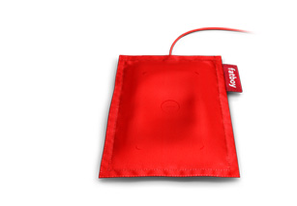

Autonomous Animation Control
MCU loading
MCU loading
MCU
MCU
Z Z Z
time
time
Animation pattern
Complex Animation Example
Animation pattern playback times
-
PT
PT1
PT2
PT3
APU1
AEU1
AEU2
AEU3
APU2
APU: Animation pause unit; AEU: Animation engine unit;
PT: Playback times of AEU
Each LED dot has pattern control module
AEU (Animation engine unit)
Time and start/end PWM of
every sloper can be configured
Notes:
Register-based, ease-of-use autonomous animation control.
Individually setting the patterns for every LED dot.
Flexibly configure the time and range to achieve arbitrary animation.
Gamma control to ramp up/down smoothly for human eyes.
Flexible playback and AEU combination to achieve complex animations.
Precise timing control that cooperating with different LEDs among different ICs.
Free controller from heavy load and let it to do other tasks.
Save the system standby power, controller could be in sleep mode with ultralow Iq.

Slide 5
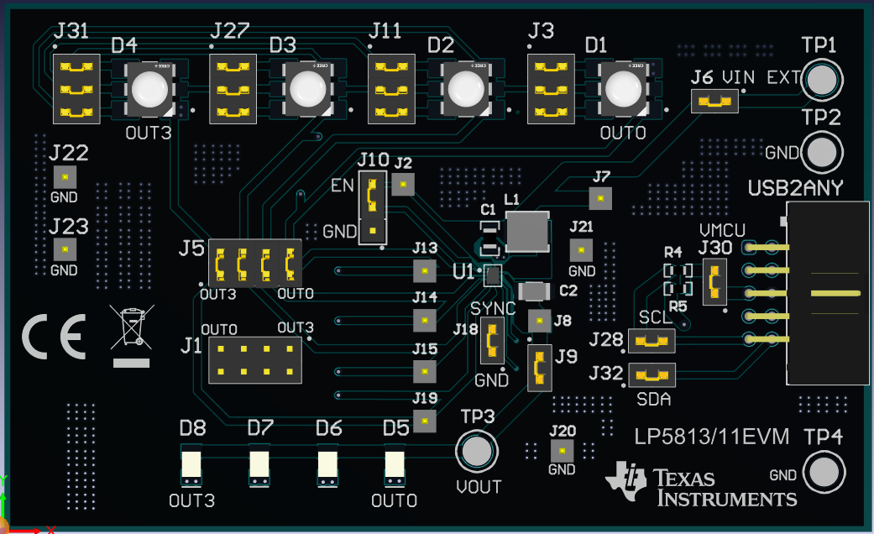
LP5813EVM Key Connector
Boost enable connector
External power supply for boost
1.8 – 5.5V for soft start
0.5 - 5.5V after start up
TCM-mode choose
USB2ANY connector
Direct-mode choose
Figure1. LP5813EVM
Boost output voltage/
Linear power supply
3 – 5.5V for power suplly
Notes:
TLC59731 is another WS2811 Alternative

Slide 6
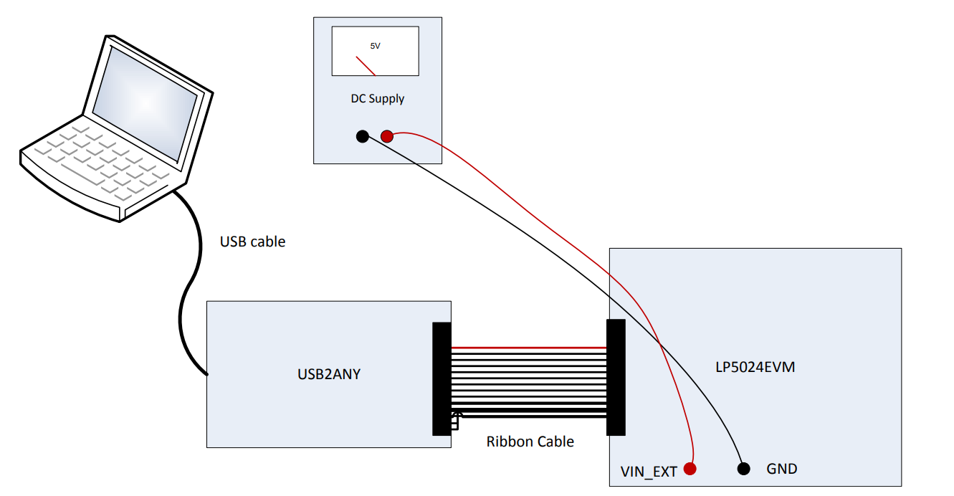
Hardware set up for GUI
Connect DC Supply to Vout if don’t use boost function
LP5813EVM
Figure2. Hardware set up for GUI

Slide 7
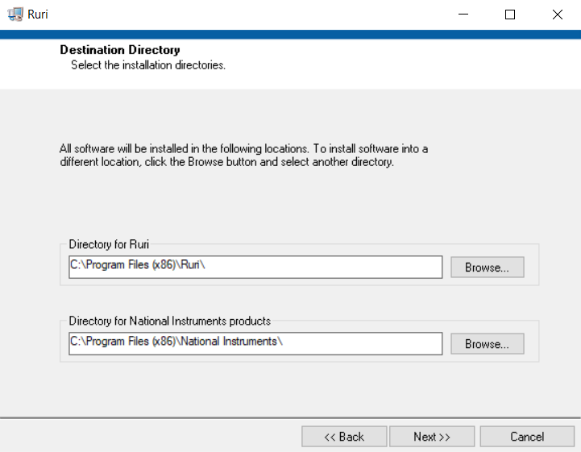
GUI Installation
Download the GUI from below link:
https://tidrive.ext.ti.com/u/-Ztuy6qbbsjrm27A/e34cfc12-e83d-4b0b-8abb-40e764fdb370?l
Access code: Jt;ak4A1
2) Click Ruri Installer -> Volume -> setup to install the GUI
3) Click Next -> Next -> Finish during installing.
Remember the location where you install the GUI
4) Find Ruri.exe in the document, double click to open the LP5813 GUI.
Notes:
TLC59731 is another WS2811 Alternative

Slide 8
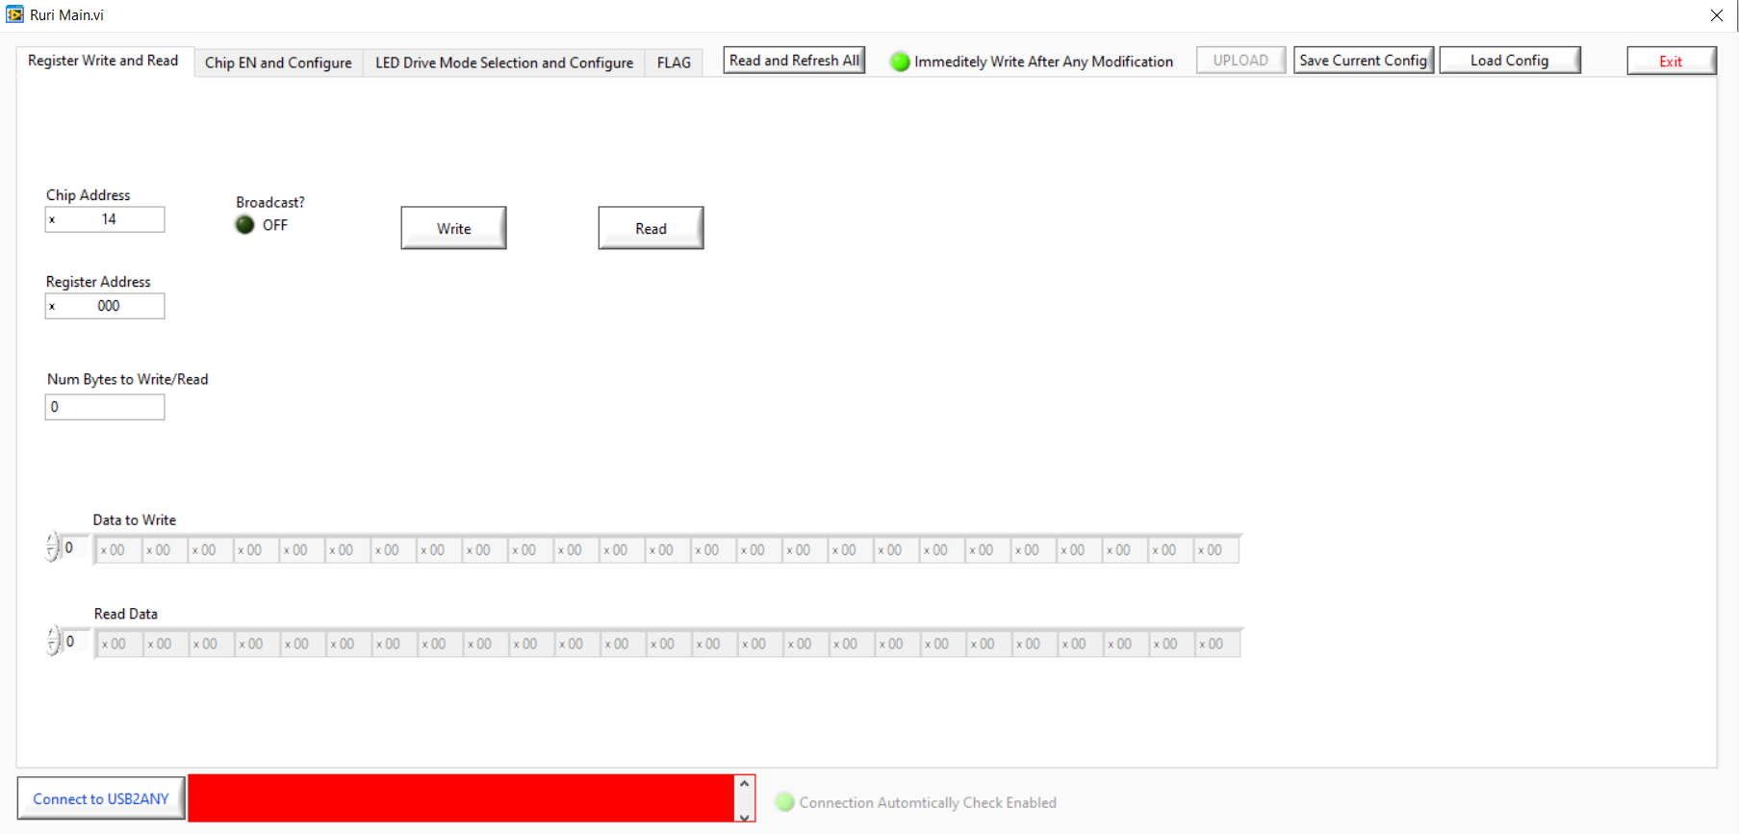
How to use the LP5813 GUI
Step1: Click Connect to USB2ANY, if the connection is ready, the bar behind will turn green.
Check Chip Address, it will be better to turn on broadcast.
Figure3. Register Write and Read page

Slide 9
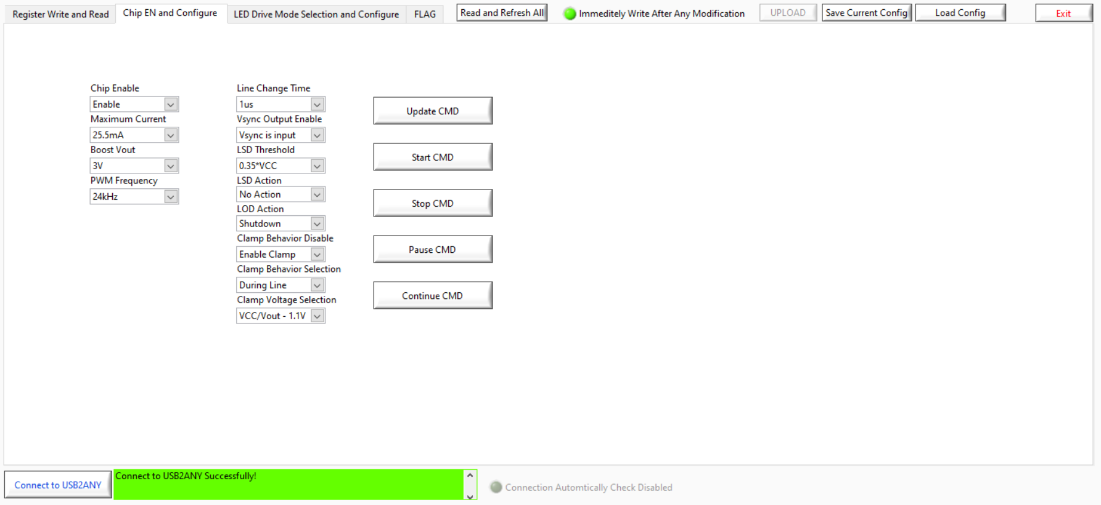
How to use the LP5813 GUI
Step2: Enable the chip and configure the parameters, then click Update CMD.
It will better to Read and Refresh all registers before the following steps.
Figure4. Chip EN and Configure page

Slide 10
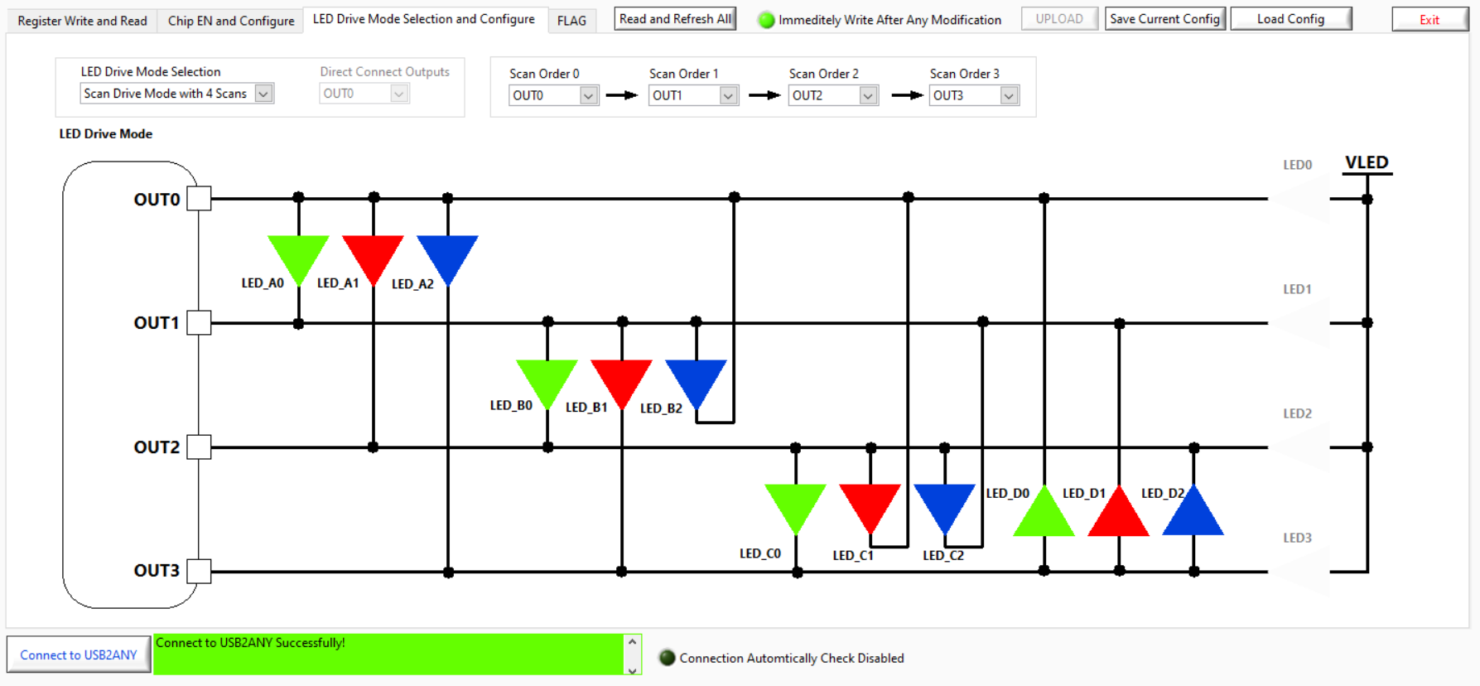
How to use the LP5813 GUI
Step3: Select LED drive mode and scan order
Double click LED shape go to next step
Figure5. LED Drive Mode Selection and Configure page

Slide 11
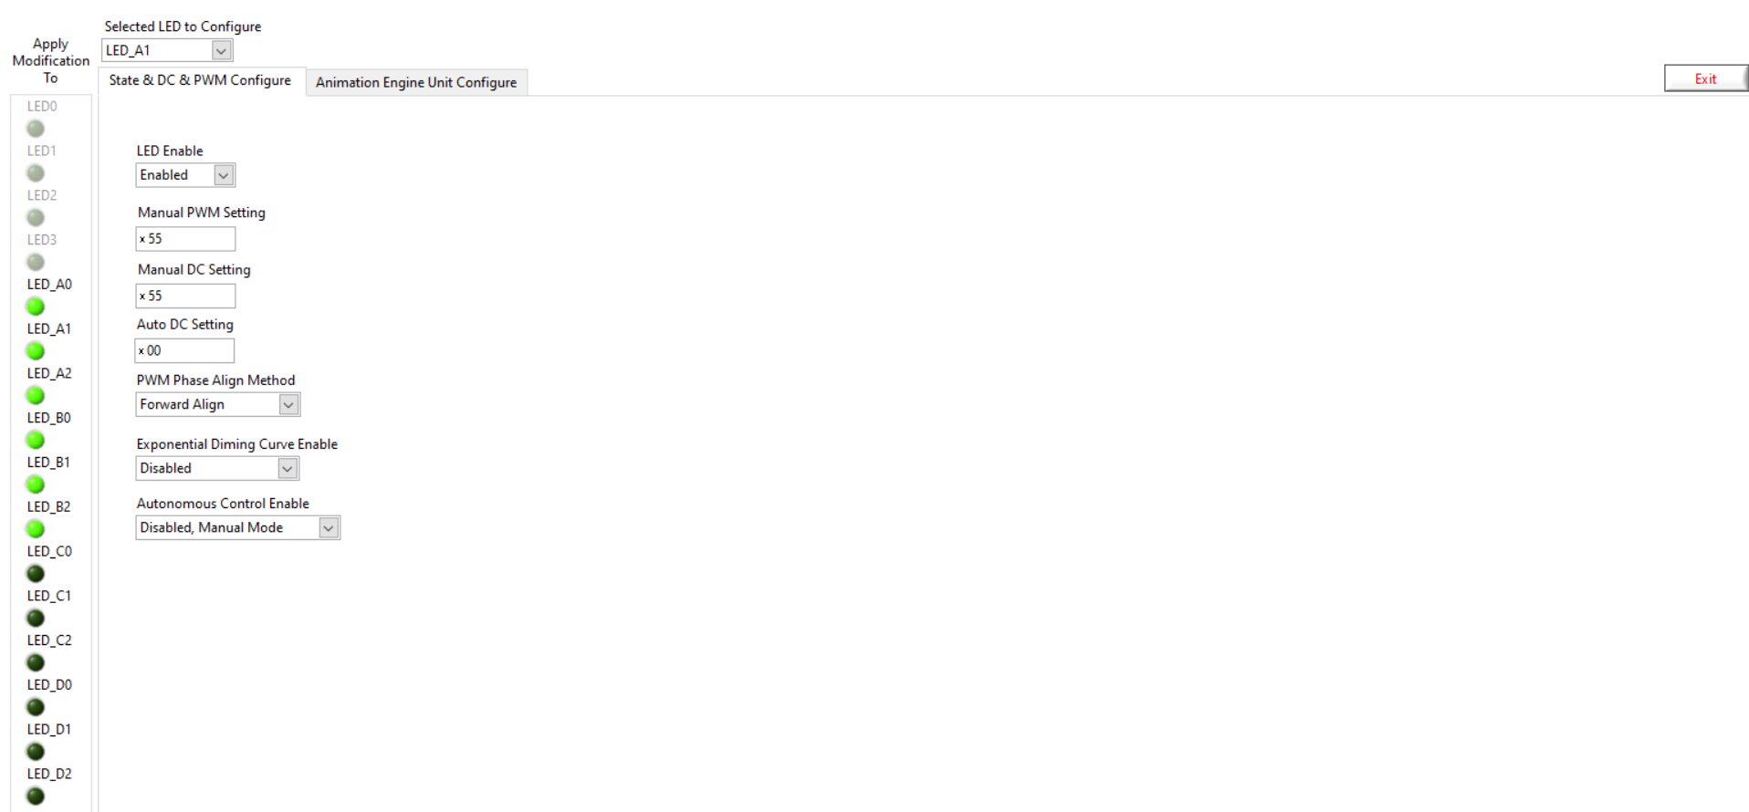
How to use the LP5813 GUI
Step4: Configure the functions and parameters related to each LED.
If auto animation function is needed, please select Autonomous Control Enable, set Auto DC and go to next step
Select the LEDs you want to configure to same function (Group setting)
Figure6. State & DC & PWM Configure page

Slide 12
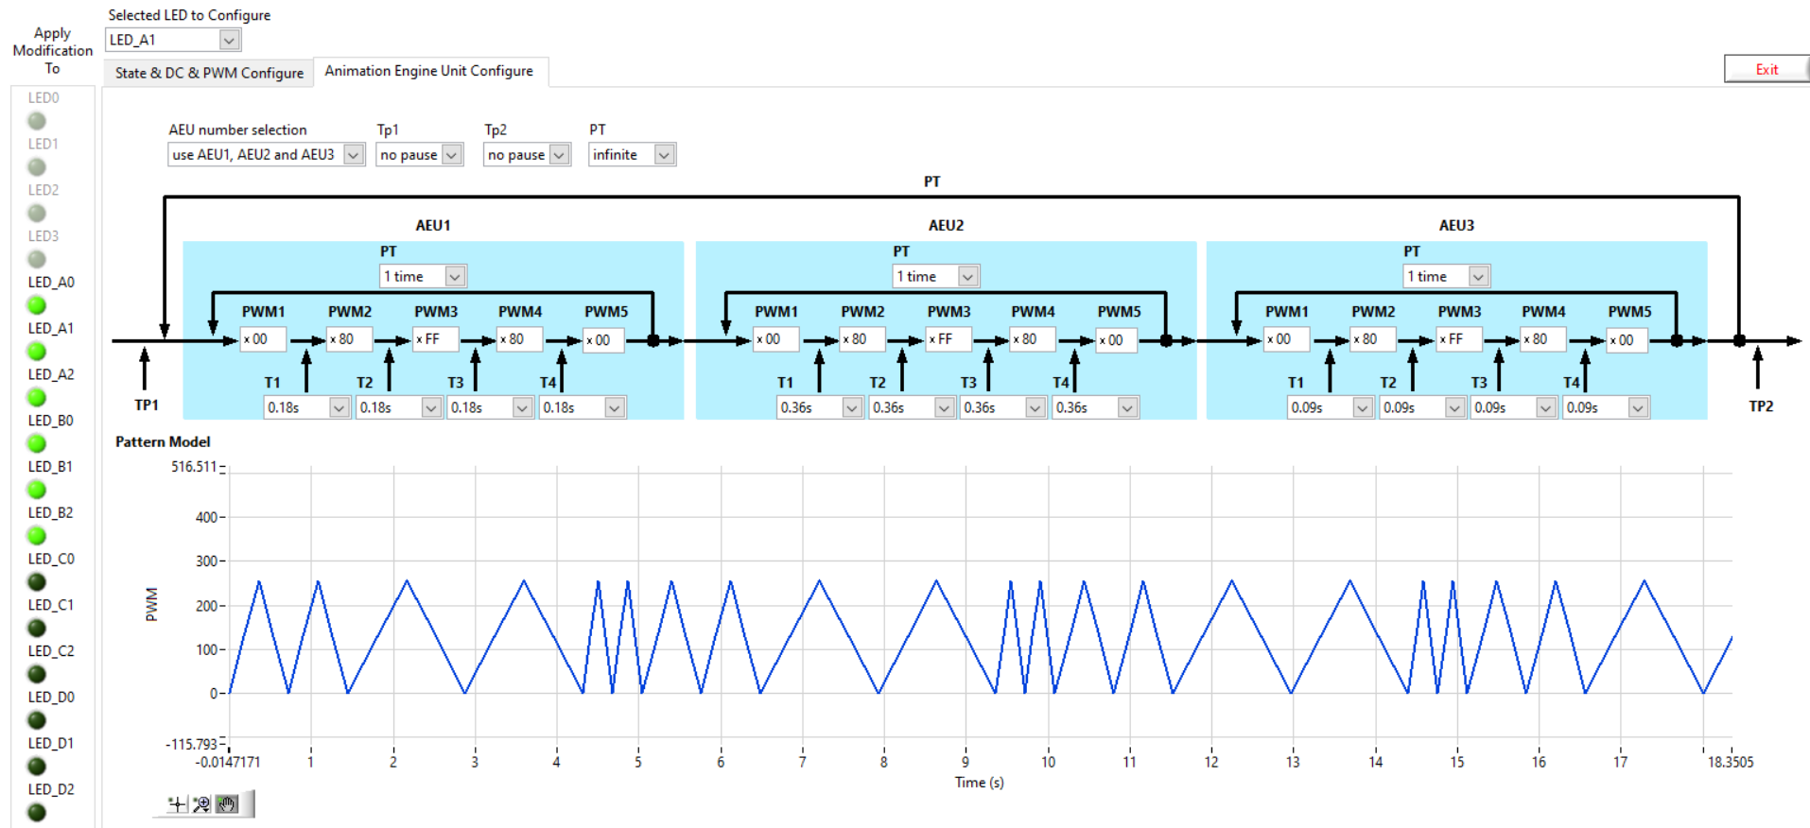
How to use the LP5813 GUI
Step5: Configure the functions and parameters related to LED auto animation engines
Tp1/Tp2: Time pause on the beginning/end
PT: Playback times
Select how many AEU are used.
Figure7. Animation Engine unit configure page

Slide 13
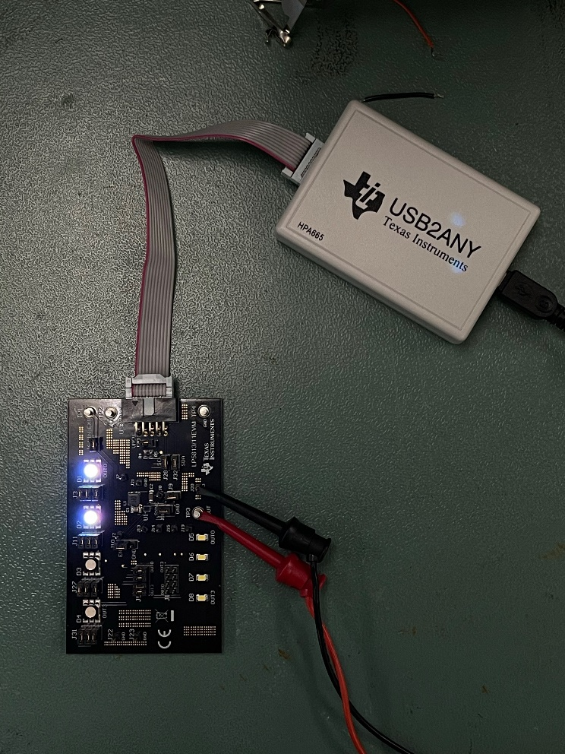
How to use the LP5813 GUI
Step6: Go back to Chip EN and Configure page, click Update CMD and Start CMD, the LEDs you configured before will light up and follow the pattern you set (if animation engine is used).
Figure8. LP5813EVM Demo

Slide 14
Thank You

