Slide 1
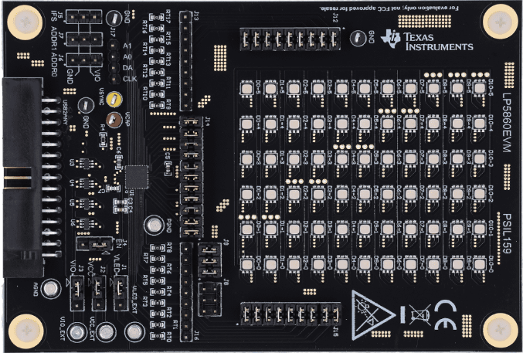
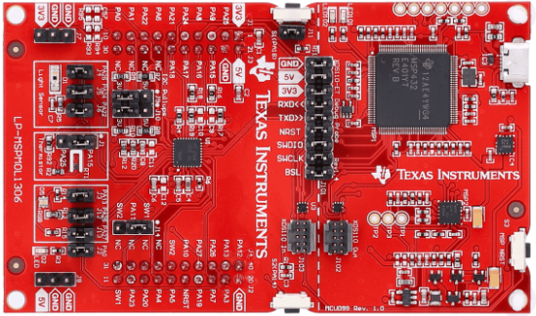
Required Hardware
LP5860EVM
https://www.ti.com/tool/LP5860EVM?keyMatch=LP5860&tisearch=universal_search&usecase=partmatches
MSPM0L1306 LaunchPad
https://www.ti.com/tool/LP-MSPM0L1306?keyMatch=MSPM0L1306&tisearch=universal_search

Slide 2
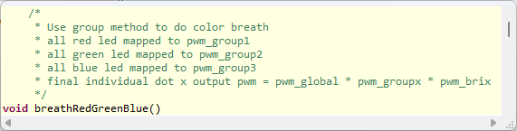
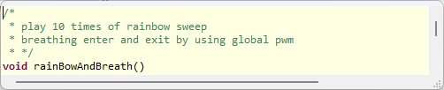

CCS Codes
There are 3 patterns demonstrated in the code based on I2C and SPI protocol.

Slide 3

Hardware Setup
LP5860/TEVM
MSPM0L1306 LaunchPad

Slide 4
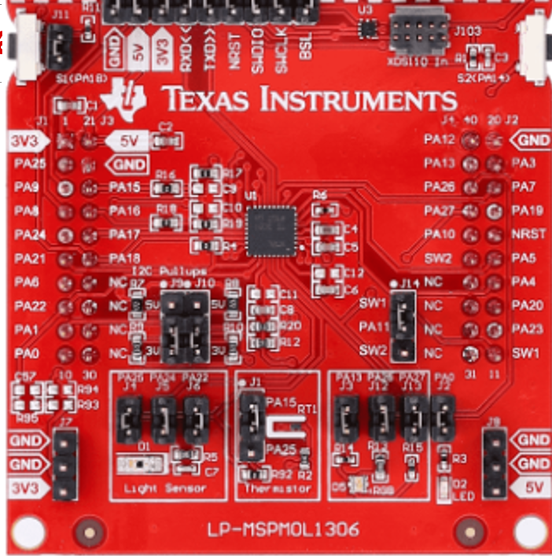
Hardware Connection – I2C
3.3V
3.3V
5V
3.3V
EN pull high
PA1
PA0
GND
SCL
SDA
GND
3.3V
5V
IFS pull low
Only keep these jumpers and remove all other jumpers on the board

Slide 5
Hardware Connection – SPI
3.3V
3.3V
5V
3.3V
EN pull high
PA5
PA6
PA4
PA23
GND
SCLK
SIMO
SOMI
CS
GND
3.3V
5V
IFS pull high
Only keep these jumpers and remove all other jumpers on the board

Slide 6
Hardware Setup
VLED
BOOST Circuit
SW0 to SW11
CS0 to
CS8
CS9 to
CS17
7x9 LED matrix
LP5860EVM

