Slide 1
A-1. SINGLE MCU – 3 DRIVER IC Control
MCU BLOCK
F280039CPZRQ1
LED BLOCK 1
96 channel
64 scan
LP5891Q1 4pcs
LED BLOCK 2
96 channel
64 scan
LP5891Q1 4pcs
LED BLOCK 3
96 channel
64 scan
LP5891Q1 4pcs
- Is it possible to control 3 blocks with a single MCU?
- If possible, please recommend which pins of the MCU would be best to use.
- If possible, how many blocks can be controlled ?
- If it is not possible, how should MCU synchronization or pin configuration be handled?
No, it is not possible to control it this way. F280039CPZRQ1only has 2 CLB tiles and could only support controlling 2 daisy chains.
For controlling 2 LED blocks, I recommend using LP5899 for transmitting it into SPI mode. Then for the controlling you could refer to figure 3-3 in user’s guide:LP5891-Q1 Sample Code User's Guide (Rev. A)

Slide 2
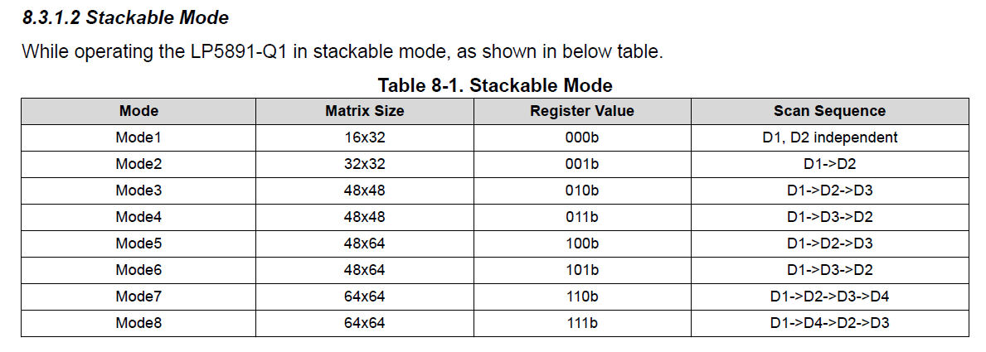
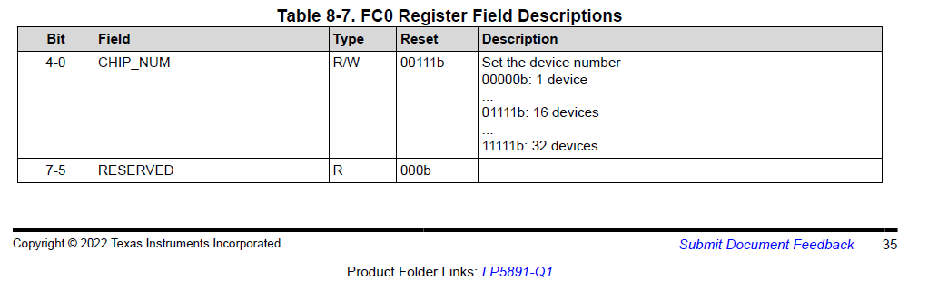
A-2. SINGLE MCU – 3 DRIVER IC Control
On page 35, there is a section mentioning FC0 REGISTER -> CHIP_NUM for devices 0~32.
Does this mean that up to 32 devices can be controlled?
There is no further explanation provided.
Yes, it means you can at most control 32 devices cascaded.
On page 13, it states that the STACKABLE MODE supports 8 devices. Is it not possible to configure other combinations?
You can also use independent devices and cascade them together. But do not mix and cascade the INDEPENDENT MODE with STACKABLE MODE .

Slide 3
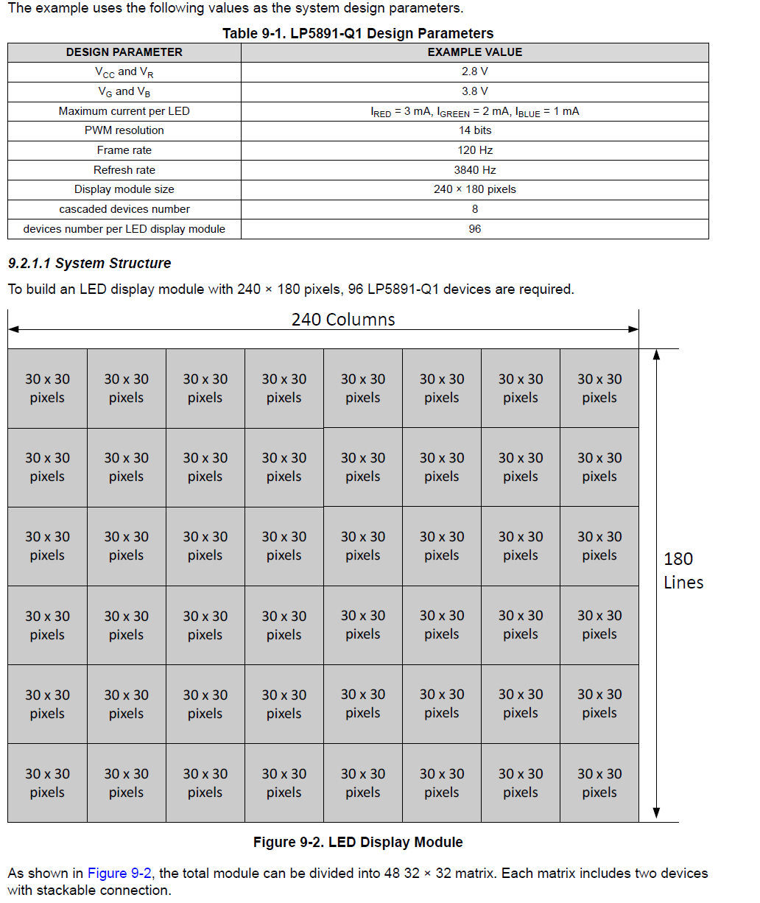
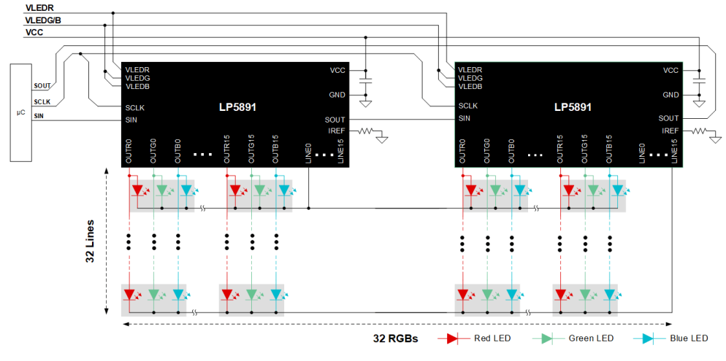
What I am most curious about is the example on page 50,
where it mentions using 96 ICs, stacked in pairs.
What does "cascaded devices number = 8" mean in this context?
I would also appreciate a detailed explanation of the MCU and DRIVER IC configuration used in the example.
Each 30*30 pixels contains one stacked module, which includes 2 devices.
So for cascaded 8 devices, it means one daisy chain of devices will only have 8devices, which is 4 stacked modules.
One cascaded daisy chain
In other words, for this LED display it has 12 daisy chains in total.

Slide 4
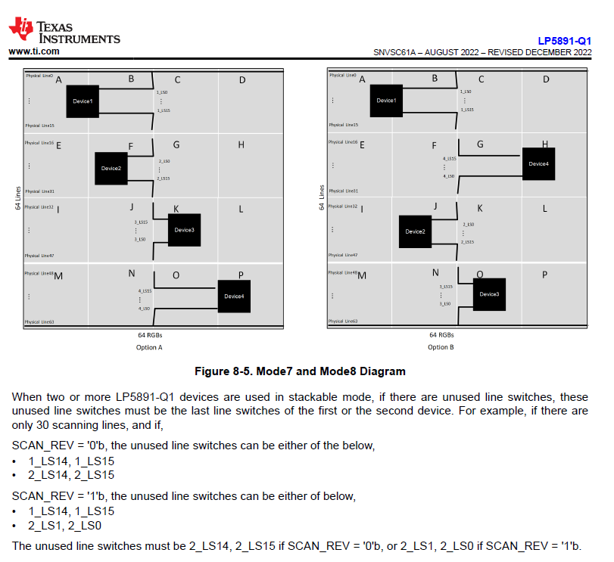
B. Unused Scanline Set (Datasheet 15P)
B-1)
According to the datasheet, it is specified that
“Unused Scan Line must be the last line.”
I would like to understand
what kind of issues may occur if this rule is not followed.
For example, when cascading three ICs with a total of 81 scan lines,
the recommendation implies that all 15 unused scan lines should be
assigned to only one device, at the end.
(In some cases, this rule can be disadvantageous in terms of PCB artwork or spatial layout.)
However, if I distribute them evenly across the three devices, such as:
Device 1: LS11~15 unused
Device 2: LS11~15 unused
Device 3: LS11~15 unused
would this cause any functional or reliability issues in operation?
Please just follow the data sheet. The chip will automatically scan from line to line, do not do that.
B-2)
In addition, should the same rule for unused scan lines also be applied to “channels”? Or is it possible to configure the channels arbitrarily?
Yes for channels you can configure them arbitrarily.

