Slide 1
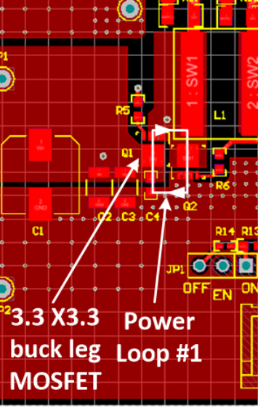
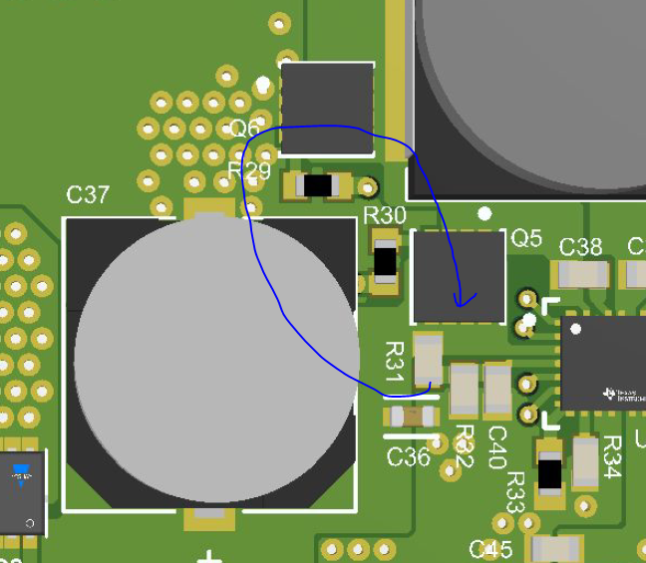
Layout guideline link: https://www.ti.com/lit/an/slvaer0b/slvaer0b.pdf?ts=1619329894229&ref_url=https%253A%252F%252Fwww.google.com%252F
Buck-side FETs and input Capacitors:
EVM:
Input capacitors C37 is put far away from high side FET Drain and low side FET Source.
Input capacitors are placed close to the buck-leg MOSFETs

Slide 2
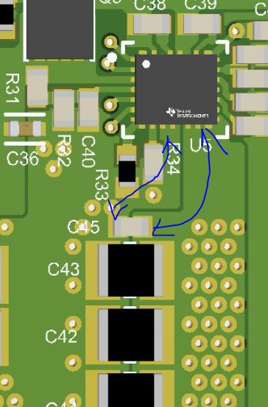
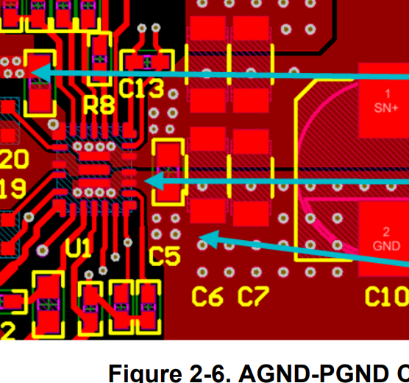
EVM:
Output capacitors C5, C6, C7 are placed close to IC
Output capacitors C45 is put very far away form IC.

Slide 3
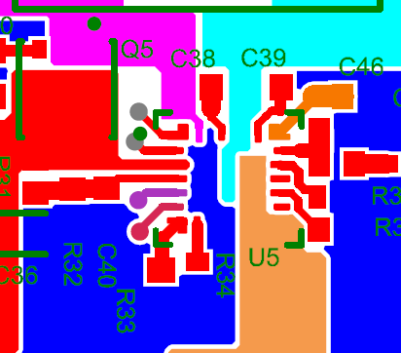
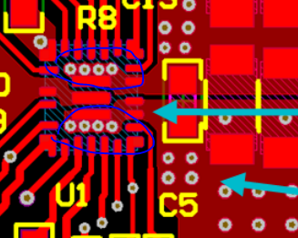
EVM:
Four VOUT and GND vias are put under IC for better thermal dissipation
No VOUT and GND vias

