Slide 1
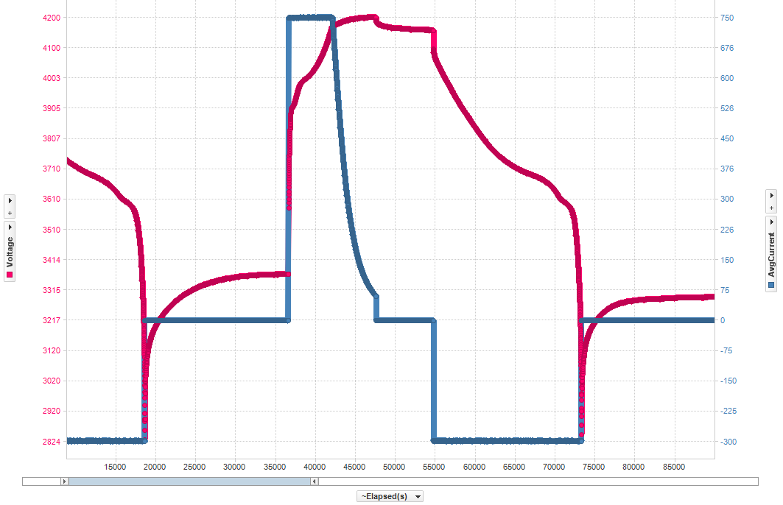
Learning Cycle
Relax >2hrs
Relax >5hrs
Discharge to empty
@ >C/10
Relax >5hrs
Charge to full
Discharge to empty

Slide 2
Gauge Configuration – Learning Cycle (Step 1)
Option A
Send IT_ENABLE command (0x0021)
DataRAM:ControlStatus:RUP_DIS = 0
DataFlash:IT_Enable = 1
Send RESET command (0x0041)
DataRAM:ControlStatus:RUP_DIS = 1
Learning cycle actually starts here!
Relax >5hrs
Option B
Send IT_ENABLE command (0x0021)
DataRAM:ControlStatus:RUP_DIS = 0
DataRAM:ControlStatus:VOK = QEN = 1
DataFlash:IT_Enable = 1
DataFlash:UpdateStatus = 00 (04 for pack-side gauge)
Discharge to empty

Slide 3
Gauge Configuration – Learning Cycle (Step 2)
DataRAM:ControlStatus:VOK -> 0
DataFlash:Qmax0 -> updated
DataFlash:UpdateStatus -> 01
(05 for pack-side gauge)
DataRAM:Flags:FC bit should -> 1 before charger shuts off!
charger shuts off
Charge to full
Relax >2hrs

Slide 4
Gauge Configuration – Learning Cycle (Step 3)
DataRAM:ControlStatus:VOK -> 0
DataFlash:Qmax0 -> updated
DataFlash:UpdateStatus -> 02
(06 for pack-side gauge)
Start discharge
(VOK will set again)
Ra tables are updated during discharge
Discharge to empty
@ >C/10
Relax >5hrs

