Slide 1
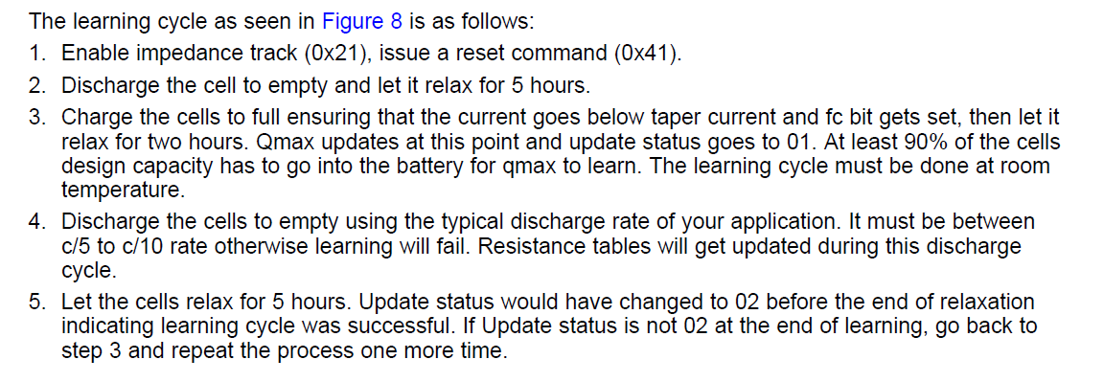
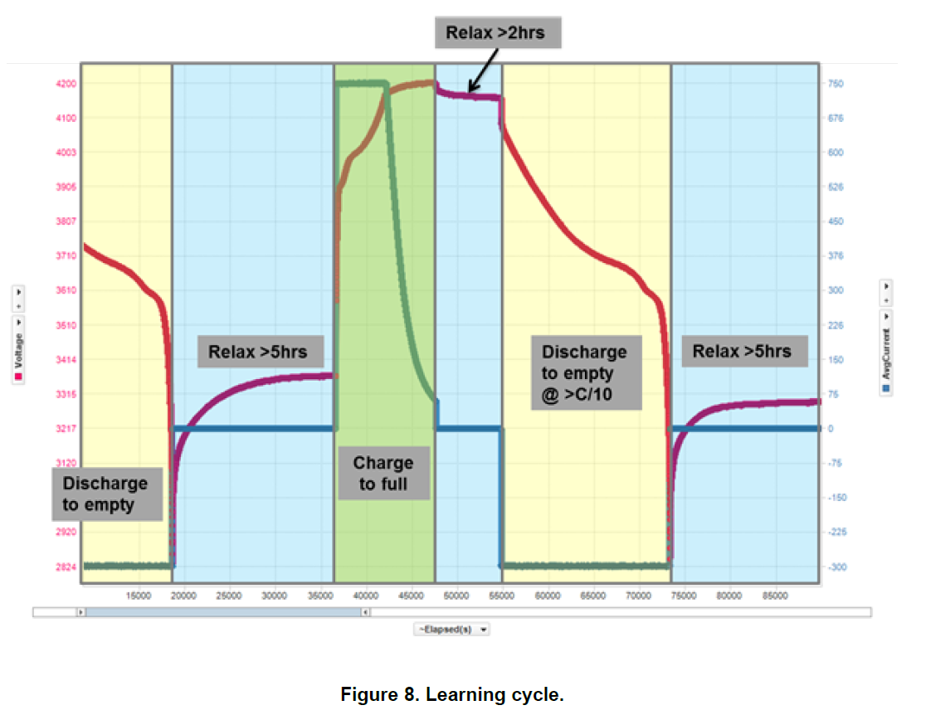
Learning Cycle

Slide 2
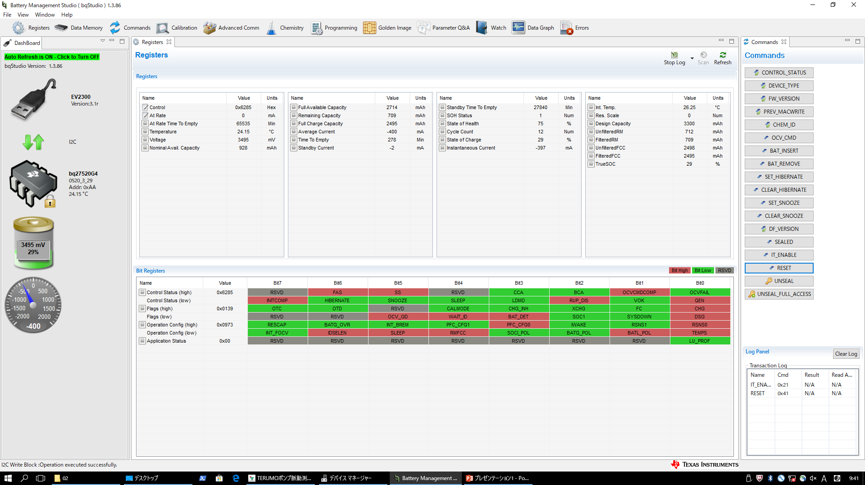
Step1（Sending IT_ENABLE command）
1.Click here
3.Discharge at constant current(400mA).

Slide 3
Step2（Sending RESET command）
2.Click here

Slide 4
After Step2
Step3 Starting 1st discharge. Discharge current is 274mA. And end-voltage is lower than 3.0V
Step4 Relaxing in more than 5hours.
Step5 Starting charging(CC, CV)
Step6 Relaxing in more than 2hours after charging current become zero.
Step7 Starting 2nd discharge. Discharge current is 274mA. And end-voltage is lower than 3.0V
Step8 Relaxing in more than 5hours. Learning cycle would be completed.

Slide 5
ロゴ以外不要
社内プレゼンテーションテンプレート 最終ページ

