Slide 1
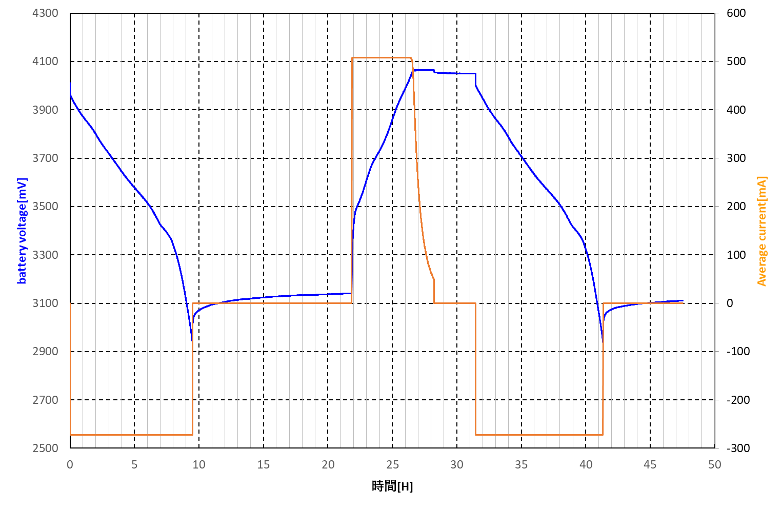
Log file during learning cycle
Which current in the following figure is the taper current you mean?

Slide 2
Notes:
ノートサンプル

