Slide 1
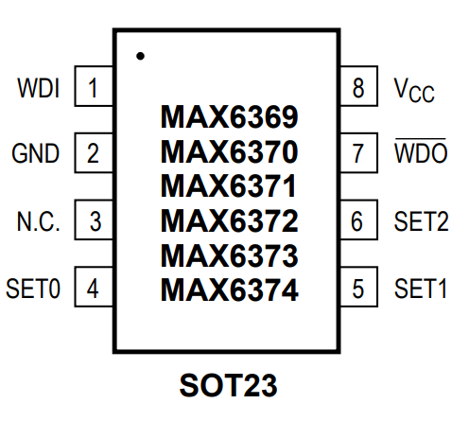
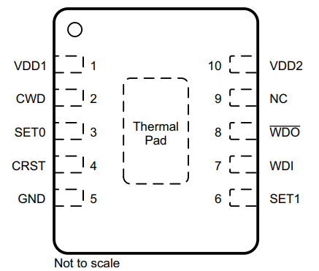
MAX6369 VS TPS3430-Q1
 | MAX6369 | TPS3430-Q1
Watchdog Type | Timer | Window
Quiescent Current Typ | 10 µA | 10 µA
Output Type | Open-Drain
Supply Voltage | 2.5 – 5.5 V | 1.6 – 6.5V
Watchdog Timeout | Fixed | Fixed and Adjustable through Capacitor
Watchdog Timing Ratio | NA | Adjustable through SET
Reset Timeout | Fixed | Fixed and Adjustable through Capacitor
Watchdog Disable |  | 
Package | 6 Pin SOT-23 | VSON-10

