Slide 1
Application Circuit
Evaluation for CSD17308Q3
DUT (Voltage Supply)_V | I_{DS} (Continuous Drain Current )_A | Feasibility | Remark
1.2 | 4 | OK | Verified
20 | 4 | ? | Consideration of power dissipation

Slide 2
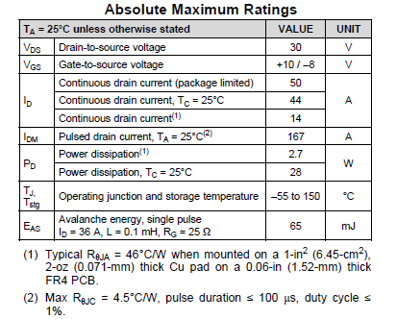
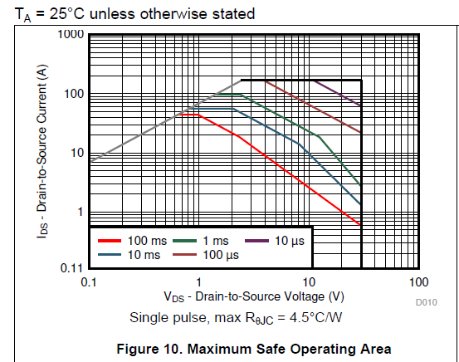
How to evaluate the intended application ?
Target : VDS = 20V, Continuous IDS = 4A
Application required < Specification
20V < 30V, 4A < 14A seems to be ok
Application required 20V, 4A
Continuous current drain is not allowed

