Slide 1
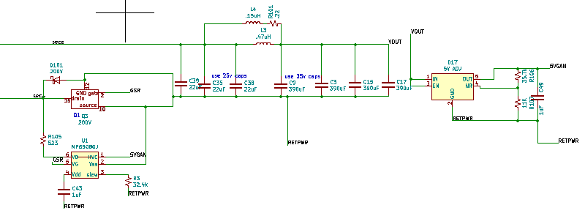
SCHEMATIC FOR SECONDARY OF UCC28782 Circuit
SR is EPC2034
SHUNT DIODE ACROSS EPC2034 IS FOR STARTUP ONLY.

