Slide 1
Measuring LDO Noise
Kyle Van Renterghem
Systems Engineer
Texas Instruments

Slide 2
Table of Contents
LDO Noise
How to reduce noise from an LDO
Noise Measurement
Block Diagram
Setting up a noise measurement
Affects of the noise floor
EVM Setup
Analyzer Settings

Slide 3
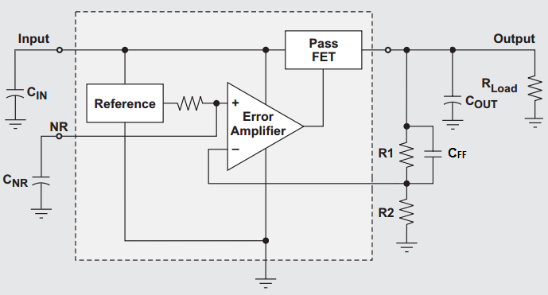
LDO Noise
The noise at the output of an LDO is dominated by the noise of the reference, this noise is amplified by the closed loop gain set by R1 and R2.

Slide 4
What Affects LDO Noise
If there is no noise reduction capacitor the biggest factor is the output voltage.
Without a Cnr the RMS noise is proportional to the gain of the circuit Vout/Vref .
If there is a noise reduction capacitor the output voltage is much less of a factor.
The next biggest effect is the noise reduction cap, the larger the cap the more low frequency noise will be attenuated by the low pass RC filter.
A feedforward cap also has a large effect on the noise, and again the larger it is the more noise it will attenuate.
However, it attenuates high frequency noise by reducing the closed loop gain at high frequencies.
The input and output capacitors have very little effect on the output noise except in the higher frequency ranges where their impedance drops significantly.
The output current and headroom (Vin-Vout) also has very little effect on the output noise.

Slide 5
C_{NR} Reduces Noise
The noise at the output of an LDO is dominated by the noise of the reference, this noise is amplified by the closed loop gain set by R1 and R2.
A noise reduction cap can be used to help filter the noise generated by the reference.

Slide 6
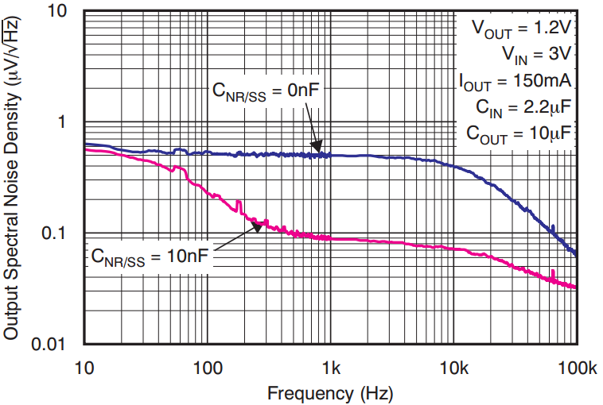
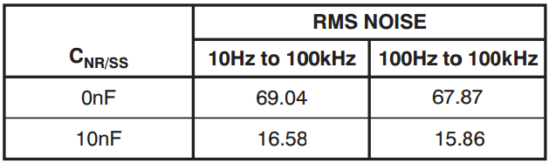
C_{NR} Effect on Noise
Installing a small noise reduction cap can make a big difference in the output noise of an LDO
The below graph shows the TPS7A4901 noise with and without a noise reduction cap

Slide 7
C_{FF} Reduces Noise
The noise at the output of an LDO is dominated by the noise of the reference, this noise is amplified by the closed loop gain set by R1 and R2.
A feedforward cap can be used to attenuate the gain of the reference noise at higher frequencies

Slide 8
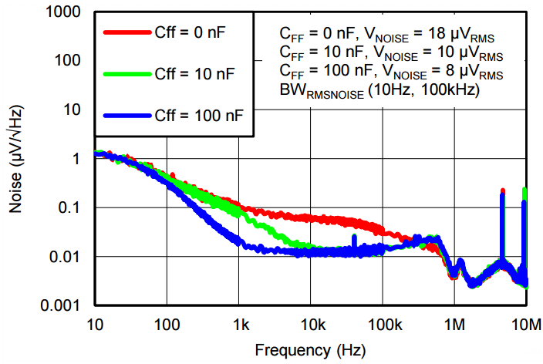
C_{FF} Effect on Noise
Installing a small feedforward cap can make difference in the output noise of an LDO
The below graph shows the TPS7A8300 noise with various feedforward caps

Slide 9
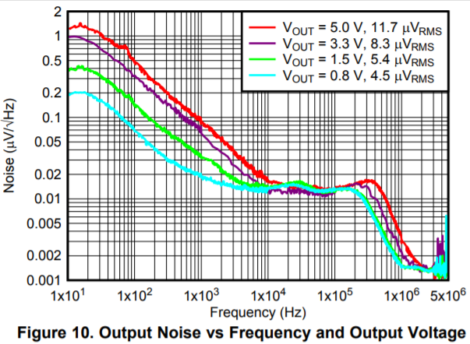
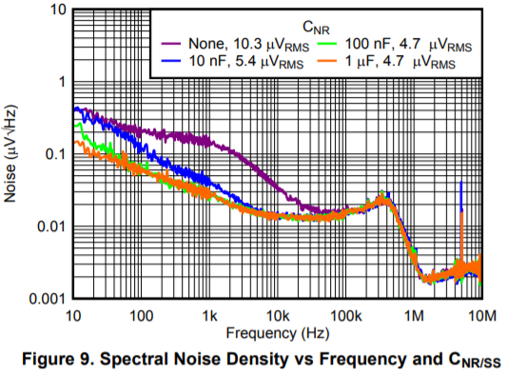
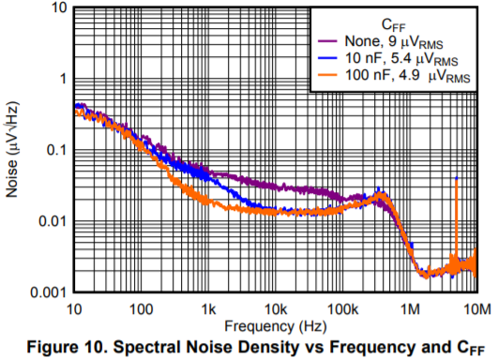
What Conditions Effect Noise
Number one thing that effects noise performance is the output voltage
The next thing that effects noise is the noise reduction capacitor
And the final thing that effects noise to a large degree is the feedforward capacitor

Slide 10
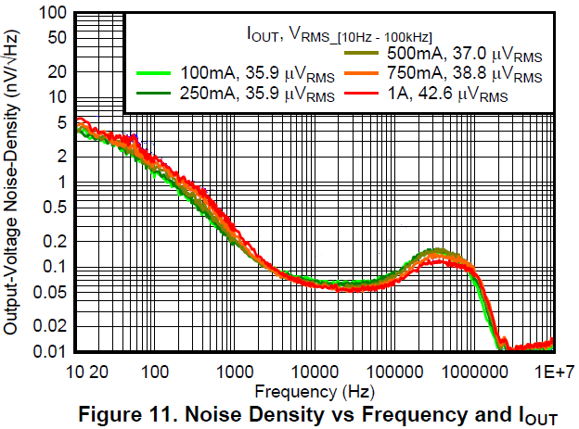
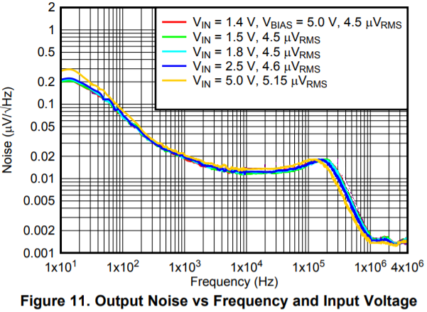
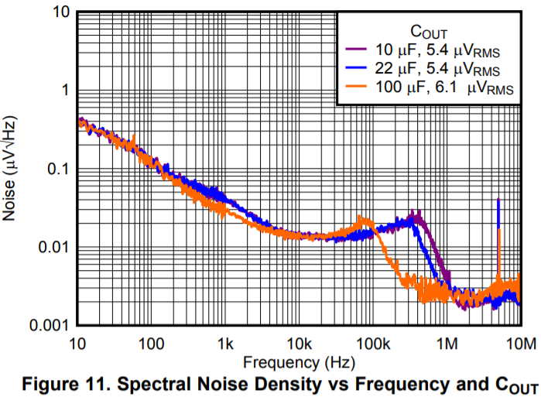
What Conditions Do Not Effect Noise
Number one thing that has almost no effect on noise is output current
The next thing that has very little effect on noise is Vin
And the final thing that has a small effect on noise is output capacitor
(very large Cout can show some difference)

Slide 11
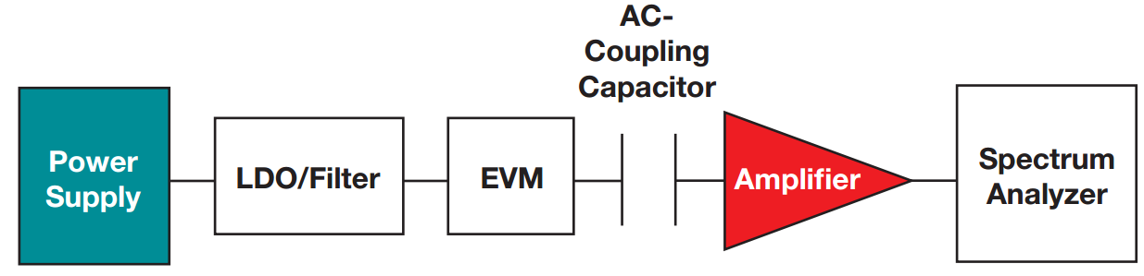
Noise Measurement Block Diagram

Slide 12
Noise Measurement Block Diagram
Bench top supply
or battery

Slide 13
Noise Measurement Block Diagram
OPTIONAL
Some sort of filter used
to clean up power supply
Bench top supply
or battery

Slide 14
Noise Measurement Block Diagram
OPTIONAL
Some sort of filter used
to clean up power supply
Bench top supply
or battery
Evaluation module of
LDO to be tested

Slide 15
Noise Measurement Block Diagram
OPTIONAL
Some sort of filter used
to clean up power supply
Used to block
DC voltage
Bench top supply
or battery
Evaluation module of
LDO to be tested

Slide 16
Noise Measurement Block Diagram
OPTIONAL
Some sort of filter used
to clean up power supply
Used to block
DC voltage
Bench top supply
or battery
Evaluation module of
LDO to be tested
OPTIONAL
Amplifier used for
gaining up small signals

Slide 17
Noise Measurement Block Diagram
OPTIONAL
Some sort of filter used
to clean up power supply
Bench top equipment
Used to block
DC voltage
Bench top supply
or battery
Evaluation module of
LDO to be tested
OPTIONAL
Amplifier used for
gaining up small signals

Slide 18
Power Supplies & Filtering
Ideally the input power supply should be a battery to minimize the noise coming from the supply.
Any noise on the input is attenuated by the power supply rejection ratio (PSRR) of the LDO but will still contribute to the output noise
Batteries aren’t always feasible with high current measurements
Typical bench top power supplies are very noisy with large spikes in the spectral noise plot at the line cycle (50Hz or 60Hz) and the switching frequency of the internal switching regulator
You need to filter the input of the LDO being tested.
Pi-filters are great for switching noise but these get rather large in order to filter out line frequency noise
LDOs are great for line cycle noise, but some LDO’s don’t have enough PSRR at the switching frequency to adequately attenuate the noise coming from the power supply
Make sure to select an LDO with a low output noise itself
TPS7A8300 or the TPS7A4700 may be good options
Or you can use a combination of a low noise LDO for the line cycle noise and a small pi-filter for the switching noise

Slide 19
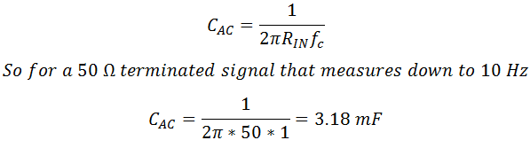
AC Coupling Cap
The AC coupling cap is a large capacitor used to block the DC signal from going to either the amplifier or the spectrum analyzer.
Most spectrum analyzers have voltage or current limitations often requiring that pretty much only the AC signal is transmitted to the equipment
The AC coupling cap should be sized such that the cutoff frequency is approximately an order of magnitude lower than the lowest frequency to be measured.

Slide 20
Amplifier
For low noise LDOs where the noise of the LDO approaches the noise floor of the spectrum analyzer an amplifier can be used to effectively increase the resolution of the spectrum analyzer
This amplifier should be low noise as its input-referred noise will be gained up by the closed loop gain of the circuit.
You will need to select an amplifier with a gain bandwidth product that is suitable to your frequency range and the amount of gain required.
The power rails of the amplifier will also need to be filtered otherwise the power supply noise will go straight to the output of the amplifier attenuated only by the PSRR of the amplifier.
If the output noise of the LDO is only slightly higher than the noise floor and you don’t use an amplifier the noise floor will significantly increase the measured value of the LDO noise.

Slide 21
Noise Floor’s Affects on Measurements
A general rule of thumb is that the noise density of the measured device should be ten times larger than the effective noise floor of the test setup.
This will keep the contribution of the noise floor to your measurement below 0.5%.
Where:
N_{DUT} is the noise density of the LDO
N_{NF} is the noise density test setups noise floor
x is the ratio of N_{DUT}/ N_{NF}

Slide 22
Shielding
It is important to place the test equipment inside a grounded copper box and use shielded cables whenever possible.
The wires connecting to the positive and negative terminals of the power supply create large inductive loops which are susceptible to picking up environmental noise.
It is important to use BNC or SMA connectors whenever feasible
If shielded cables are not available keep the wires as short as possible and twist the positive and negative wires together to minimize the inductive loop

Slide 23
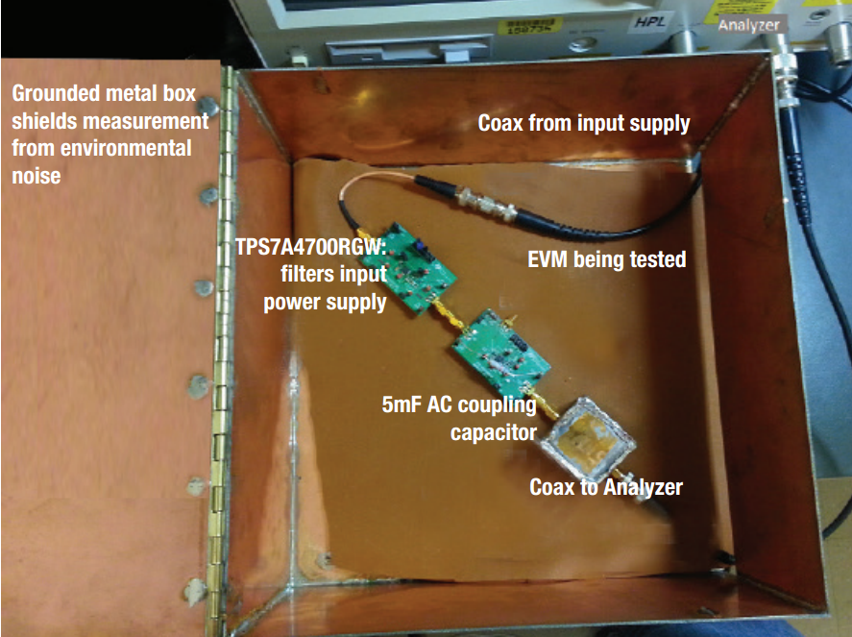
Shielding

Slide 24
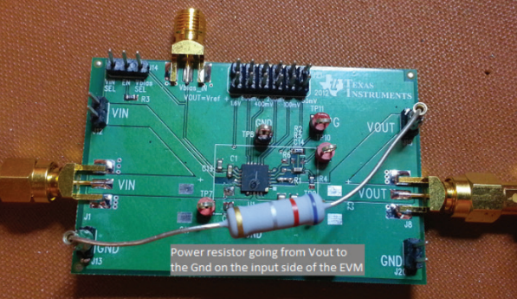
EVM/Board Setup
Use a resistive load
Electronic loads will introduce their own noise to the measurement
If using a small board for test purposes, ground the load as close to the negative terminal of the input supply on the board as possible.
Helps avoid excessive noise on the ground plane of small boards
Use SMA or BNC connections
If the board does not come with any standard, you can usually solder an SMA connector across the LDO’s output cap.
Beware this is a fragile arrangement and may rip the cap and its pads off the test board.

Slide 25
Analyzer Settings
The resolution bandwidth sets the width of the bandpass filter on the input and should be at least an order of magnitude smaller than the frequency you are measuring
However, the lower the resolution bandwidth the longer the measurement will take.
Some analyzers have an Auto feature which will automatically increase the resolution bandwidth as the measured frequency increases. This can decrease test time significantly
Due to the inherent fluctuations in the output noise’s magnitude it is important to average several sweeps to get a clear picture of the output noise.
We typically use between 25 and 50 averages when we make noise measurements.
If your spectrum analyzer is capable of it, set the sweep type to logarithmic sweep
This will keep the step sizes reasonable as it sweeps across large frequency ranges
If your analyzer can only do linear sweeps you may need to break up the measurement into several runs to ensure you have good step sizes across all your swept frequencies

Slide 26
How to Measure Noise White Paper
You can go to http://www.ti.com/lit/wp/slyy076/slyy076.pdf
Or you can do a Google search for “TI How to Measure LDO Noise” and it should be in the top 5 results
If you add my first name (Kyle) to that search it should be the top result

Slide 27
Questions?

