Slide 1
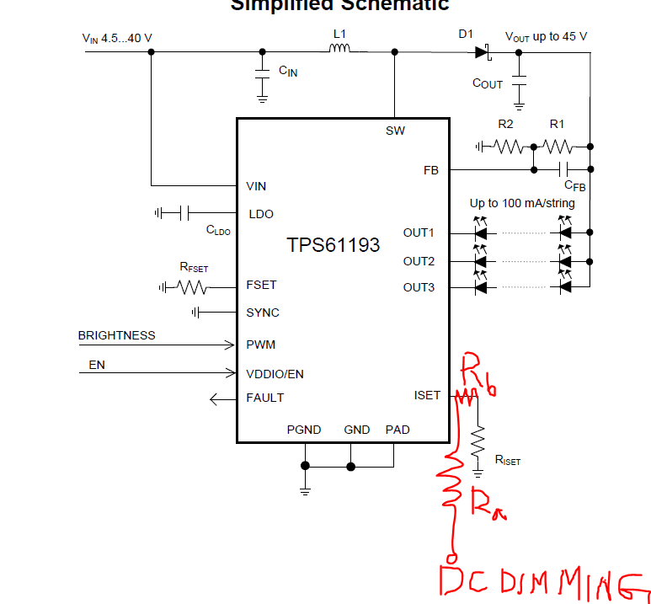
The proposal is :
When increasing the dimming voltage, the output current is reduce.
Ra and Rb must be set according to the input analog volatge.

