Slide 1
OS6870-UCD9090 Power Sequence On/Off Setting

Slide 2
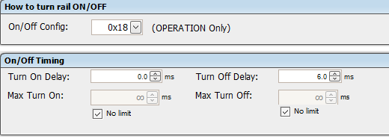
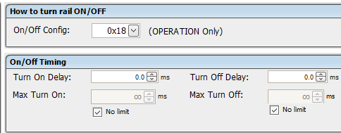
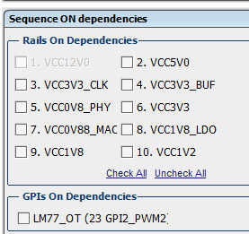
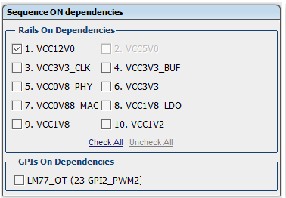
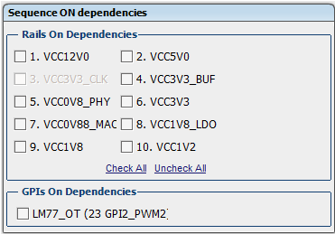
Power sequence on: 12V->5V&3.3_CLK&3.3_BUF->0.8V->3.3V&1.8V_LDO&2.5V->0.88V->1.8V->1.2V
5V,
3.3V_CLK&3.3V_BUF DC to DC IC是吃5V的電壓
12V
3.3V_CLK&3.3V_BUF

Slide 3
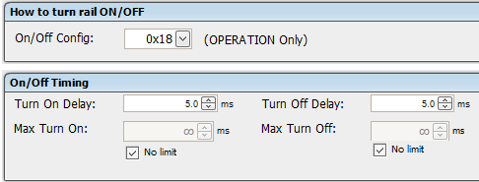
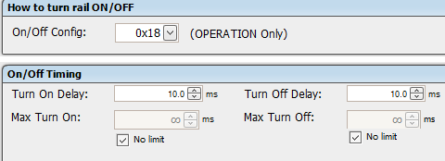
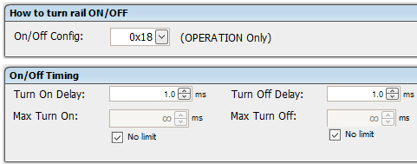
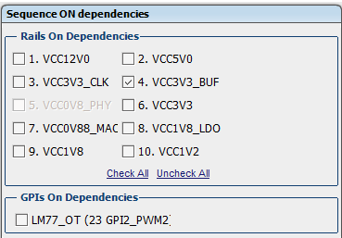
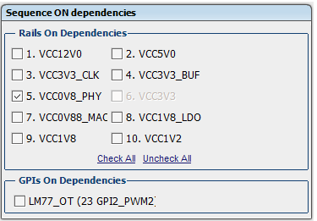
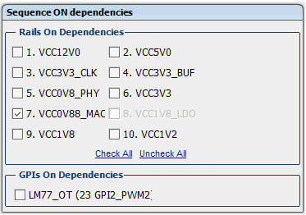
Power sequence on: 12V->5V&3.3_CLK&3.3_BUF->0.8V->3.3V&1.8V_LDO&2.5V->0.88V->1.8V->1.2V
0.8V
3.3V,
1.8V_LOD 是吃3.3V的輸入電壓
1.8V_LDO

Slide 4
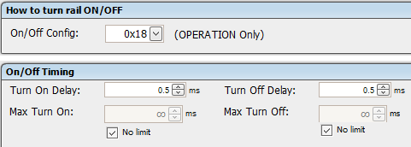
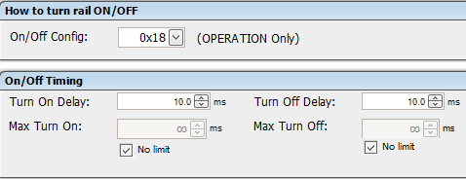
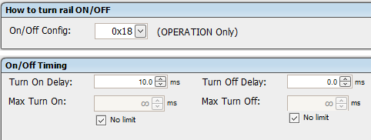
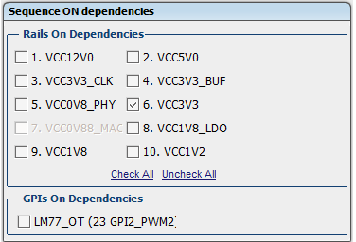
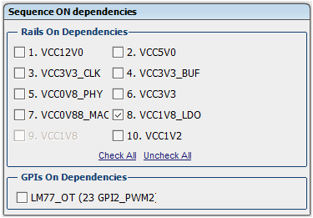
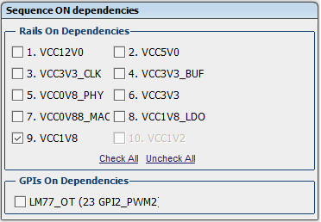
Power sequence on: 12V->5V&3.3_CLK&3.3_BUF->0.8V->3.3V&1.8V_LDO&2.5V->0.88V->1.8V->1.2V
0.88V
1.8V
1.2V

Slide 5
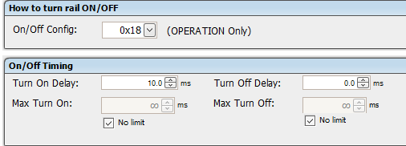
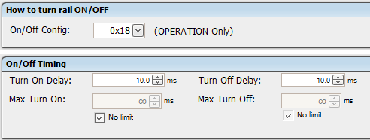
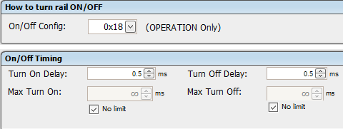
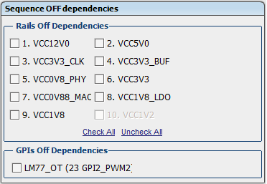
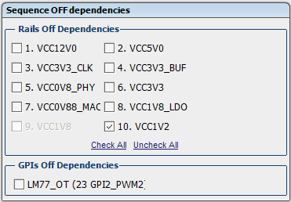
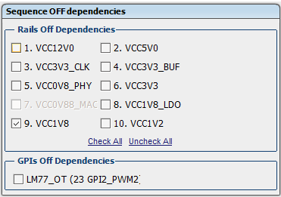
Power sequence off: 1.2V->1.8V->0.88V->3.3V&1.8V_LDO&2.5V->0.8V->5V&3.3V_CLK&3.3V_BUF->12V
1.2V
1.8V
0.88V

Slide 6
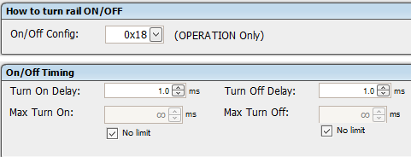
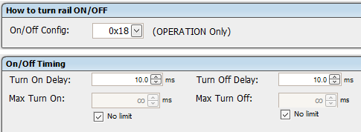
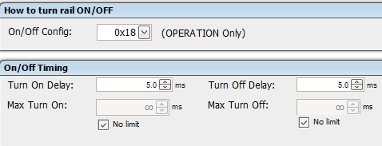
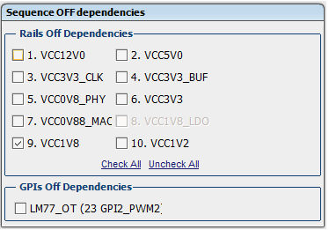
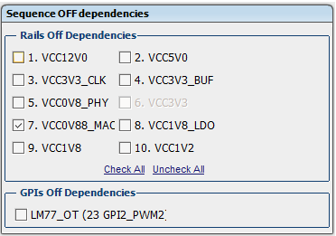
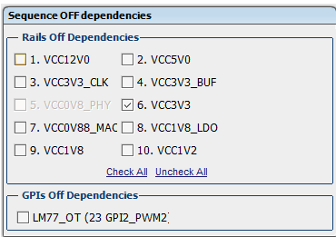
Power sequence off: 1.2V->1.8V->0.88V->3.3V&1.8V_LDO&2.5V->0.8V->5V&3.3V_CLK&3.3V_BUF->12V
3.3V,
1.8V_LOD 是吃3.3V的輸入電壓
1.8V_LDO
0.8V

Slide 7
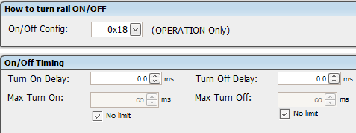
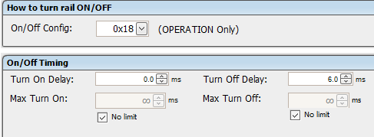
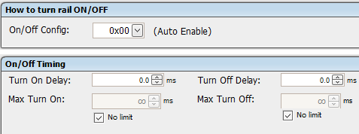
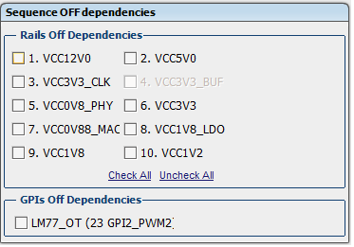
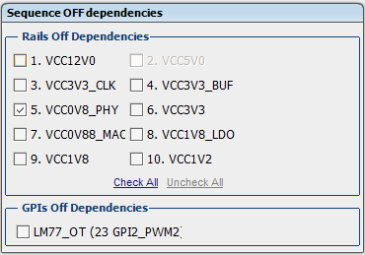
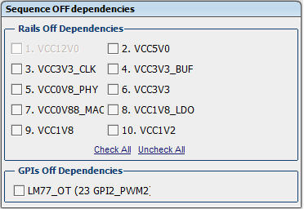
Power sequence off: 1.2V->1.8V->0.88V->3.3V&1.8V_LDO&2.5V->0.8V->5V&3.3V_CLK&3.3V_BUF->12V
5V,
3.3V_CLK&3.3V_BUF DC to DC IC是吃5V的電壓
3.3V_CLK&3.3V_BUF
12V

Slide 8
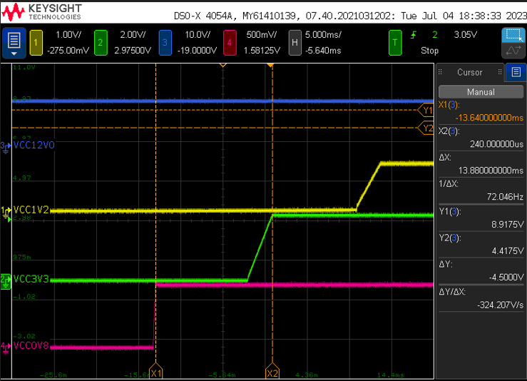
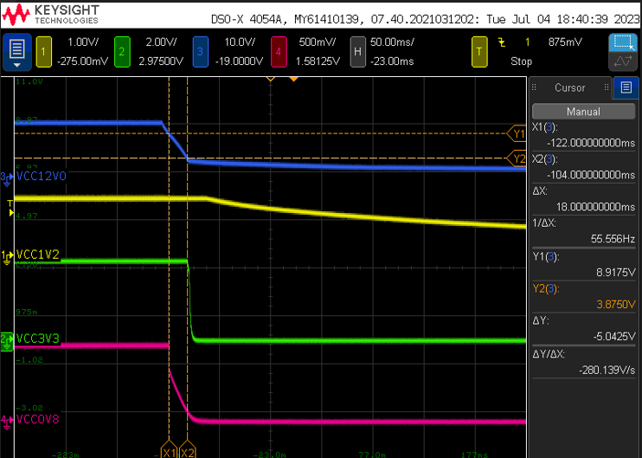
UCD9090在設定power sequence on時序是pass,但是power sequence off時序是fail,並不是如使用手冊描述的一樣
下圖分別是power sequence on跟power sequence off,只有量測12V,0.8V,3.3V,1.2V
power sequence on
power sequence off

Slide 9
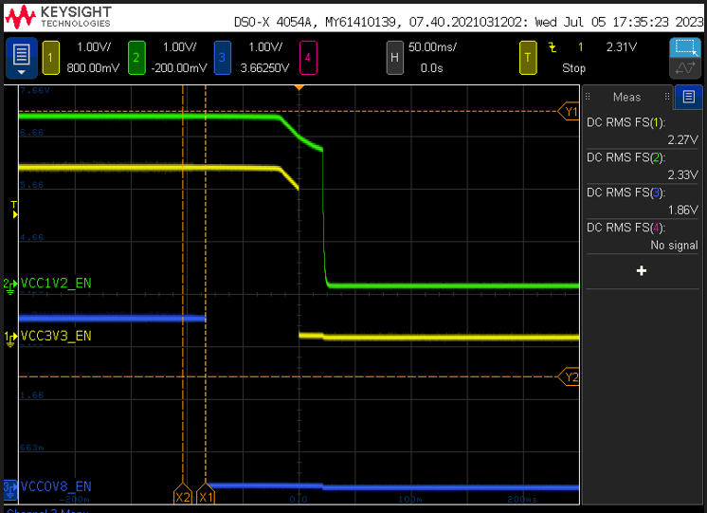
並且有量測Enable pin,可得到0.8V_EN比較早drop,然後是3V3_EN,最後是1.2V_EN
跟量測的power down sequence是一樣的

