Slide 1
OTP TEST of the TPS25850
Kuno Wu
2021.11.16

Slide 2
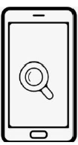
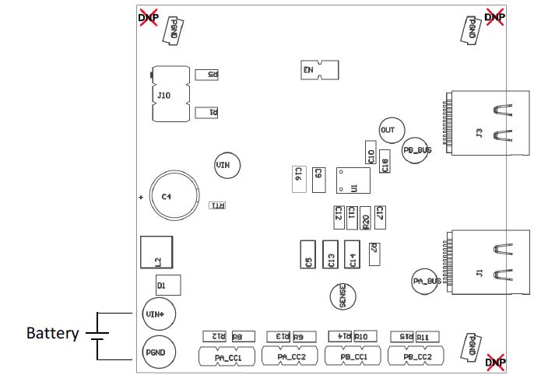
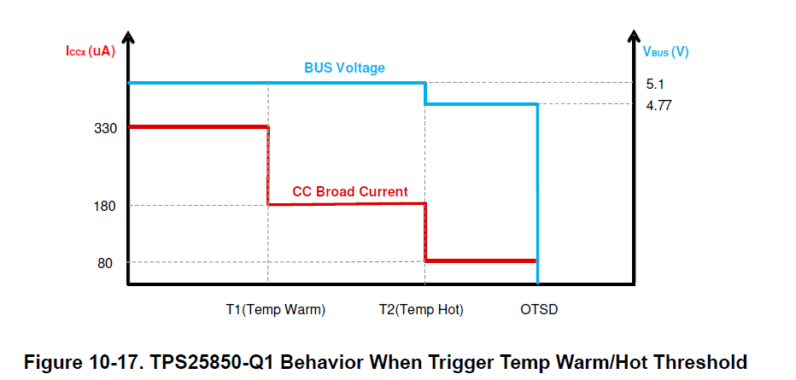
Test System Block Diagram:
Power:be use to create a OTP signal
TPS25850 EVM
Phone
V
I
C2:VBUS
C2:CC1
C3:IOUT
V
Notes:
WV USB Controller: TAM based on USB port, estimate 325Mu Car charging port in 2020, AUP 0.55;
USB Power Switch: TAM based on TV 424Mu $15M, NB 275Mu $15M, SB 400Mu $20M, other PE = $60M, Comms $0, industry $30M, Car power switch, $30M
USB Protection: TAM based Cell phone 1.5B $100M, Other portable device (E-Cigarrete 100M, Smart watch xx) 500Mu $35M; Car STB 97Mu $30M; HDMI $15M

Slide 3
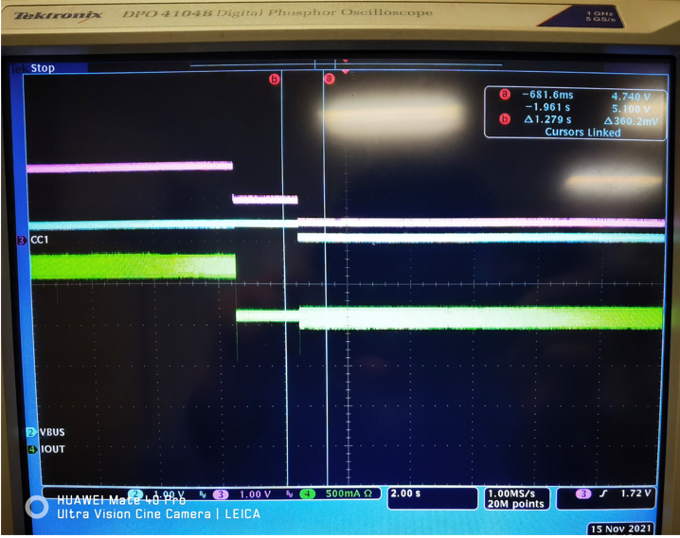
Test Result: Phone Types:Google
First Step:
OTP is 0V,VBUS is 5V，IOUT is 2.3A;
Second Step
:OTP is 2.55V, VBUS is 5V,IOUT is 1.5A.
Third Step:
OTP is 3.315V,VBUS is 4.75V,IOUT is 1.5A.
C2:VBUS
C2:CC1
C3:IOUT
Notes:
WV USB Controller: TAM based on USB port, estimate 325Mu Car charging port in 2020, AUP 0.55;
USB Power Switch: TAM based on TV 424Mu $15M, NB 275Mu $15M, SB 400Mu $20M, other PE = $60M, Comms $0, industry $30M, Car power switch, $30M
USB Protection: TAM based Cell phone 1.5B $100M, Other portable device (E-Cigarrete 100M, Smart watch xx) 500Mu $35M; Car STB 97Mu $30M; HDMI $15M

Slide 4
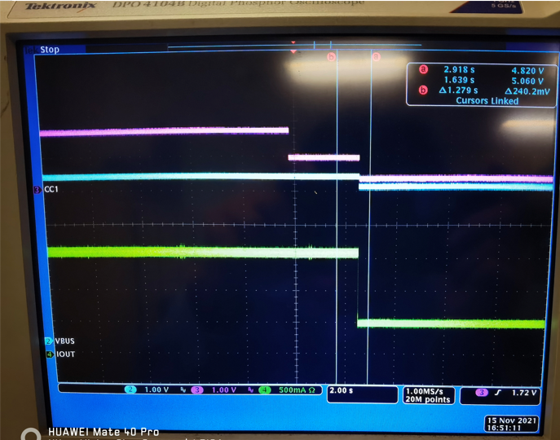
Test Result: Phone Types:Huawei nova4
First Step:
OTP is 0V,VBUS is 5V，IOUT is 1.5A;
Second Step
:OTP is 2.55V, VBUS is 5V,IOUT is 1.5A.
Third Step:
OTP is 3.315V,VBUS is 4.75V,IOUT is 0.5A.
C2:VBUS
C2:CC1
C3:IOUT
Notes:
WV USB Controller: TAM based on USB port, estimate 325Mu Car charging port in 2020, AUP 0.55;
USB Power Switch: TAM based on TV 424Mu $15M, NB 275Mu $15M, SB 400Mu $20M, other PE = $60M, Comms $0, industry $30M, Car power switch, $30M
USB Protection: TAM based Cell phone 1.5B $100M, Other portable device (E-Cigarrete 100M, Smart watch xx) 500Mu $35M; Car STB 97Mu $30M; HDMI $15M

Slide 5
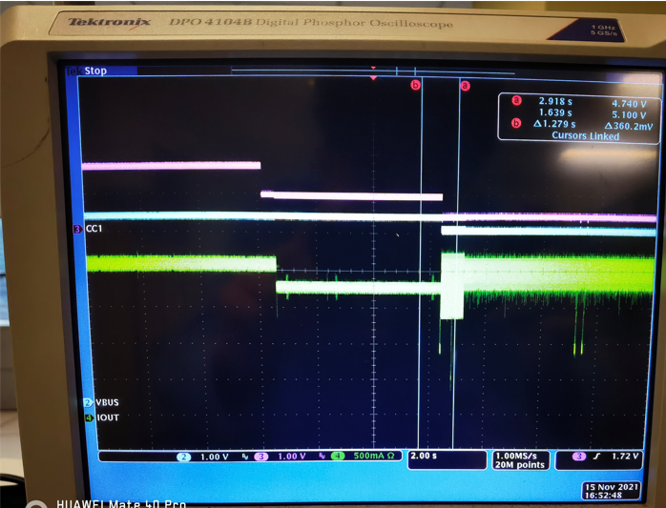
Test Result: Phone Types:Huawei P30
First Step:
OTP is 0V,VBUS is 5V，IOUT is 2.0A;
Second Step
:OTP is 2.55V, VBUS is 5V,IOUT is 1.5A.
Third Step:
OTP is 3.315V,VBUS is 4.75V,IOUT is 2.0A.
C2:VBUS
C2:CC1
C3:IOUT
Notes:
WV USB Controller: TAM based on USB port, estimate 325Mu Car charging port in 2020, AUP 0.55;
USB Power Switch: TAM based on TV 424Mu $15M, NB 275Mu $15M, SB 400Mu $20M, other PE = $60M, Comms $0, industry $30M, Car power switch, $30M
USB Protection: TAM based Cell phone 1.5B $100M, Other portable device (E-Cigarrete 100M, Smart watch xx) 500Mu $35M; Car STB 97Mu $30M; HDMI $15M

Slide 6
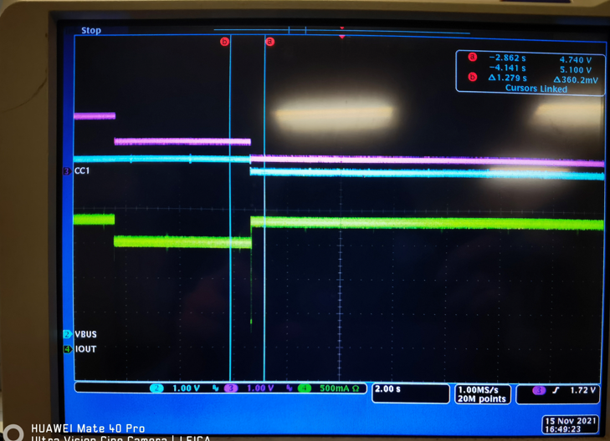
Test Result： Phone Types：Huawei Mate20 pro
First Step:
OTP is 0V,VBUS is 5V，IOUT is 2.0A;
Second Step
:OTP is 2.55V, VBUS is 5V,IOUT is 1.5A.
Third Step:
OTP is 3.315V,VBUS is 4.75V,IOUT is 2.0A.
C2:VBUS
C2:CC1
C3:IOUT
Notes:
WV USB Controller: TAM based on USB port, estimate 325Mu Car charging port in 2020, AUP 0.55;
USB Power Switch: TAM based on TV 424Mu $15M, NB 275Mu $15M, SB 400Mu $20M, other PE = $60M, Comms $0, industry $30M, Car power switch, $30M
USB Protection: TAM based Cell phone 1.5B $100M, Other portable device (E-Cigarrete 100M, Smart watch xx) 500Mu $35M; Car STB 97Mu $30M; HDMI $15M

Slide 7
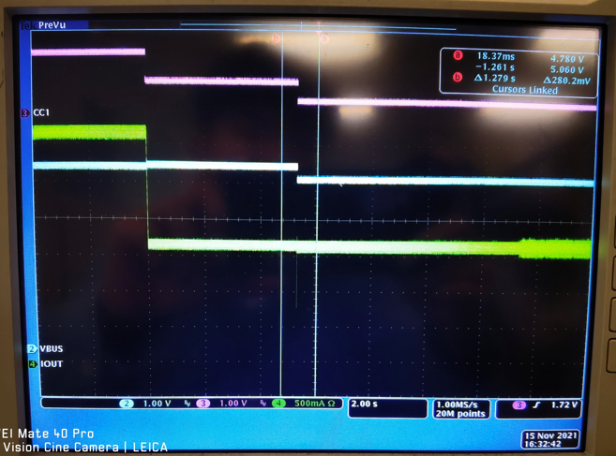
Test Result： Phone Types：APPLE IPAD
First Step:
OTP is 0V,VBUS is 5V，IOUT is 3.2A;
Second Step
:OTP is 2.55V, VBUS is 5V,IOUT is 1.5A.
Third Step:
OTP is 3.315V,VBUS is 4.75V,IOUT is 1.5A.
C2:VBUS
C2:CC1
C3:IOUT
Notes:
WV USB Controller: TAM based on USB port, estimate 325Mu Car charging port in 2020, AUP 0.55;
USB Power Switch: TAM based on TV 424Mu $15M, NB 275Mu $15M, SB 400Mu $20M, other PE = $60M, Comms $0, industry $30M, Car power switch, $30M
USB Protection: TAM based Cell phone 1.5B $100M, Other portable device (E-Cigarrete 100M, Smart watch xx) 500Mu $35M; Car STB 97Mu $30M; HDMI $15M

Slide 8
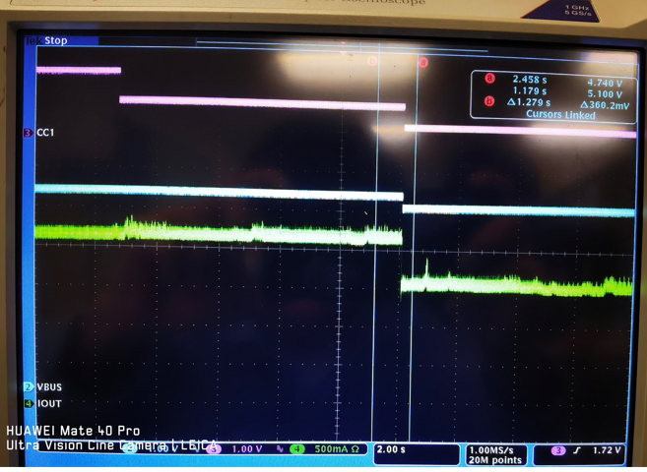
Test Result： Phone Types：APPLE IPHONE SE
First Step:
OTP is 0V,VBUS is 5V，IOUT is 2.1A;
Second Step
:OTP is 2.55V, VBUS is 5V,IOUT is 2.1A.
Third Step:
OTP is 3.315V,VBUS is 4.75V,IOUT is 1.5A.
C2:VBUS
C2:CC1
C3:IOUT
Notes:
WV USB Controller: TAM based on USB port, estimate 325Mu Car charging port in 2020, AUP 0.55;
USB Power Switch: TAM based on TV 424Mu $15M, NB 275Mu $15M, SB 400Mu $20M, other PE = $60M, Comms $0, industry $30M, Car power switch, $30M
USB Protection: TAM based Cell phone 1.5B $100M, Other portable device (E-Cigarrete 100M, Smart watch xx) 500Mu $35M; Car STB 97Mu $30M; HDMI $15M

Slide 9
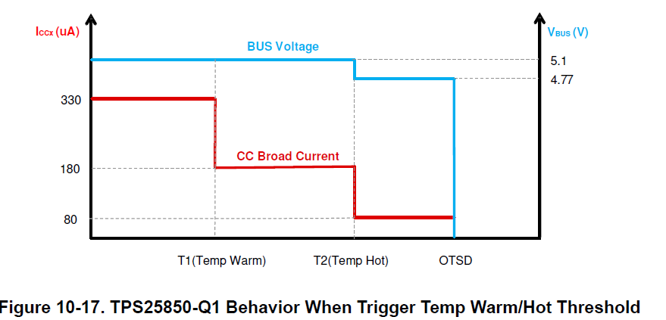
Summary： 1.For the device TPS25850,its OTP behavior is the same as the datasheet. 2.For the mobile phone charging current when the device TPS25850 is OTP,it depends on the manufacturer,some will decrease the charging current,others will increase.
Notes:
WV USB Controller: TAM based on USB port, estimate 325Mu Car charging port in 2020, AUP 0.55;
USB Power Switch: TAM based on TV 424Mu $15M, NB 275Mu $15M, SB 400Mu $20M, other PE = $60M, Comms $0, industry $30M, Car power switch, $30M
USB Protection: TAM based Cell phone 1.5B $100M, Other portable device (E-Cigarrete 100M, Smart watch xx) 500Mu $35M; Car STB 97Mu $30M; HDMI $15M

Slide 10
Remove DP&DM,Only Type C
Summary： 1.For the APPLE,when the TPS25850 go to the ‘HOT’,it will stop to charging. 2.For the Huawei,the charge current will become lower.
3.For the Google,it is the same with the DP&DM exist.
4.Starting to charge is faster.

Slide 11
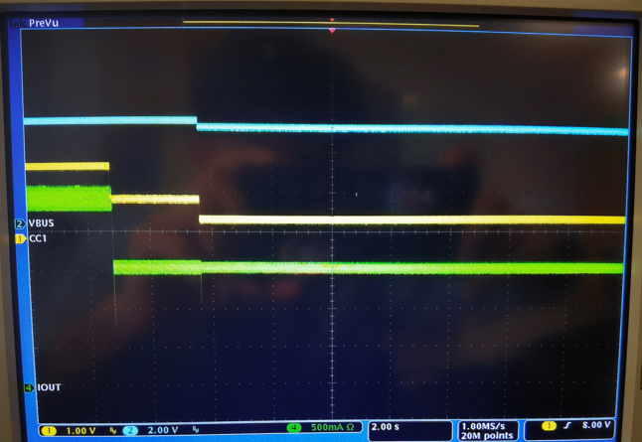
Test Result: Phone Types:Google
It is the same as the DP&DM exist

Slide 12
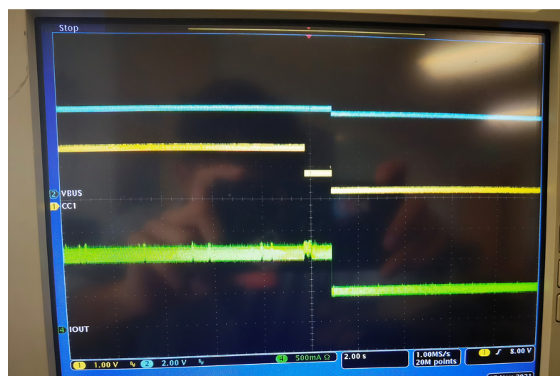
Test Result: Phone Types:Huawei nova4
Charging current become lower.

Slide 13
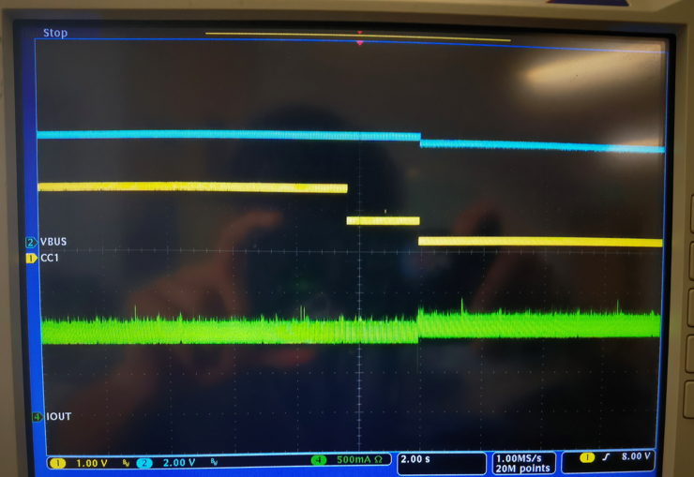
Test Result: Phone Types:Huawei P30
Charging current become lower.

Slide 14
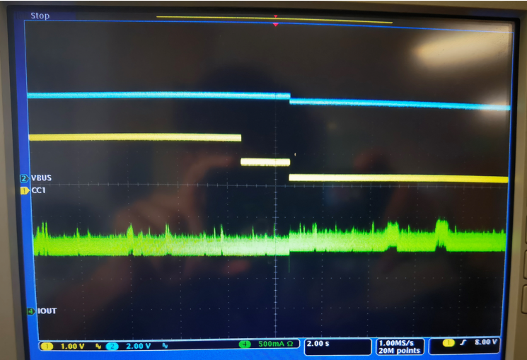
Test Result: Phone Types:Huawei Mate20 Pro
Charging current become lower.

Slide 15
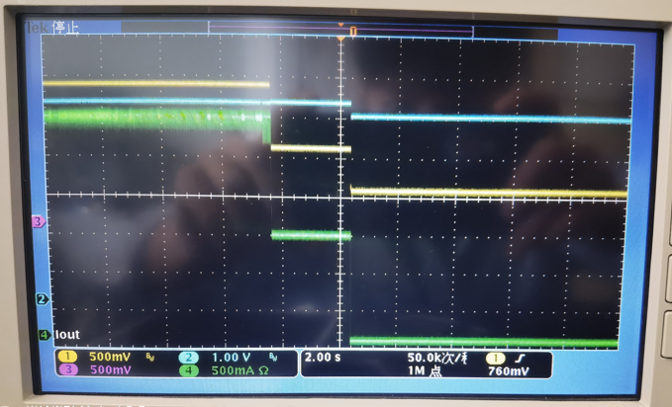
Test Result: Phone Types:IPAD
Charging current is the same as the OTP isn’t ‘HOT’,when it is ‘HOT’,the charging current become zero.

Slide 16
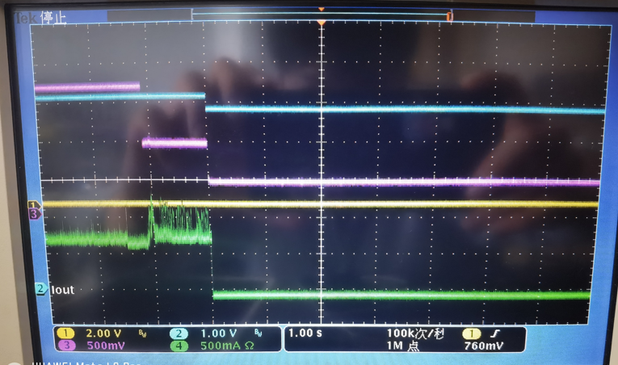
Test Result: Phone Types:Iphone SE2
Charging current is the same as the OTP isn’t ‘HOT’,when it is ‘HOT’,the charging current become zero.

