Slide 1
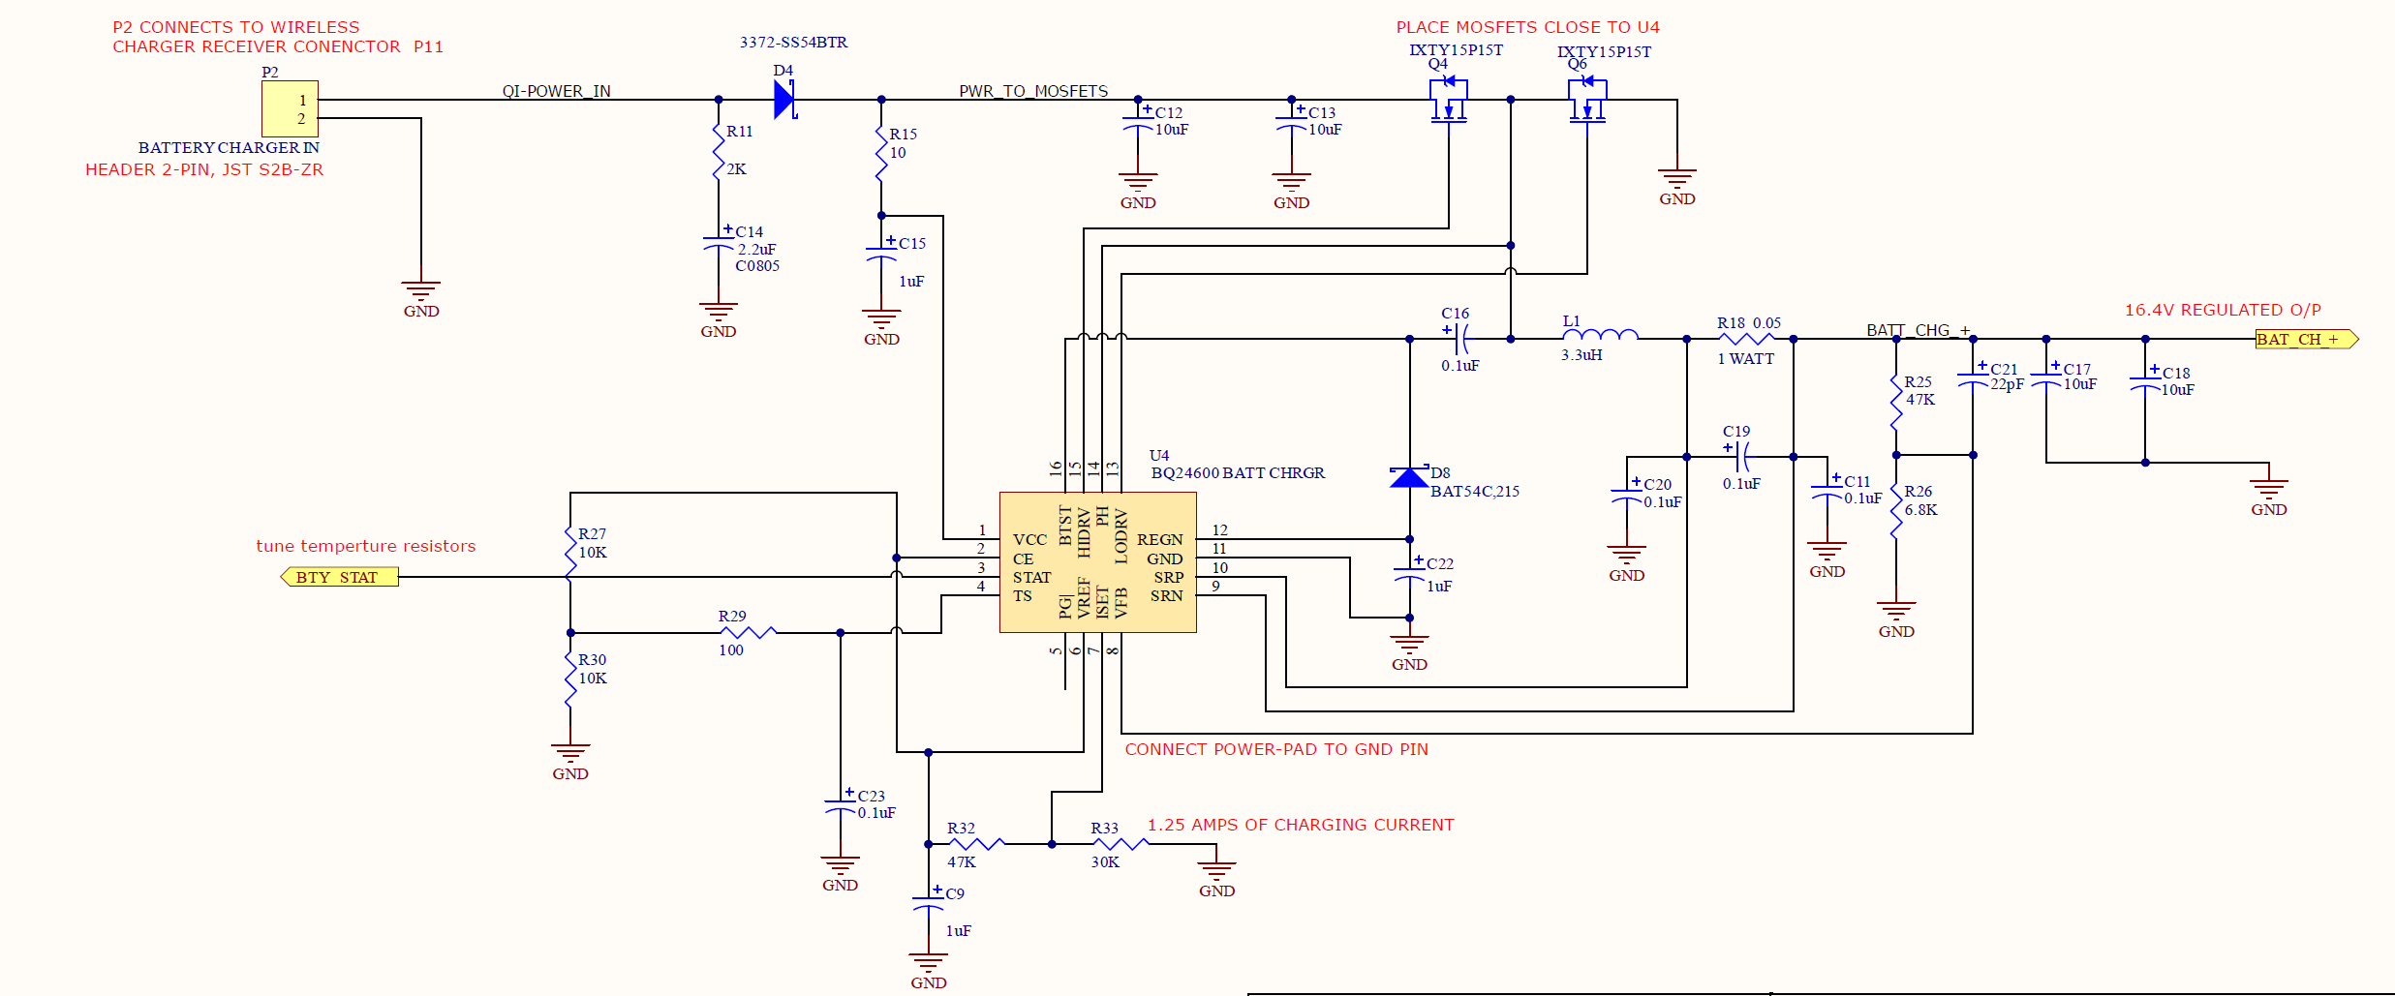
See waveforms at A, B and C in next slides
A
B
C
4S Li-ion (18650) battery is always connected to output. Between BAT_CH_+ & GND

Slide 2
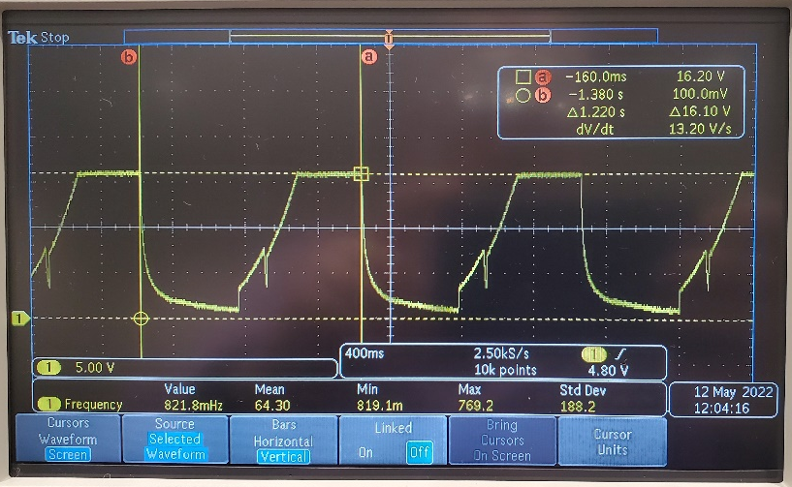
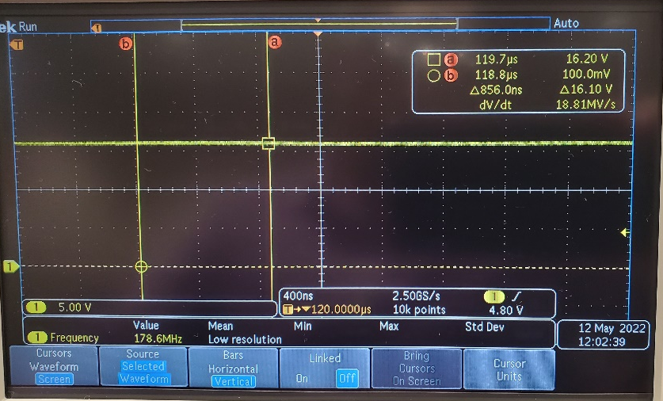
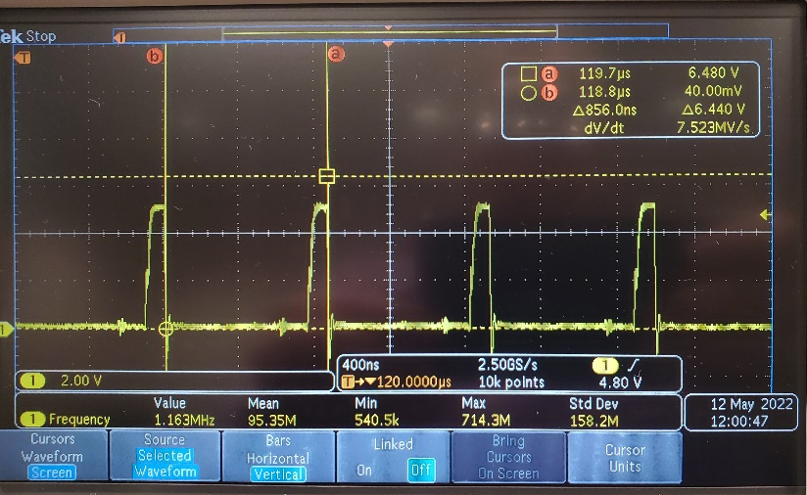
Initially, on Powering up of BQ24600 IC, the output (at point C) is not stable it rises to 16.4V which is my charging voltage and then drops down to almost zero and starts back up. This happens every 1.2 seconds.and appears as follows:
After shorting R26, the output (at point C) becomes stable and always equal to the battery voltage. If the battery is drained to 12VDC, the output of the IC is 12V. If the battery is charged, it would stabilize at 16.4VDC. Charging current is always zero.
Waveform at point B (lo-side MOSFET Gate) when the output is stable.

Slide 3
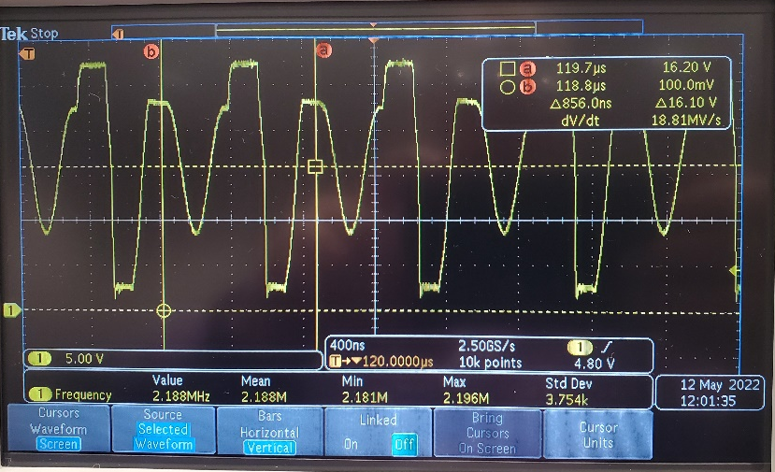
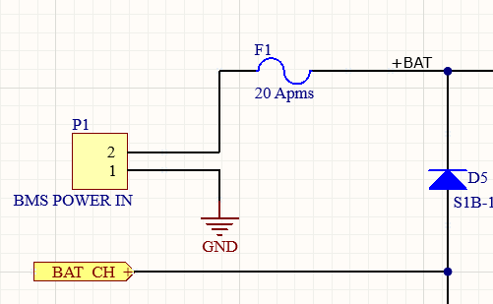
Waveform at point A (High Side Mosfet Gate) when the output is stable. I have my doubts here. This does not seem to be a proper switching waveform for a MOSFET gate.
The BAT_CH_+ terminal in schematic in previous slide connects to the battery via D5 and F1. Waveform at point A is before D5 so it is going up and down so fast.
P1 header connects to the battery (always connected). Battery has a built-in BMS (Not designed by me). Usually, as soon as any charger is connected to the Battery pack, charging begins, so I am not worried about the charge-MOSFET on the BMS being in OFF-state.
(The +BAT line proceeding to the right connects to a power-P-MOSFET, that supplies power to MCU and intelligence.
The BAT_CH_+ line proceeding downwards, switches on a transistor that switches on the P-MOSFET. )

Slide 4
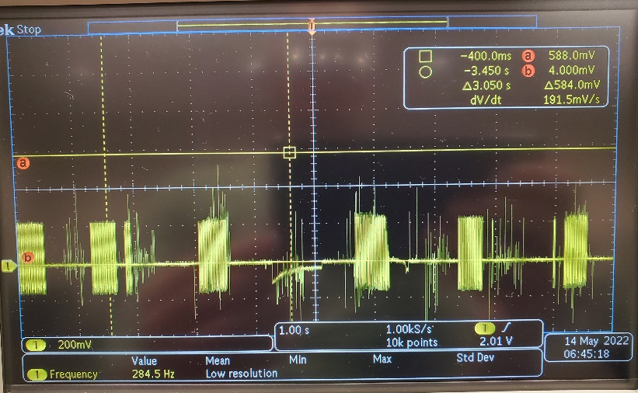
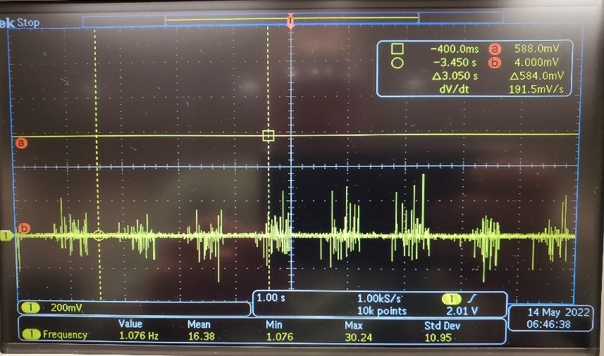
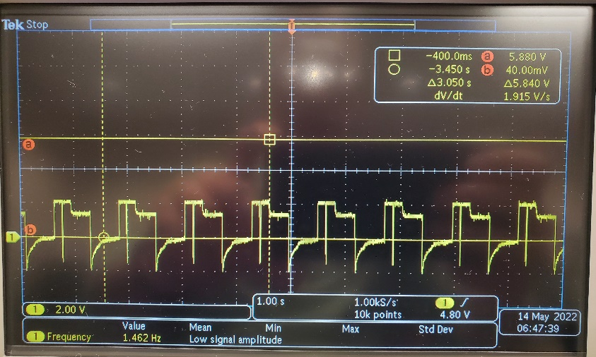
BEFORE SHORTING Vfb PIN TO GROUND
STAT – Pin
PG(BAR) Pin
Vfb PIN

Slide 5
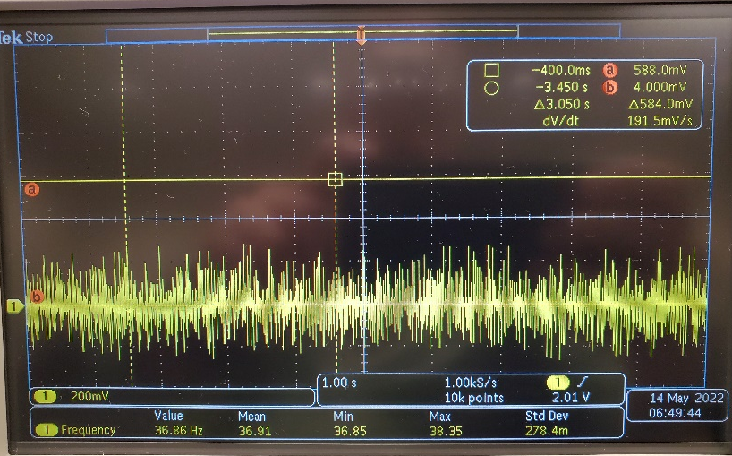
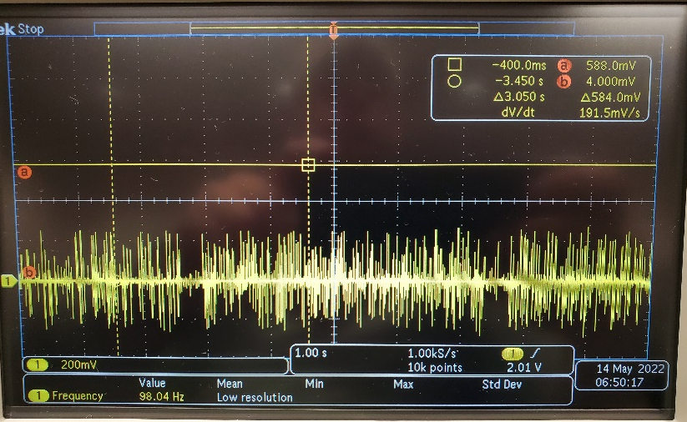
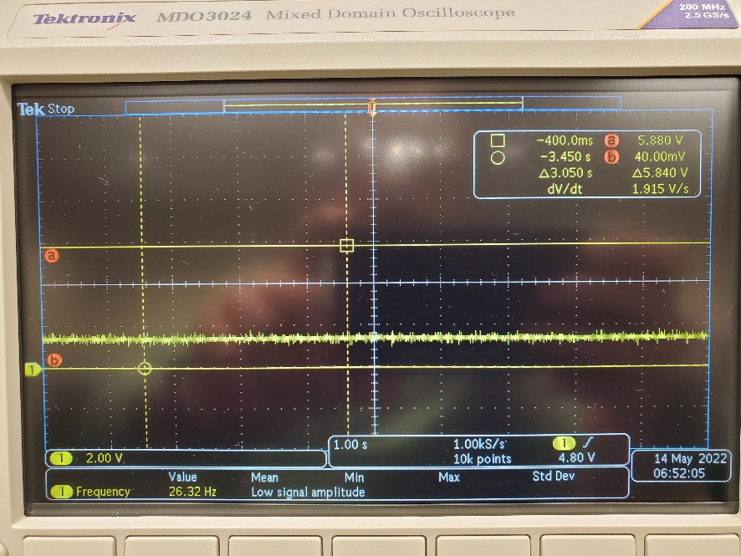
AFTER SHORTING Vfb PIN TO GROUND
(Emphasis on Shorted for at least aprox. 1 second)
STAT – Pin
PG(BAR) Pin
Vfb PIN
(1.3vdc)

