Slide 1
Instructions:
This IC (TPS61176)is used in the mass production project. The backlight flickers when the abnormality occurs(Backlight current fluctuation);
EN is fixed level input;
Appendix 1: PCBA circuit design schematic diagram
Appendix 2: PCBA layout schematic diagram
Appendix 1
Appendix 2

Slide 2
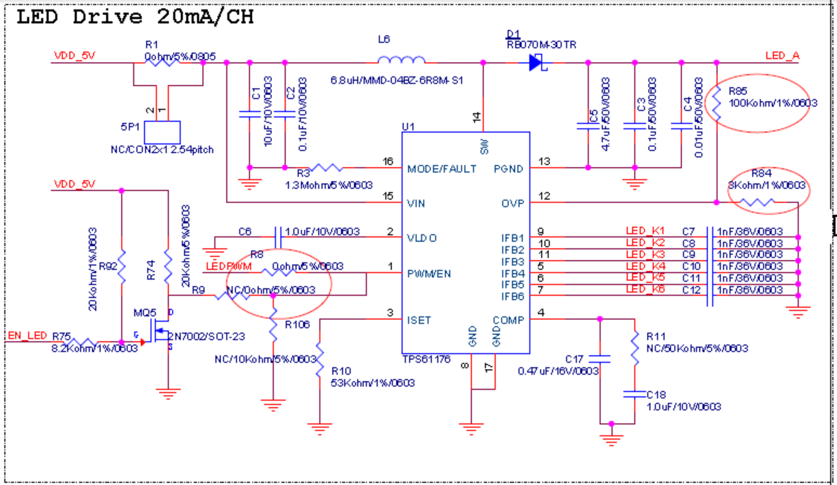
For TPS61176 chip, the current EN pin voltage we use is about 1.7V (as shown in the red box below). Under this condition, when the output channel is > = 3 (the total output current is about 60mA), the problem of backlight flash caused by unstable output current is likely to occur (there is no flash problem for 40mA output).
When the EN pin voltage is increased to 1.8 ~ 3.3, the flicker will disappear. In the specification, the EN pin voltage is more than 1.2V. Please help to see if there are restrictions in other parts of the chip.

Slide 3
Experiment item:
1、 Flash screen voltage of test board
 | When the backlight flashes, the voltage of U1 1pin connected to the ground |  | When the backlight does not flash, the voltage of U1 1pin connected to the ground
Normal PCBA | <0.8V | 1.35V-1.56V | 0.8V-1.35V | 1.56V-3.3V
Abnormal PCBA | <0.9V | 1.49V-1.7V | 0.9V-1.49V | 1.7V-3.3V
Test instructions: >Connect the black lead of multimeter to J31 pin12
> Red lead connected to R8 connected to U1 side
Note：
1.Remove R8, and supply power to U1 Pin1 through the external filling of power box;
2. IC spec requires that the effective level of enable pin is greater than 1.2V;
3. The voltage provided by the main board to the enable pin of the power board is 1.7V;
Summary:
both OK and ng boards will flash. When the enable pin voltage is lowered, the backlight of the module will flash.

Slide 4
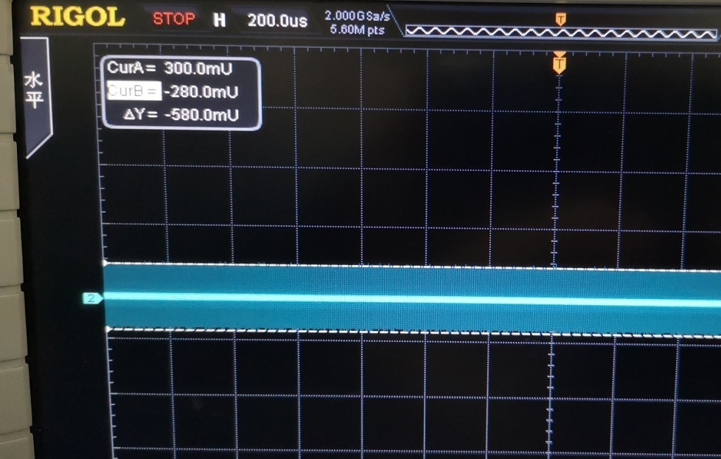
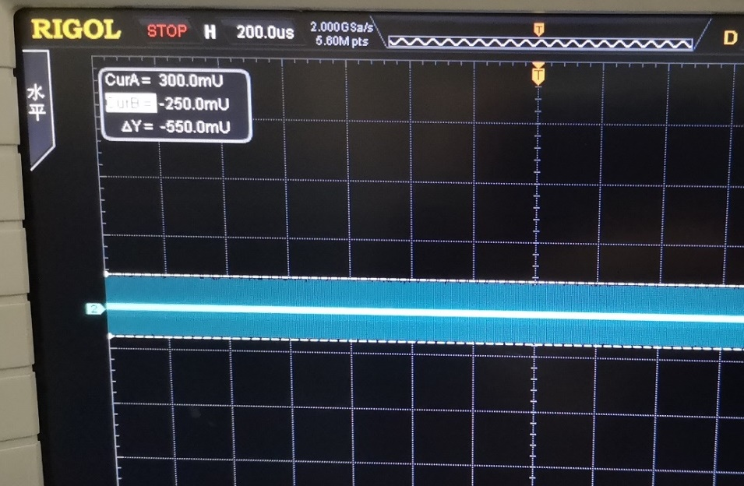
Experiment item:
2、 Test the power supply stability of U1 pin13 (GND of IC)
Abnormal PCBA：
The ripple of U1 pin13 is about 0.58v
Normal PCBA：
The ripple of U1 pin13 is about 0.55v
Test instructions:
>The negative terminal of oscilloscope is connected to pin12 of J31 (input terminal GND of power board). >The positive terminal of oscilloscope is connected to the grounding end of C3 (near U1 pin13)
Summary:
The GND ripple of U1 is large, which may affect the level judgment of U1 enable pin.

Slide 5
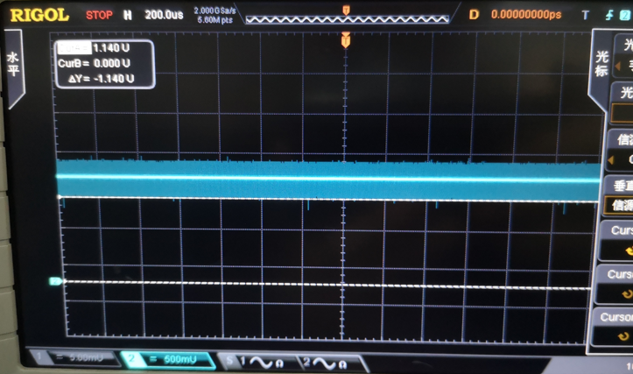
Experiment item:
3.Test the GND level of U1 Pin1 to U1 as follows:
The ripple of U1 Pin1 is about 0.5V

Slide 6
Experiment item:
4. Reduce the backlight current of abnormal PCBA (flashing screen) ：
The resistance of R10 (53kohm / 1% / 0603) increased to 60 ~ 80K Ω, and the backlight current and display status were observed;
Category | Initial test results | R10 Increase to 63.3KΩ | R10 Exchange for 53KΩ | R10 Increase to 100KΩ | R10Exchange for 53KΩ
Abnormal PCBA A | LEDA current value:58.2~59.6 Current fluctuation flashing screen | LEDA current value:50.72，Stable current value Normal picture | Current value from fluctuation to stability Screen flickers to normal | / | /
Abnormal PCBA B | LEDA current value:57.8~59.4 Current fluctuation flashing screen | LEDA current value:50.62 Stable current value Normal picture | LEDA current value: 57.9~58.6 Stable current value flashing screen | / | /
Abnormal PCBA C | LEDA current value:58.3~59.6 Current fluctuation flashing screen | LEDA current value:50.60 Stable current value Normal picture | / | LEDA current value:31.81，Stable current value Normal picture | LEDA current value:59.99 Stable current value Normal picture

Slide 7
Experiment item:
5. Increase the backlight current of normal products: ：
The resistance of R10 (53kohm / 1% / 0603) was reduced to 35K Ω, and the current and screen display were observed;
Category | Initial test results | R10 reduced to38.7KΩ | R10 exchange for 53KΩ
Normal PCBA | LEDA current value:60.2 Stable current value Normal picture | LEDA current value:80.4~82.4 Current fluctuation flashing screen | LEDA current value:60.19 Stable current value Normal picture

