Slide 1
Overshoot with LP8865Y-Q1 in SEMCO
Jun/25 2024

Slide 2
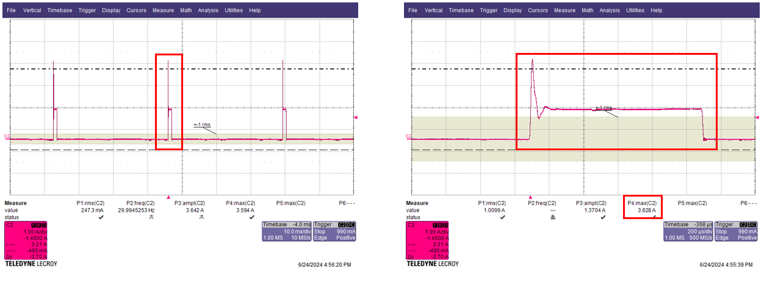
1. LED DRIVER Input Current
- Issue : Overshoot occurs excessively on Turn On
- Normal Current : 1.37A / Overshoot Current : 3.62A
→ is there any soft star function with LP8865Y-Q1?
Every time dimming turn on, overshoot occurs excessively, which seems to be the cause of EMC noise. This is also a problem for Derating.

Slide 3
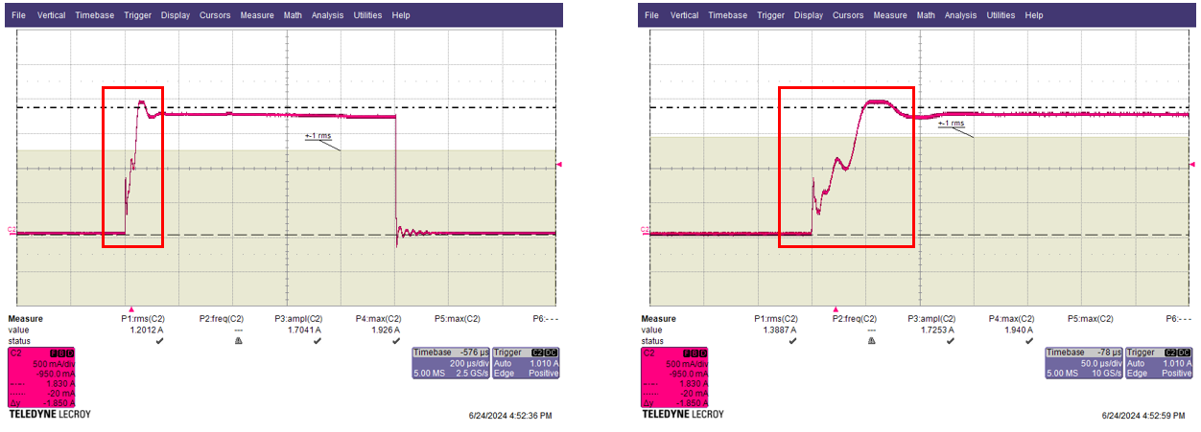
2. Output Current
- Ring occurs in the waveform when LED dimming turn-on, is it necessary to change the time constant of Comp, CSP/CSN?
- Need your guide for debugging.

