Slide 1

PCB Thermal Design with ultra small flip-chip packages (without Thermal Pad): HotRod
Arief Hernadi - Application Engineer CCP (APP, BSR)
With material provided by Frank De Stasi, Marc-Davis Marsh, Anthony Fagnani

Slide 2

Arief Hernadi
Application Engineer, CCP
Career
  Masters in Electrical Engineering, Cal Poly San Luis Obispo
  Applications Engineer (>5 years)
Expertise
  DC-DC Converter
  EMI
  PCB Layout
  Photography
2

Slide 3
Agenda
Thermal Design Primer
  Goal Thermal Management
  Thermal Design Terminology
Hot Rod Package
  Benefit of Hot Rod Package
  Comparing Hot-Rod and Standard Wirebond QFN Package
Designing a PCB for best Performance
  Estimating Board Copper Size
  Layout a Hot-Rod Package
  Thermal Vias
Example of LMR33630 SOIC and Hot Rod Package
  Evaluating Thermal performance of both package in a given design
Notes:
3

Slide 4
Thermal Design Primer

Slide 5
Heat Transfer
IC Power Loss is Heat
Conduction or diffusion: The transfer of energy between objects that are in physical contact
  The primary path for heat leaving the IC package
Convection: The transfer of energy between an object and its environment, due to fluid motion
  The primary path for heat leaving the PCB
Radiation: The transfer of energy to or from a body by means of the emission or absorption of electromagnetic radiation
  The secondary path for heat leaving the PCB and the IC package
  Goal: provide minimum resistance path for heat flow
        Minimum IC temp rise
5
Notes:
5
The primary heat transfer path is conduction.
Convection is really a combination of conduction and fluid flow. It allows heat to leave the PCB and travel to the ambient environment.
Radiation is what is measured by thermal cameras. Although significant, especially in smaller designs, much less heat is usually transferred as radiation.

Slide 6
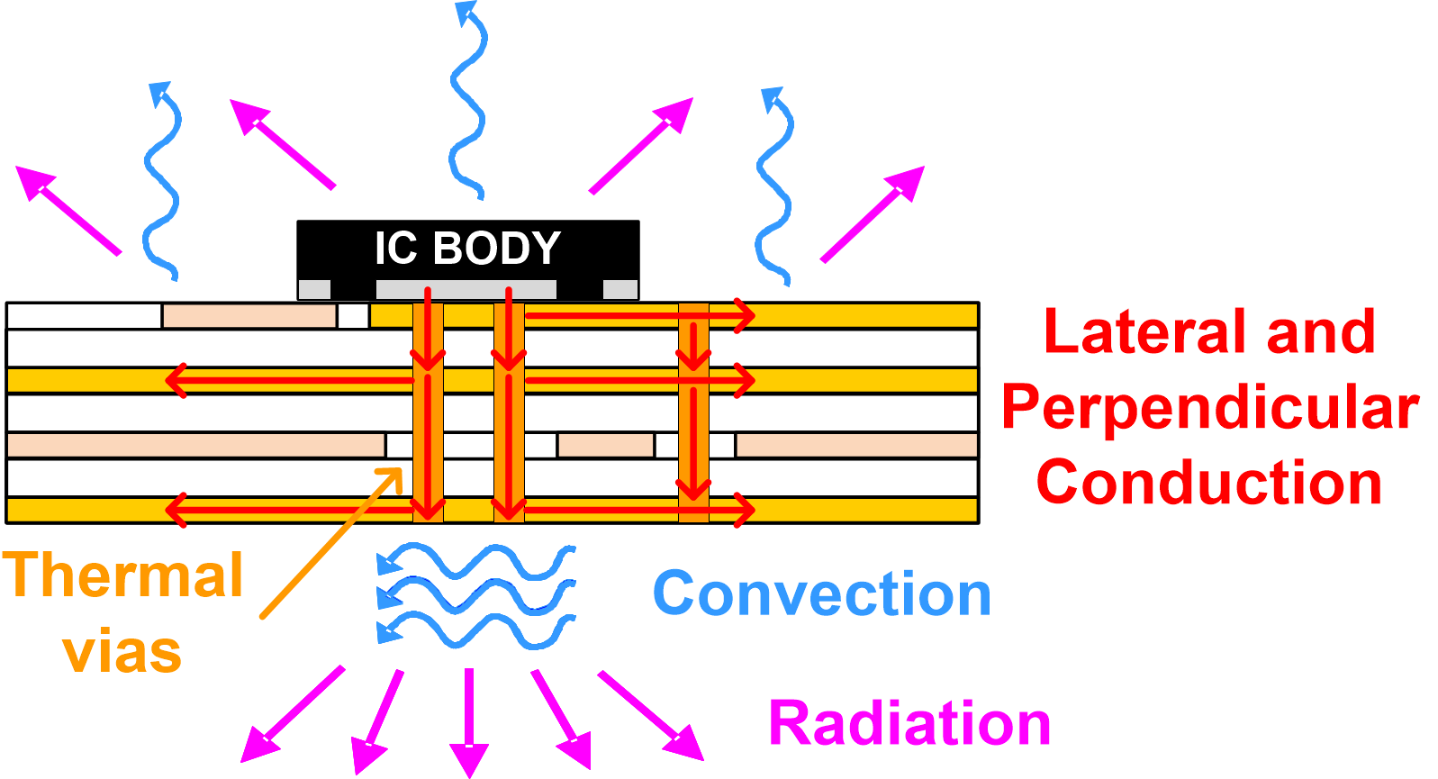
Heat transfer basic theory
Conduction:
Convection:
Radiation:
Where:
    Q = heat
    k = material conductivity
    A = area
    L = thickness (length)
    h = convection coefficient
    ΔT = temperature delta
    ε = emissivity
    σ = Stefan-Boltzmann constant
Dominant
Notes:
Conduction out of the IC, into the PCB and across the PCB. Convection off of the PCB and the package.
All heat transfer methods depend on the area. A larger area increases how much heat is transferred. In the package design, it is important to increase the area in which conduction occurs to get heat out of the IC.
The paths with lowest thermal resistance are the pad and pins of the IC.
Conduction and Convection both depend on the temperature delta.

Slide 7
Analogy Between Thermal and Electrical Resistance
Electrical => Q is Charge Thermal => Q is Heat
Notes:
To illustrate Thermal Impedance, an electrical analogy is commonly used. Thermal resistance is analogous to electrical resistance. Voltage potential is analogous to a temperature delta, and current analogous to power flow.

Slide 8
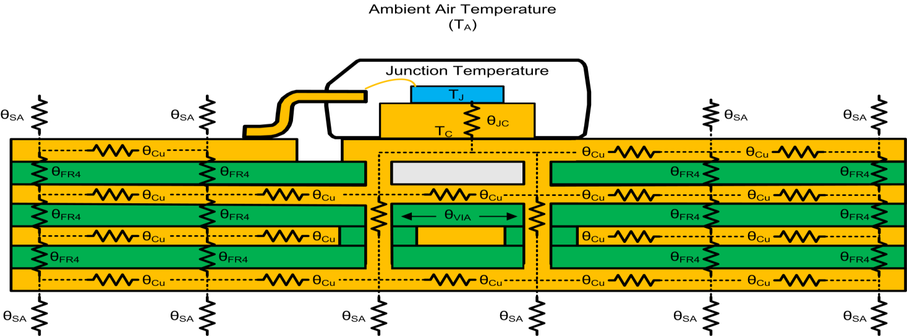
Thermal 101
Thermal Design 101
Typical Values
θ_{CU} ≈ 71.4°C/W
  Based on 1oz copper, W=1cm L=1cm. λ_{CU}= 4 W/cm K
θ_{VIA} ≈ 261°C/W
  Based on 0.5oz plating thickness, for 300um via (12mil)
  http://www.ti.com/lit/an/snva419c/snva419c.pdf
θ_{FR4} ≈ 13.9°C/W
  Based on 320um thickness, W=1cm L=1cm. λ_{FR4}=0.0023 W/cm K
θ_{SA} ≈ 1000°C/W
  W=1cm L=1cm. h= 0.001 W/cm K
8
Notes:
1-8
In most DC/DC converters, most of the heat is dissipated from the silicon to the package to the PCB, and finally the ambient air. A much smaller amount of heat is dissipated from the silicon to the case and then to the ambient air. The split of course depends on how the device is manufactured - the device could be manufactured with a heat slug on the top or bottom of the die. Often a bottom thermal pad is used.

Slide 9
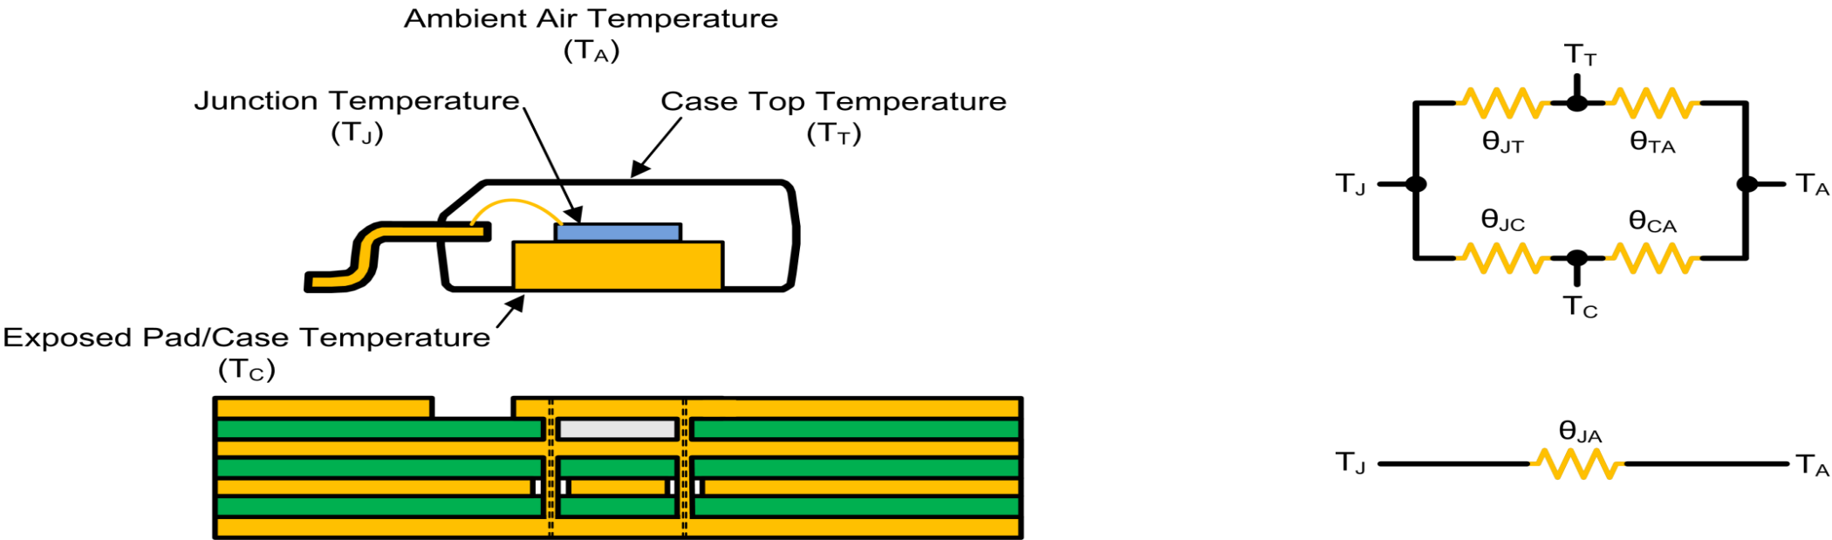
Thermal Design Terminology
Thermal Design Terminology
At each interface from the junction to the ambient air there is an associated thermal resistance
Notes:
1-9
Thermal resistance is defined in degrees Celsius per watt. As power is dissipated, there is a temperature change.
The higher the thermal resistance, the higher the temperature rise.
At each interface from the junction to the ambient air, there is an associated thermal resistance.
The temperature rise for each interface is above the next interface in the direction of heat flow from the junction to the ambient. Heat flows from the hottest to the coolest point.
The most effective path for thermal transfer is metal (i.e. traces, ground, leads, etc.). Plastics provide poor conduction paths.

Slide 10
The Goal of Thermal Management
Maximum junction temperature. Given in data sheet of converter; usually 125°C or 150°C
Power dissipation of converter.
Depends on required output power and converter efficiency
Thermal resistance from ambient to junction of converter.
Depends on everything; package, copper area, airflow, etc.
Maximum ambient temperature. Specified by customer application
The goal is to keep T_{J} below the maximum specified in the data sheet.
10
Notes:
10

Slide 11
Some Basic Terminology
Thermal resistance; θ_{JA}
  Total thermal resistance from the junction to the ambient environment
    Not too easy to estimate, in some cases
    Depends on many factors
      Package type
      Copper heatsink area
      Air flow
      Number of copper planes
      Weight of copper planes
      Number of thermal vias
      Adjacent components
      Power dissipation

Slide 12
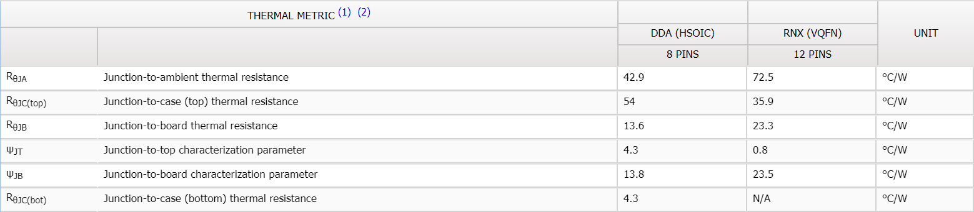
Some Basic Terminology
Difference between θ-type and Ψ-type Parameters
θ Type
  All the heat flows from the junction to location X
    Assumes isothermal conditions
  Location X serves as the external heat sink to the package
    Assumes non-isothermal conditions
ψ Type
  Only a fraction of the heat flows from the junction to location X
    Assumes non-isothermal conditions
  Temperature gradient exists in location X
    Assumes non-isothermal conditions

Slide 13
Ψ_{JT} vs θ_{JC}
Power dissipation = 2 W
Cu Plate at constant temp =25 ˚C
0.1 W
Case temp monitor
2 W
0.8 W
Junction temp monitor
Chip
Chip
Pad
Pad
PWB
PWB
1.1 W
Psi-JT
Power is dissipated in all directions
Theta JC
All the Power is forced to be dissipated only in one direction {UPWARD}
T
C
J
P
B
A
J
B
A

Slide 14
Hot Rod (Flip Chip) Package

Slide 15
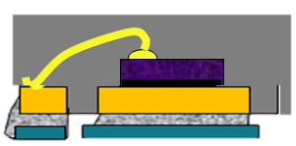
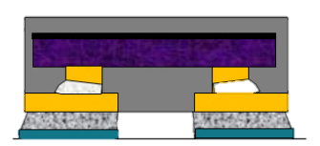
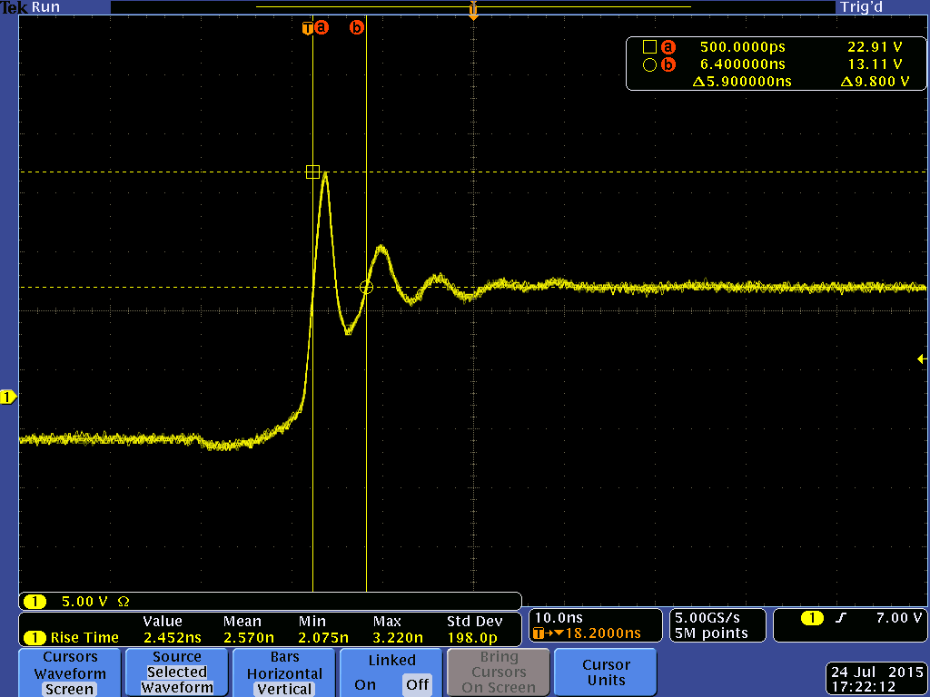
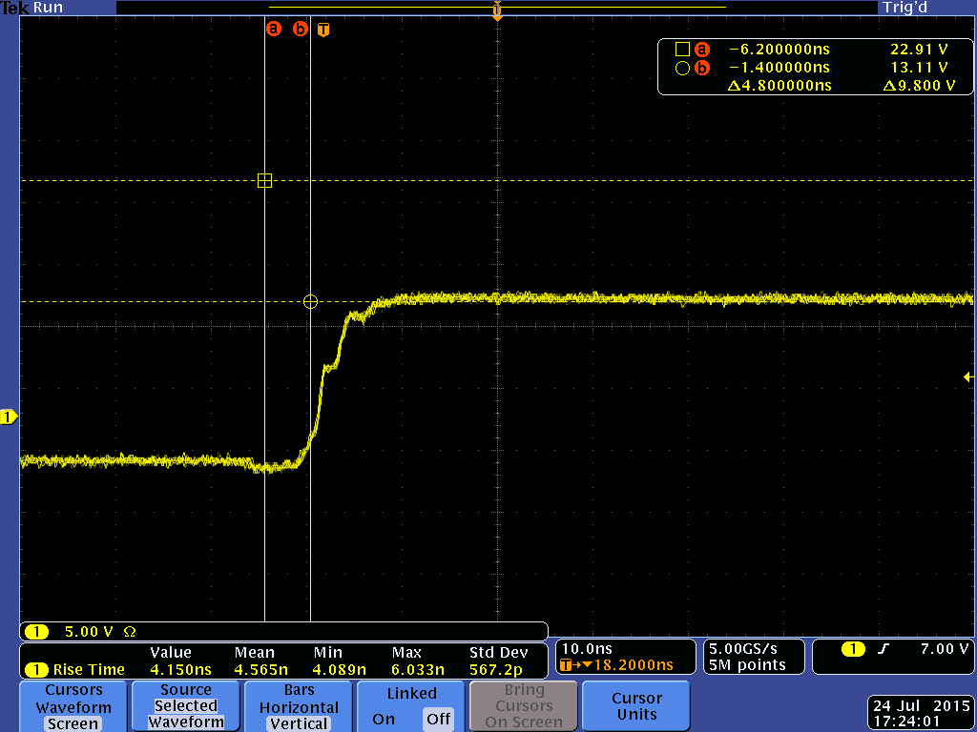
Comparing Hotrod Package and Wirebond Package
HotRod™
Standard wirebond QFN package
Flip chip on lead frame QFN
Minimize EMI through:
No-wirebond VSON packaging
Symmetric pinout
Spread spectrum feature
Wirebond
Silicon die
lead frame
board
Silicon die
copper bump
solder
lead frame
board
Die is flipped and placed directly onto the lead frame
More ringing
Less ringing

Slide 16
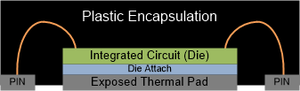
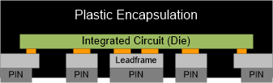
Package Differences
Exposed Thermal DAP
HotRod™ QFN
Bondwires connect IC to pins
Good thermal performance
Higher parasitic resistance and inductance
Larger than QFN
Copper pillars (bumps/posts) on IC soldered directly to the lead-frame
Poor thermals, compared to DAP
Reduced parasitic resistance and inductance
Smaller than SOIC
Heat flow
Heat flow

Slide 17
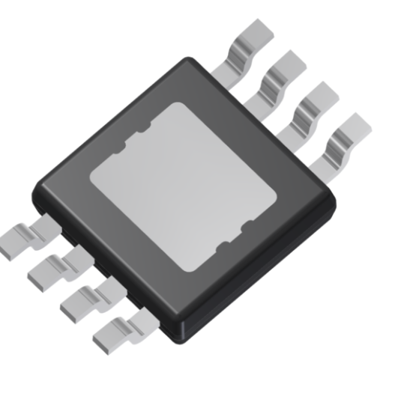
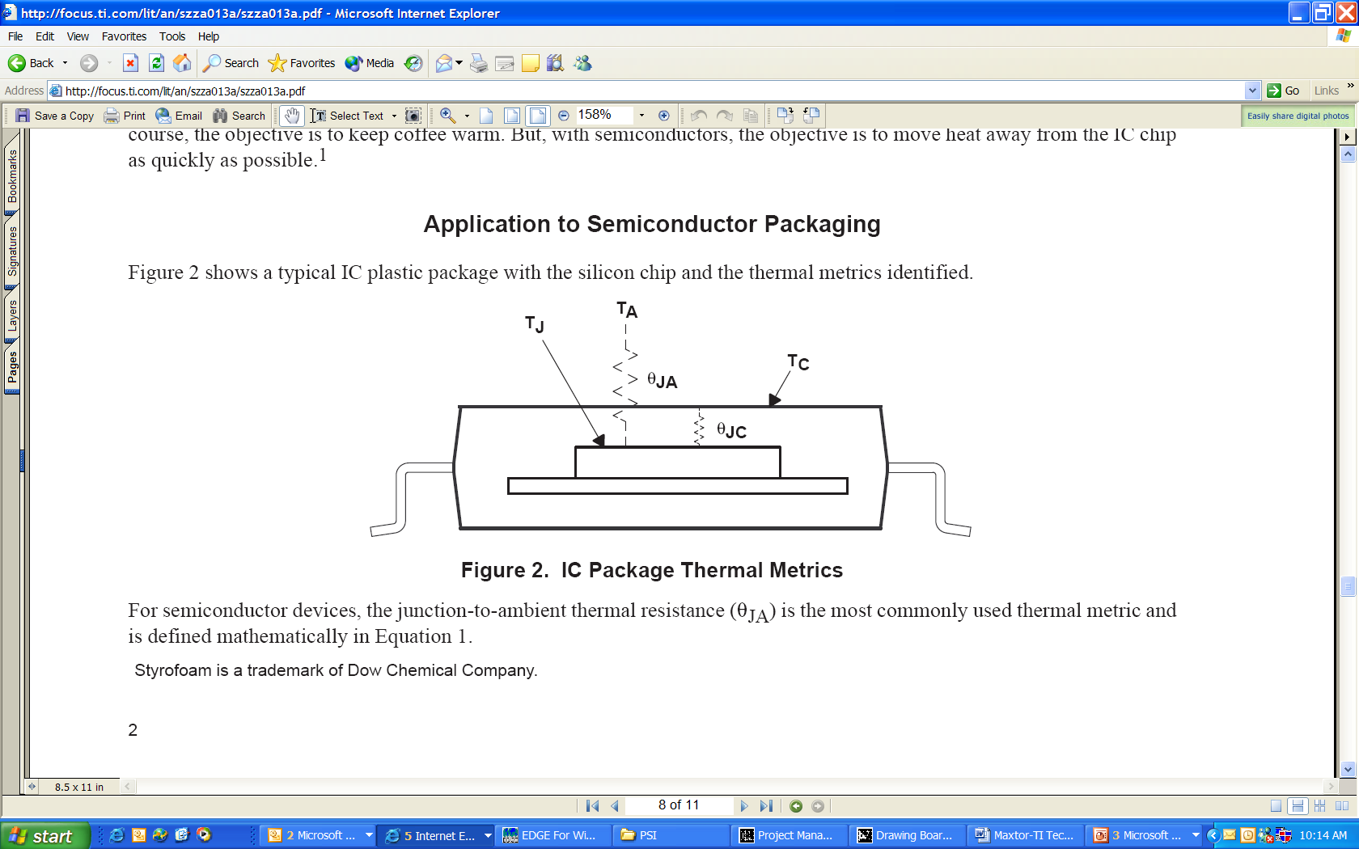
Thermal Path for Exposed Pad Packages
PowerPad™ QFP/TSSOP, QFN
  Typical power: 0.5-10W
  Thermal design for these packages:
    Soldered to PCB thermal/GND plane
    PCB has thermal pad and vias tied to ground plane
    Most of the Heat uses the Exposed Pad, because that is the lowest thermal impedance path
<1%
~20%
~80%

Slide 18
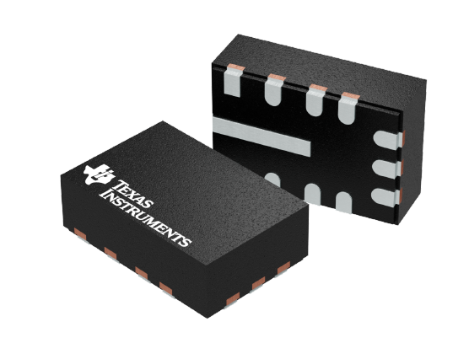
Thermal Path for HotRod™
Flipped Die on Lead Frame (HotRod™)
  Typical power: 0.5-3W
  Thermal design for these packages:
    Large Pads connected to Power Devices are essential to distribute heat.
      Most of Heat is through large pads because of metal routing but pins can also distribute heat
        PGND, GND, SW: Most effective
<2%
~98%
~98%

Slide 19
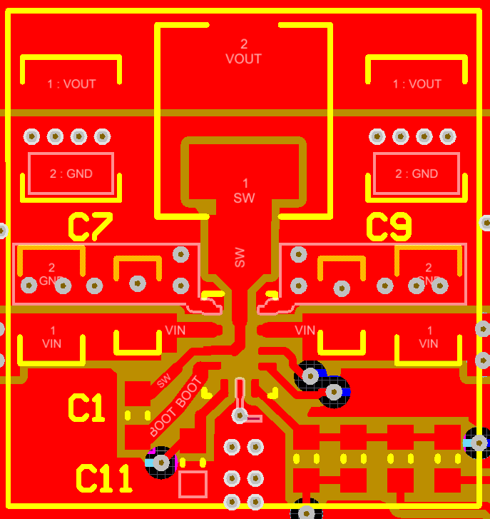
Thermal Layout for HotRod™
Fat and Wide Traces on V_{IN}, GND, SW
NOTE: Tradeoff on SW pin for EMI and Thermal
Lots of GND vias

Slide 20
Thermal Characteristics Table in Data Sheet
SOIC
HotRod™
Values of θ_{JA} given in the table are NOT useful for thermal design
  They are useful for comparing packages within TI or with our competitors
The other values can be useful
  θ_{JC} , Ψ_{JB} and Ψ_{JT} are the most useful

Slide 21
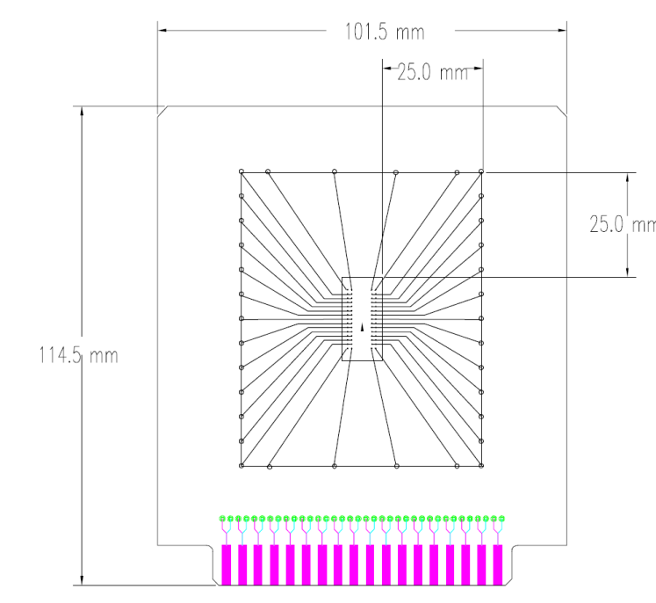
Thermal Characteristics Table in Data Sheet
The values given in the table are simulations
  The traces on the JEDEC board are too small to provide adequate heat-sinking
    For HotRod™ the heat is mostly dissipated from the pads
      This makes the JEDEC board a bad estimate for thermals
JEDEC uses the same standard for all packages
  This makes the numbers good for comparing packages
Need better methods for estimating θ_{JA}

Slide 22
Designing a PCB for Thermal Performance

Slide 23
Design Strategy Summary
Calculate P_{D} based on the efficiency and system inputs: T_{A}, V_{IN}, V_{OUT}, I_{OUT}
Calculate required θ_{JA}
Determine required board size
  Datasheet guidelines
  SNVA419C spreadsheet
  Online calculator
  WebTHERM™/Webench
Follow Layout Guidelines for vias, and routing, etc.
23
Notes:
23

Slide 24
Example:
Scenario:
Customer:” I have this input voltage, output voltage, output current and ambient temperature”
“Is it going to work OK thermally?”
How much board space/heat sinking do I need with this device?
Step 1: Estimate the IC power dissipation.
Step 2: Determine Thermal Requirements
Step 3: Determine Board Size Based on Thermal Requirements

Slide 25
Step 1. Estimate the IC Power Dissipation
1a. Look in the datasheet for an efficiency curve that is close to the given application conditions. Ideally the efficiency should be taken at a temperature greater than 25°C, since the die will always be above ambient when running with load.
1b. Calculate the total power loss using:
1c. Subtract the loss in the inductor to get the IC P_{D}:

Slide 26
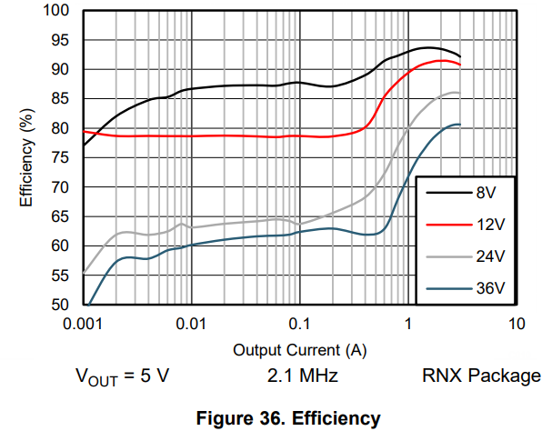
Step 1. (cont.)
Example: LMR33630 RNX (Hot Rod) V_{IN} = 12V, V_{OUT}, = 5V, I_{OUT} = 3A, 2.1MHz
1a. We find an efficiency from the data sheet:
Approximate Efficiency of 91%
based on graph shown
1b. P_{LOSS} = 1.48W
1c. P_{D} = 1.16W (R_{L}~35mΩ from EVM user guide)

Slide 27
Step 2. Calculate maximum allowable θ_{JA}
  For this step we need the maximum ambient temperature from the application requirement and the maximum junction temperature from the data sheet.
  T_{A} = 85°C
  T_{Jmax} = 150°C
  We get θ_{JA} ≤ 56°C/W
  A quick start calculator is also available to help with “what-if” calculations:
27
Notes:
27
Based on the IC power dissipation from the previous step and the ambient temperature of the customer’s application, calculate the required maximum θ_{JA} for the application. The calculation is simple. It can be simplified further by using the embedded excel calculator.

Slide 28
Step 3. Estimate the PCB Copper Area
OPTIONS:
Datasheet θ_{JA} vs Copper Area Curves (Easiest Option if available)
Thermal Estimate Based Excel Calculator
PCB Thermal Calculator online or other simulation tools
Webench Thermal Simulation
28
Notes:
28

Slide 29
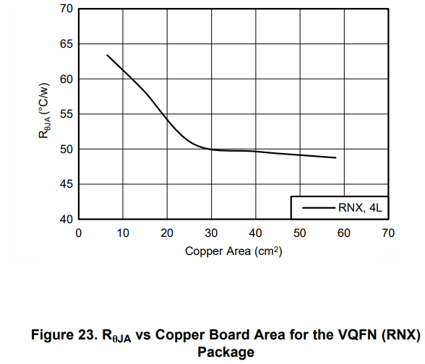
Step 3: Option A – Data Sheet Curves
This option is more accurate since it based on measured data.
The curves for LMR33630 are shown below:
This curve indicates that a 4 layer board with
an area of 4.0 cm x 5.0 cm (20 cm²) will give
θ_{JA} < 56°C/W
29
Notes:
29
Some datasheets will be more helpful in getting you started with your thermal calculations. There may be a thermal resistance vs board area curve available. In that case, you can make a quick estimate right away.

Slide 30
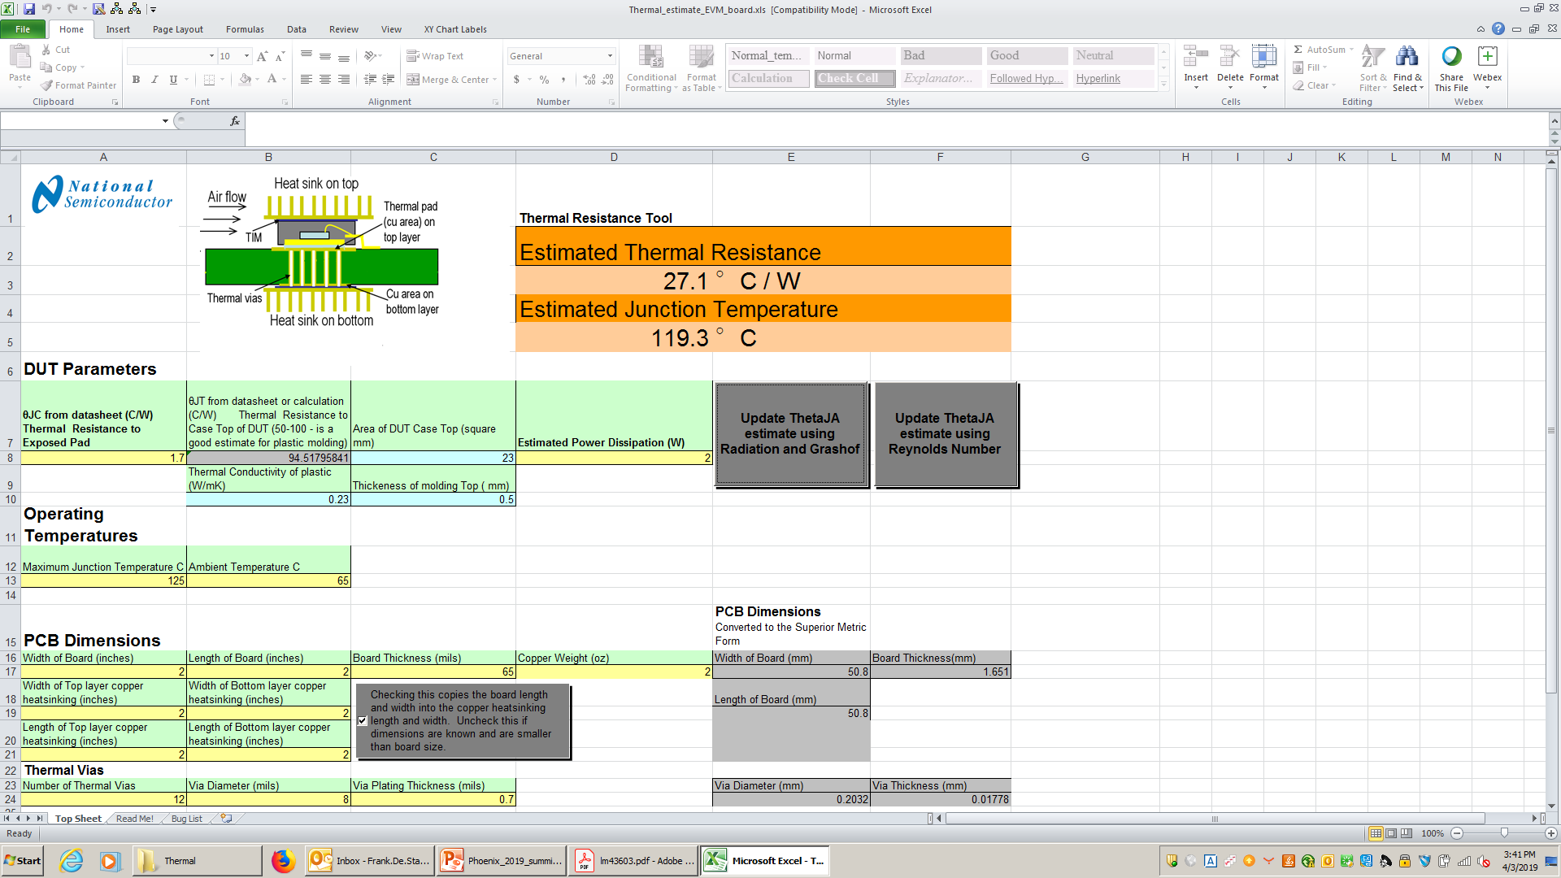
Step 3: Option B – Thermal Estimator Excel
Application Note SNVA419C and the associated spread-sheet can be used to estimate the required board size for a given set of conditions
  Allows you to play “what-if” scenarios
  Works well for packages with a DAP
    Need to “adjust” values of θ_{JC} for other package types
“AN-2020 Thermal Design By Insight, Not Hindsight”: http://www.ti.com/lit/an/snva419c/snva419c.pdf
30
Notes:
30

Slide 31
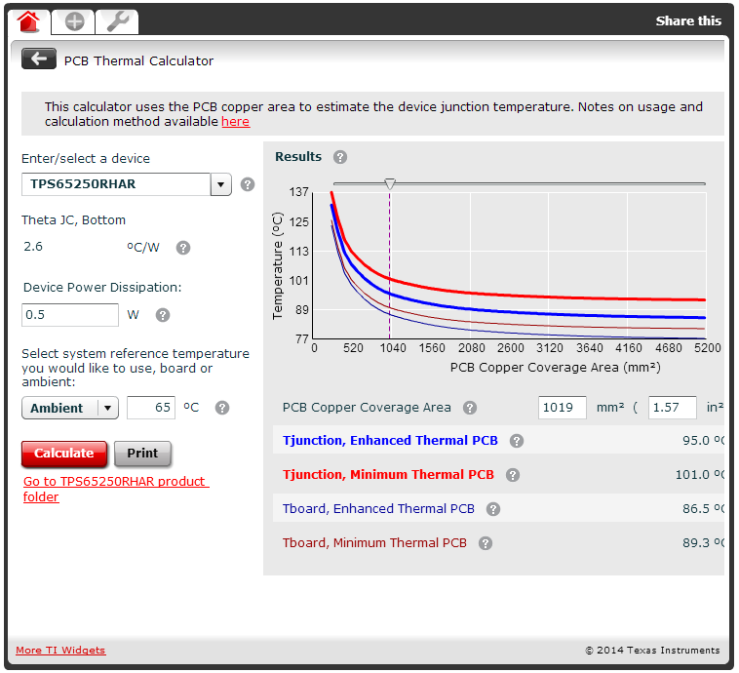
Step 3: Option C – Online PCB Calculator
Only available for some IC packages
http://www.ti.com/adc/docs/midlevel.tsp?contentId=76735
31
Notes:
31
31

Slide 32
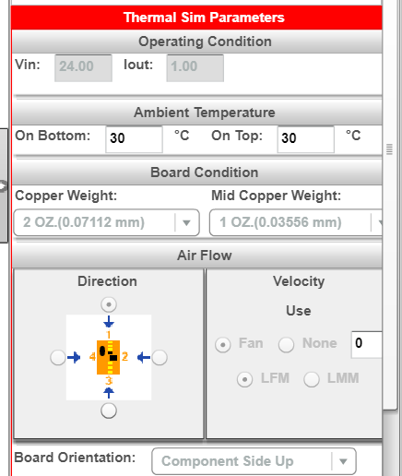
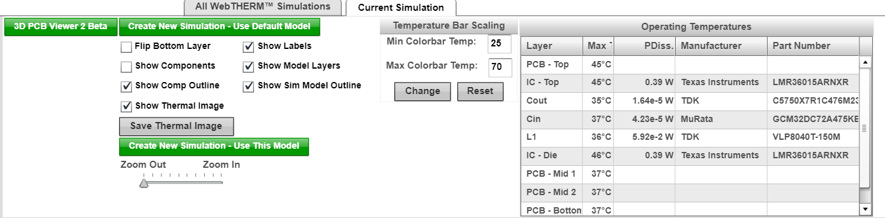
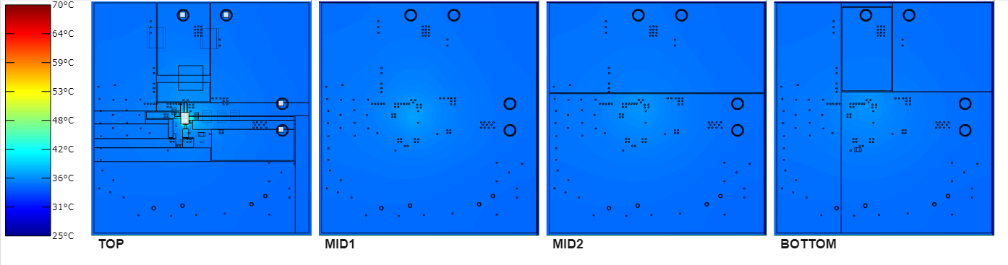
Step 3: Option D Webench / WebTHERM™
https://webench.ti.com/webench5/power/webench5.cgi
32
Notes:
32
32
32
32

Slide 33
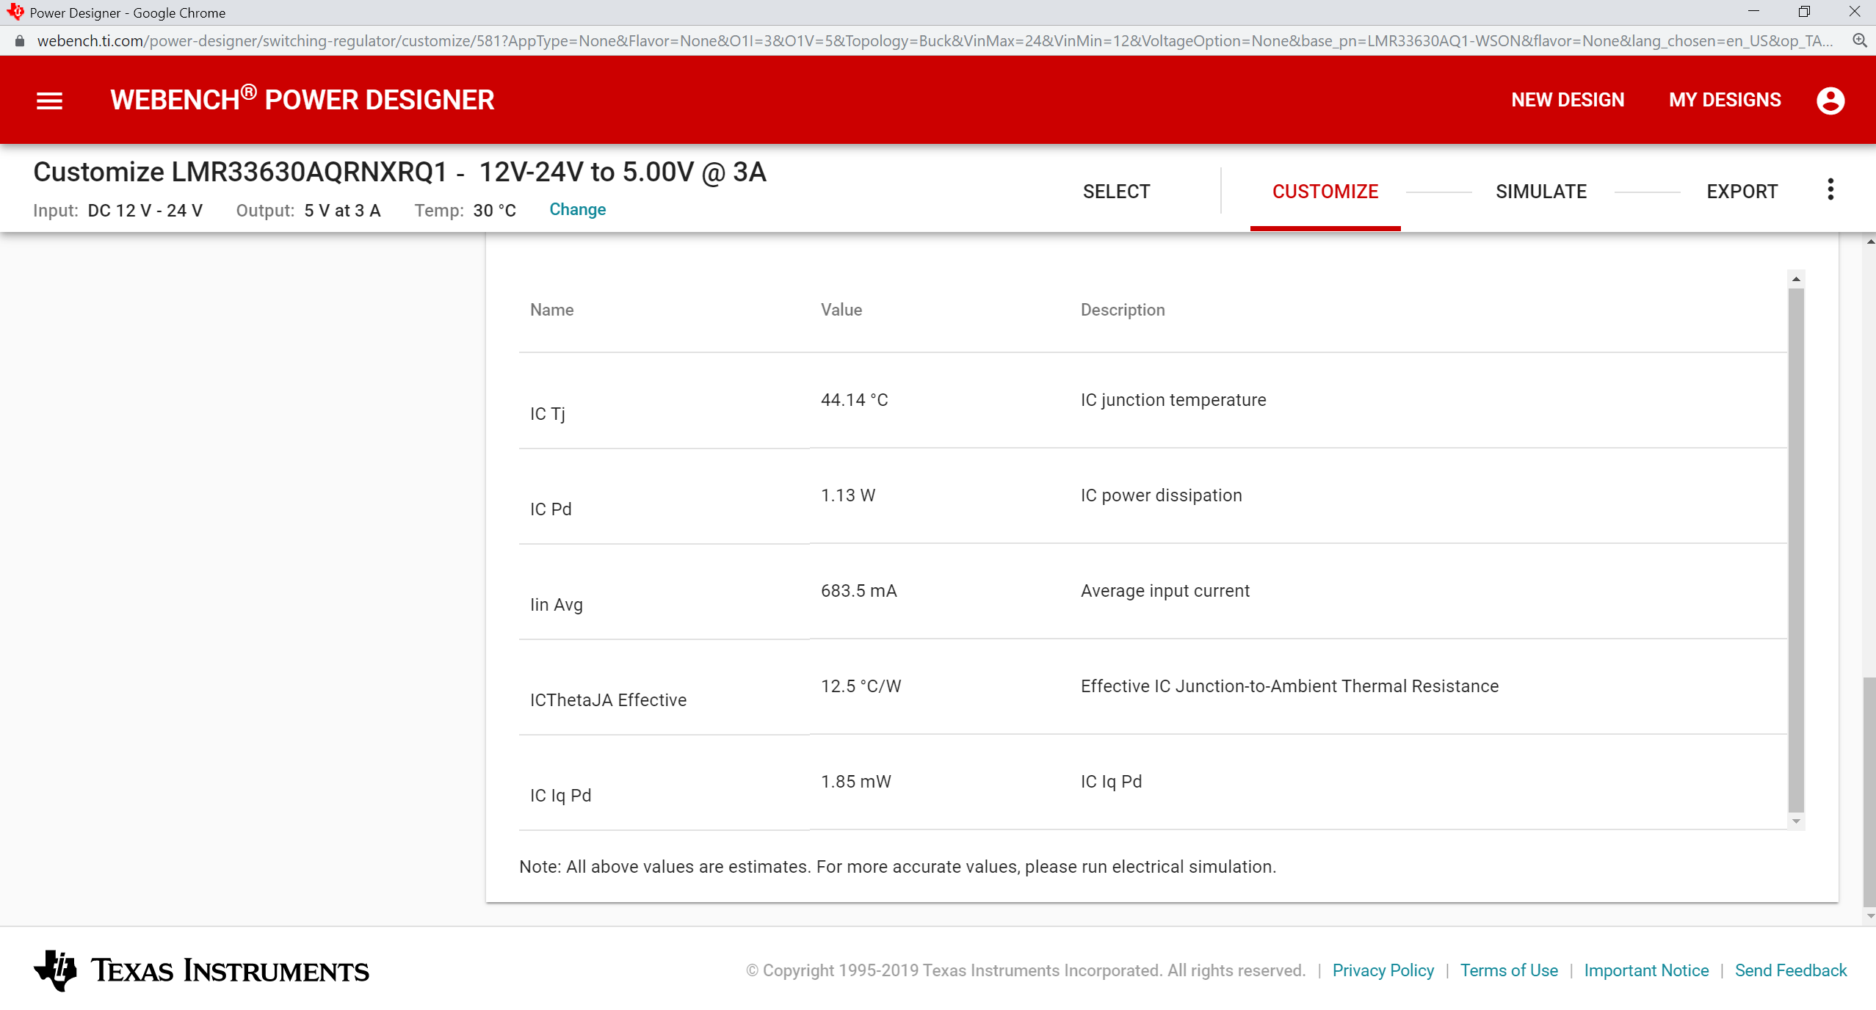
Step 3: Option D Webench / WebTHERM™
33
Notes:
33
33
33
33

Slide 34
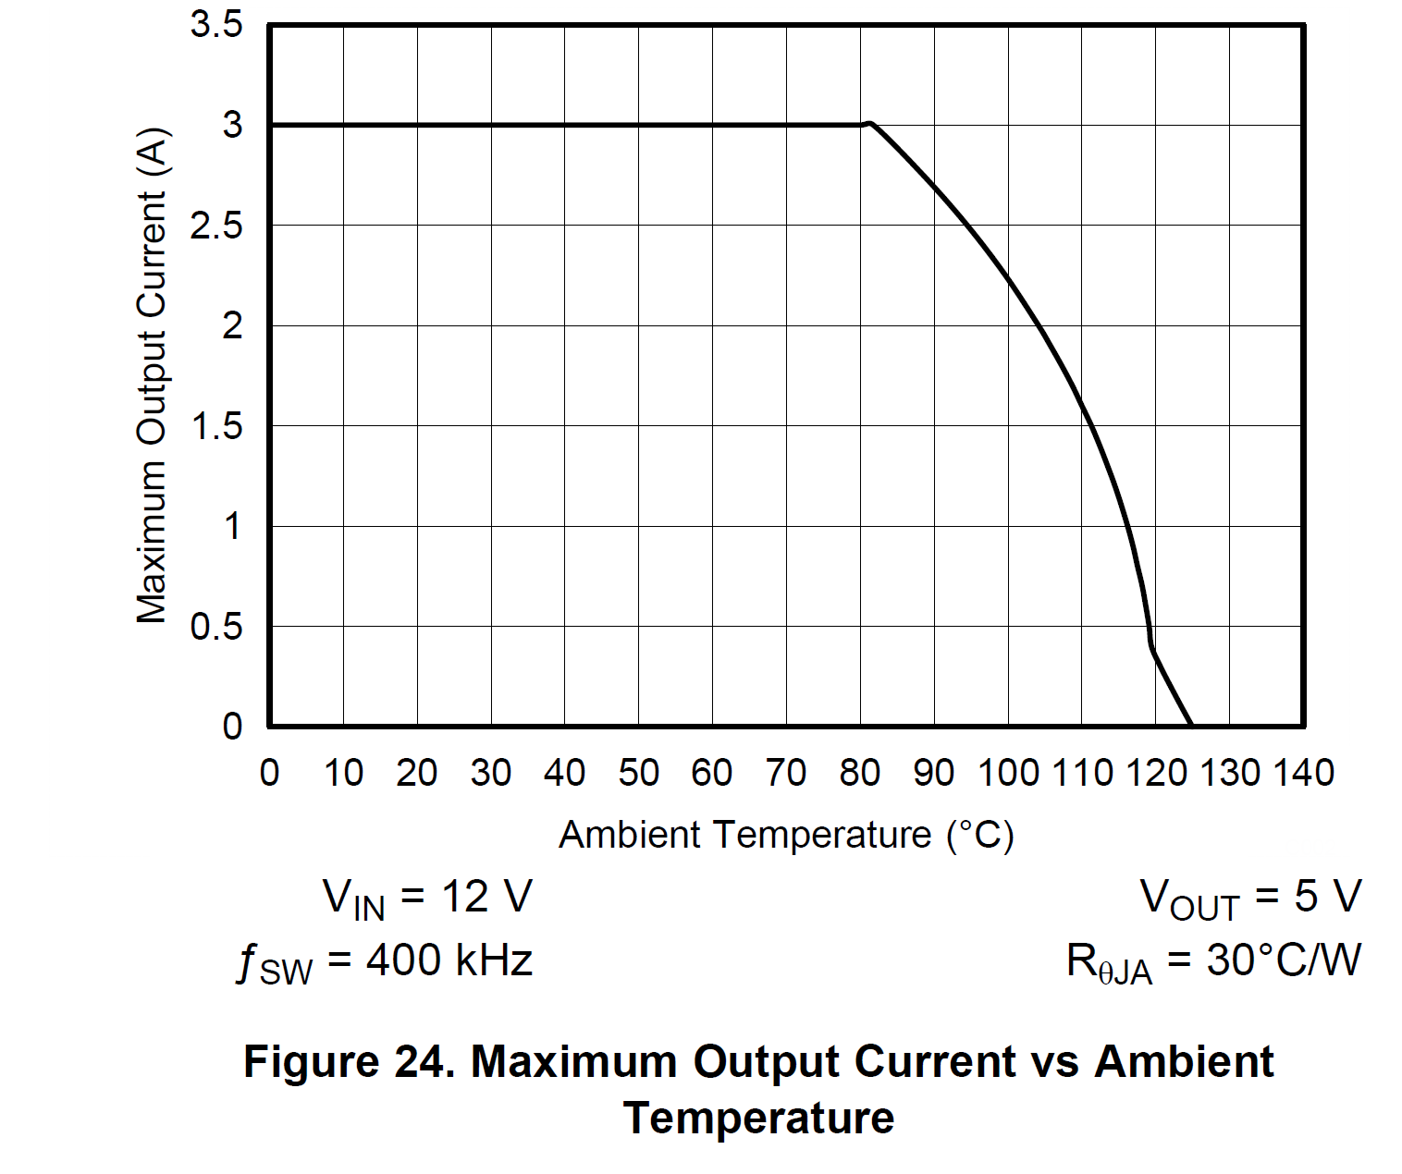
Step 3: Data Sheet De-Rate Curves
Many data sheets will have a “de-rating” curve
  This shows the maximum load current for a given ambient temperature
  Taken with one particular θ_{JA}
  Uses the efficiency taken at an elevated temperature
    85°C or 125°C
34
Notes:
34
34
34
34

Slide 35
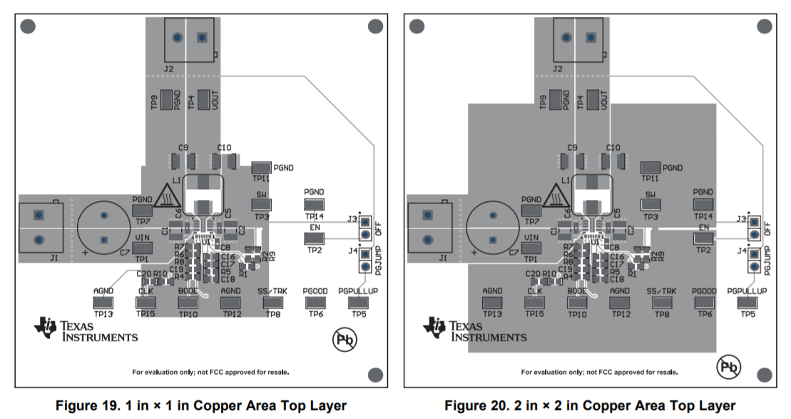
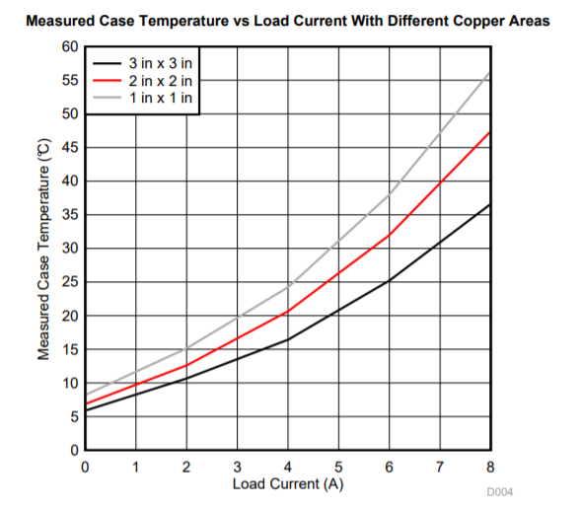

Effects of Copper Area (TPS54824)
Comparing the 2 different copper area, at higher current of 8A, the improvement of case temperature ~ 10°C
App Note: http://www.ti.com/lit/an/snva839/snva839.pdf
35
Notes:
35
35
35
35

Slide 36
Step 4: Layout Guidelines – Copper Thickness
Use appropriate copper thickness
1oz copper thickness is 35µm and 2 oz copper thickness is 70 µm
At least 1 oz copper is recommended for all DC-DC converter designs.
2 oz copper is recommended for designs that dissipate more than 3 Watts
  Example: For a copper area of 3 inches x 3 inches:
    1 oz copper : θ_{JA} ~ 28°C/W
    2 oz copper : θ_{JA} ~ 21°C/W
    About 25% improvement
36
Notes:
36

Slide 37
Step 4: Layout Guidelines – Vias
Use lots of vias
  Thermal resistances in parallel
  The more you add, the lower the resistance is.
Typical 0.3mm (12mil) thermal vias with 17.5µm (0.5oz) plating
1.56mm (62mil) PCB thickness
More thermal via guidelines in Application Notes SNVA419C and AN-1520
Via Array Thermal Resistance Calculations:
37
Notes:
37

Slide 38
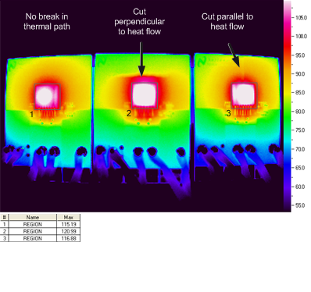
Step 4: Layout Guidelines – Cuts in Copper Planes
  Cut copper plane parallel to heat flow
115C 121C 117C
38

Slide 39
Step 4: Layout Guidelines – “Pizza Slice”
IC is the heat source and “tiny” compared to PCB
Maximize so that heat is radiating in all 360 degree directions of top and bottom copper plane
Ideally, heat source is placed in center of a PCB
If the tip of the “slice” is not touching the heat source properly then the whole “slice” can not efficiently contribute as heat sink
Make thermal cuts only in heat flow directions
Maximize total copper area, number of layers and Cu thickness on PCB
Utilize the bottom copper side of PCB
Use all available external components like Inductors, resistors and ceramic caps as potential heat conductors to bridge to colder areas / slices
Use larger components like connectors and aluminum caps to improve heat sinking of slices
Heat flow

Slide 40
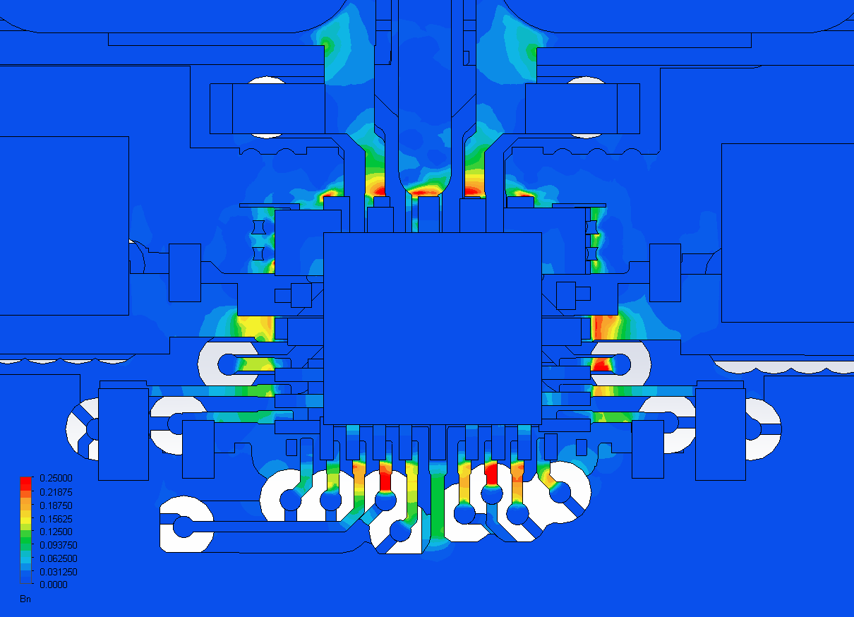
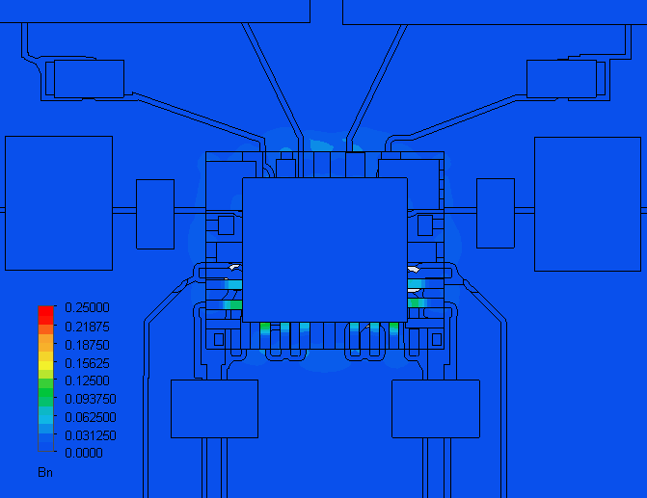
Step 4: Layout Guidelines – Optimum Cuts
Non-optimized PCB design
Die Temp = 124°C
Ɵ_{JA} = 32°C/W
Thermally Optimized PCB
Die Temp = 88.3°C
Ɵ_{JA} = 20.4°C/W
Large Copper “Slices”
SW
GND
GND
VIN
AGND
Thermal Bottlenecks
Notes:
Since bottleneck is a normalized value, it cannot be compared directly across designs. However, since these two boards use the same package model, the effects of layout are evident. The test board on the left has many thin signal traces and large via clearance (on the bottom pins), as well as thin switch node traces (on the top). In comparison, the thermally optimized application board on the right has fewer traces and vias near the board and wider switch node traces, resulting in lower thermal resistance and die temperature.

Slide 41
Step 4: Layout Guidelines – High Current Vias
High Current Via Requirements:
  1A/via max <14mil diameter
  2A/via max >14 mil diameter
  5A/via max >40 mil diameter
  Don’t block high current paths with vias
41

Slide 42
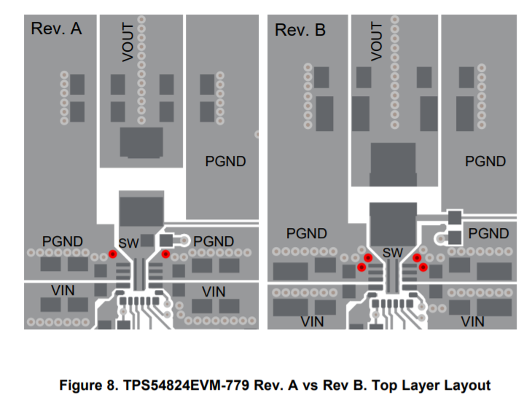
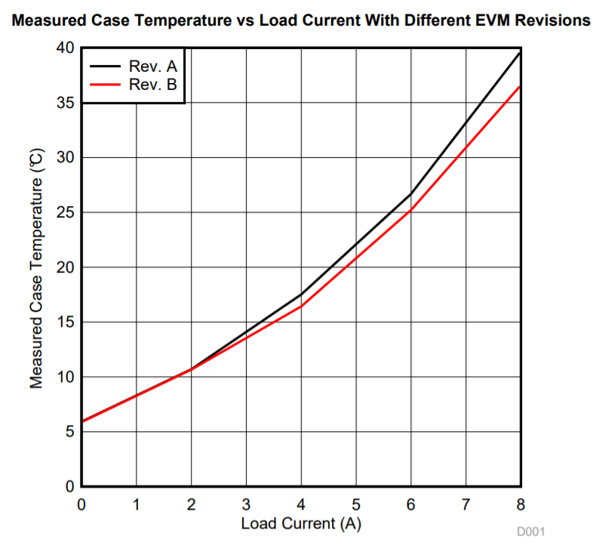
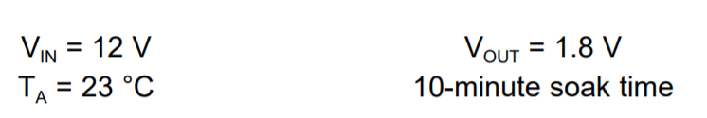
Step 4: Example of vias near the IC (TPS54824)
REV A
REV B
App Note: http://www.ti.com/lit/an/snva839/snva839.pdf
42

Slide 43
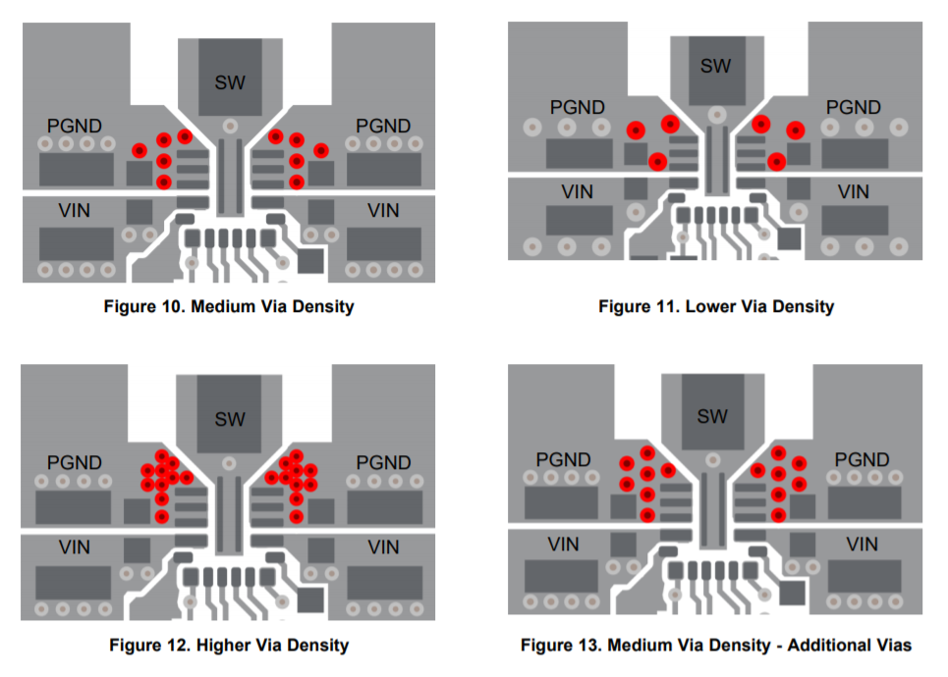
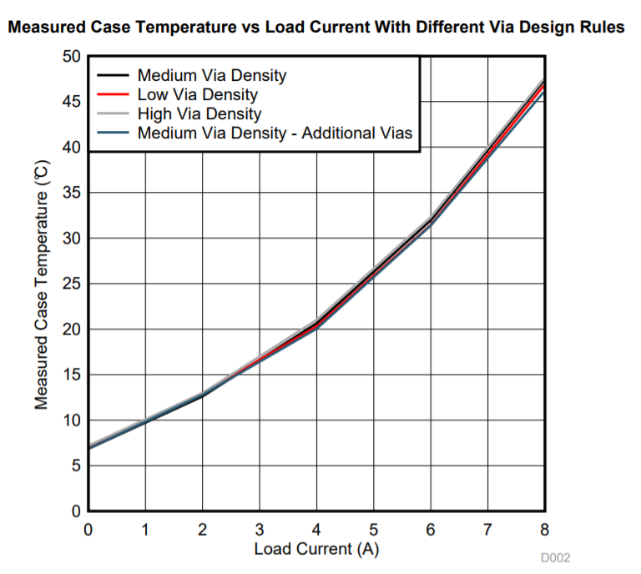
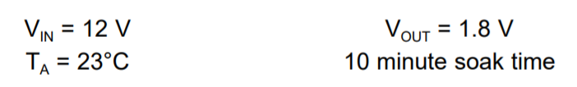
Step 4: Via Density near the IC
App Note: http://www.ti.com/lit/an/snva839/snva839.pdf
43

Slide 44
Other Considerations – Thermal Coupling & Footprint
Thermal Coupling
  Devices in a system are always thermally coupled
  Most significant when packages get closer than 2x the package dimension to each other
Thermal Footprint
  A thermal footprint is the area of the PCB that participates strongly in the convection and radiation from the package
  This area is about 18x the package area as shown
    Top of PCB and bottom of PCB count
When thermal footprints overlap, changes in junction temperatures are dramatic
Device
Thermal
Footprint
Thermal
Coupling
Max T = 69.8°C

Slide 45
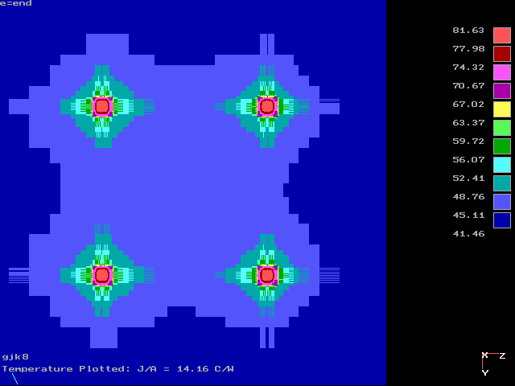
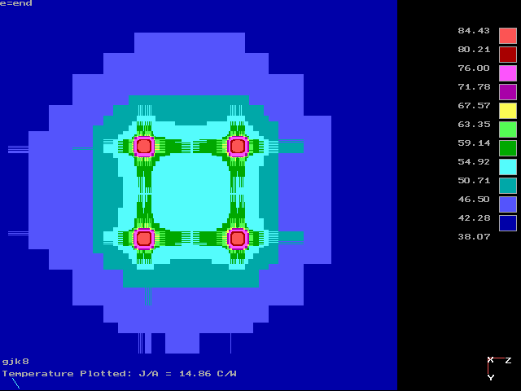
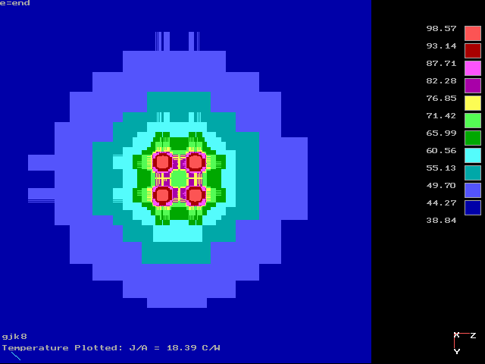
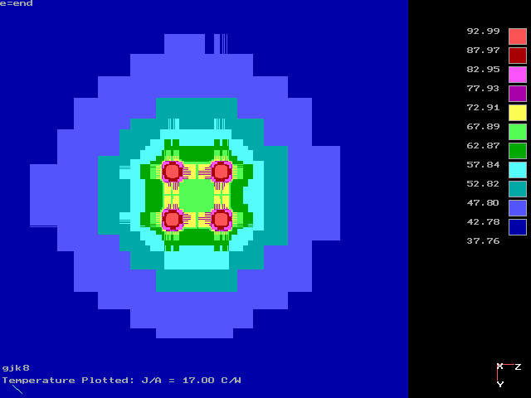
Other Considerations – Thermal Coupling Example
Separation=50mm
Max T = 81.6°C
Separation=25mm
Max T = 84.4°C
Separation=8mm
Max T = 98.4°C
Separation=12.5mm
Max T = 92.9°C

Slide 46
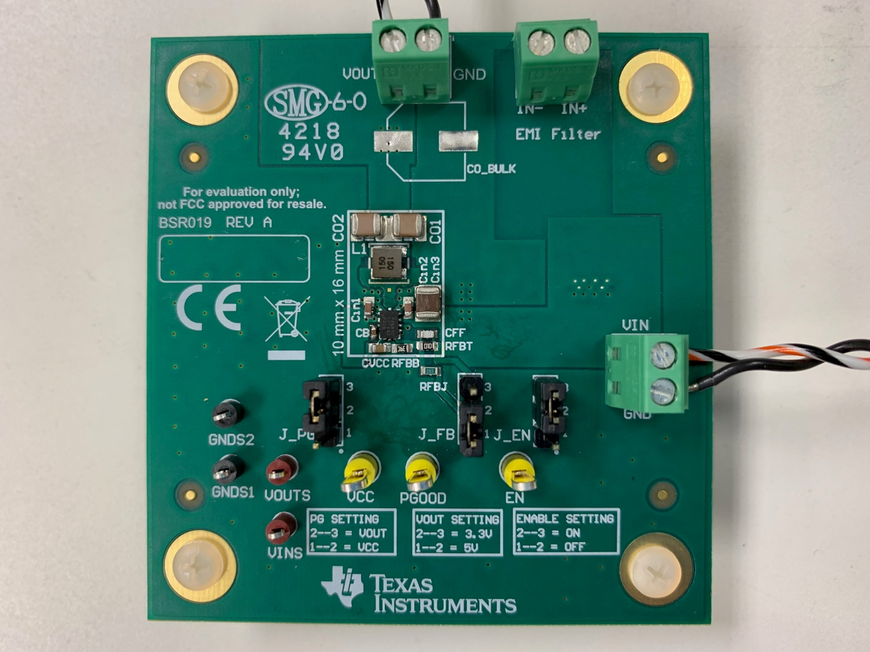
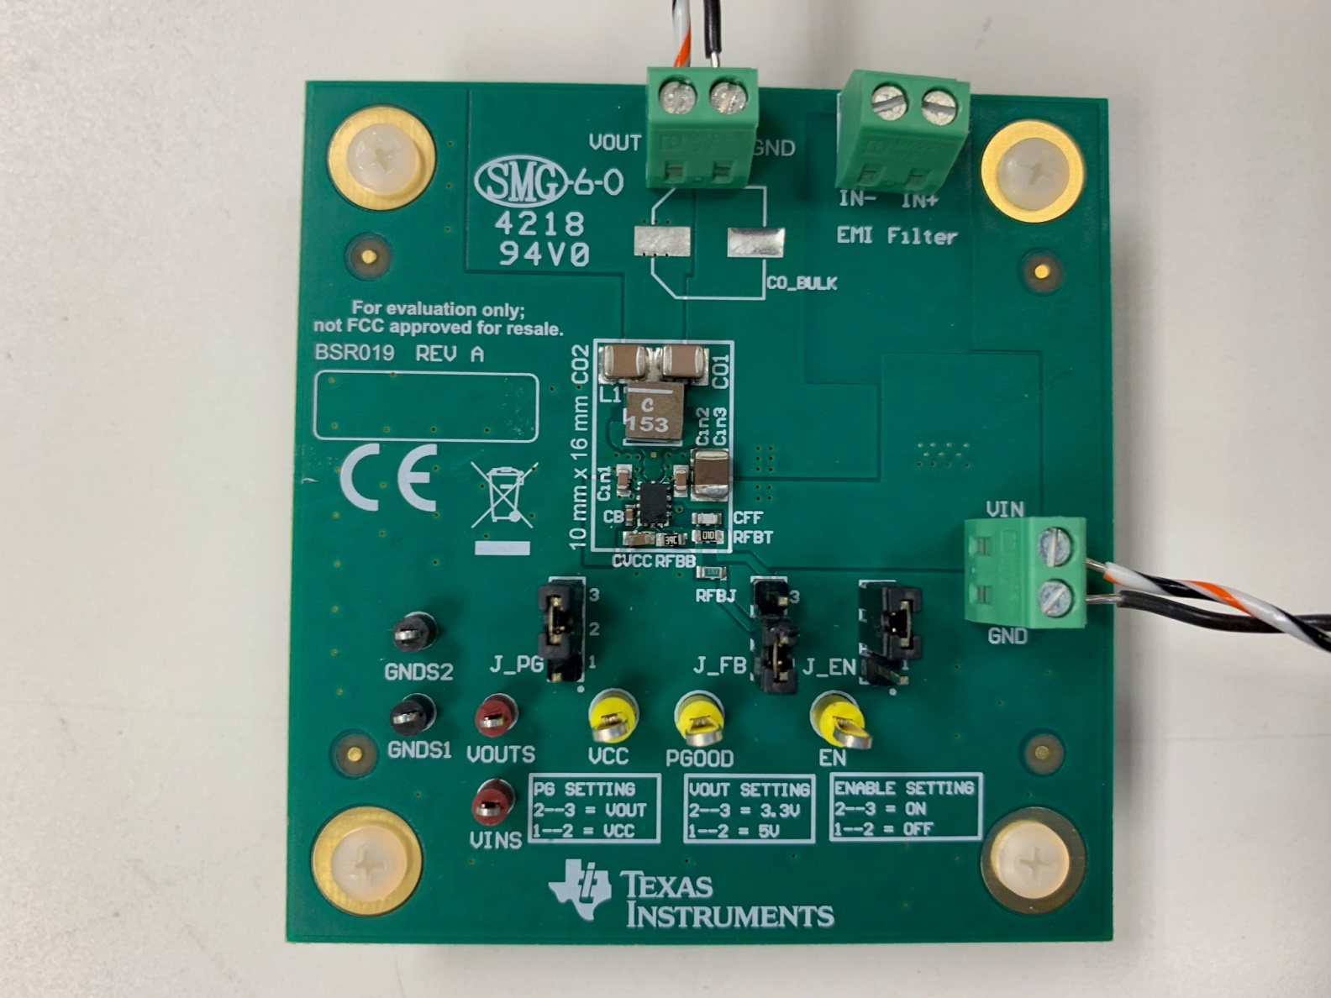
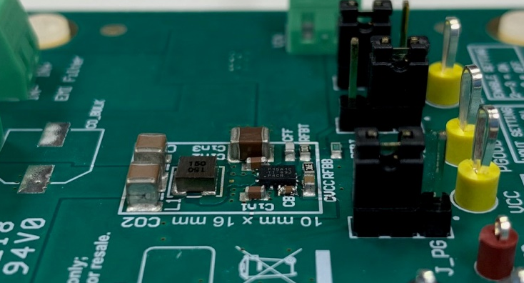
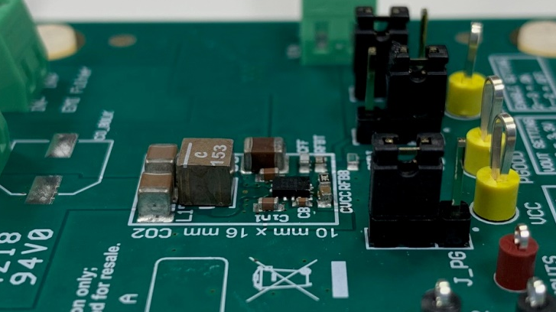
Which Thermal Performance is BETTER?
Inductor 74438335150 (3mm x 3mm x 1.5mm)
15µH, 720mΩ
Inductor XAL4040-153 (4mm x 4mm x 4mm)
15µH, 84mΩ

Slide 47
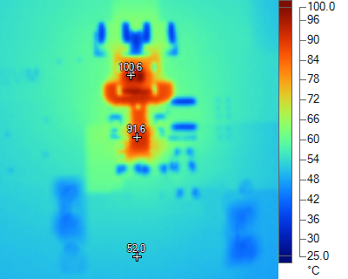
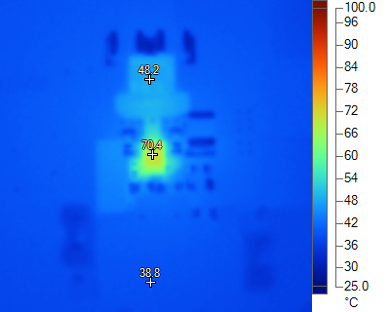
TEMPERATURE COMPARISON
Operating Conditions
  LMR36015
  VIN = 24V
  VOUT = 5V
  IOUT = 1.2A
  Switching frequency = 2.1MHz
IC Package Temperature ~ 92°C
IC Package Temperature ~ 71°C
Δ = 21°C

Slide 48
Some Layout Best Practices
Spread out hot devices on PCB
Maximize GND layer in PCB
No breaks in heat flow through planes
Increase PCB layers or thickness
Widen PCB traces near device
Thermal vias under or near device
Airflow (global and local)

Slide 49
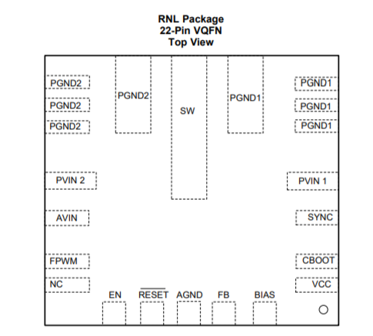
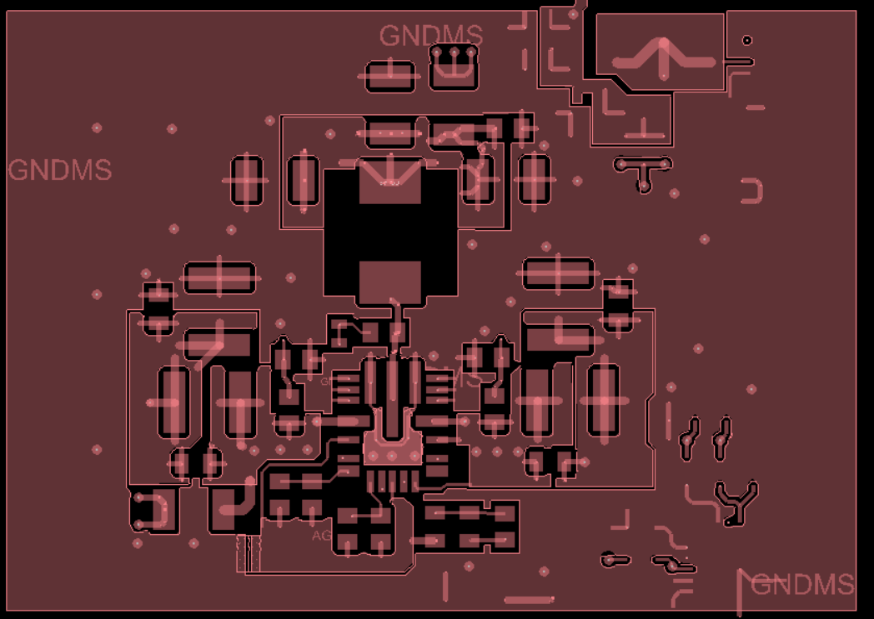
Quiz……layout review
COUT
L
CIN
CIN
LM53625
2.5A Synchronous Buck Converter 2.1MHz

Slide 50
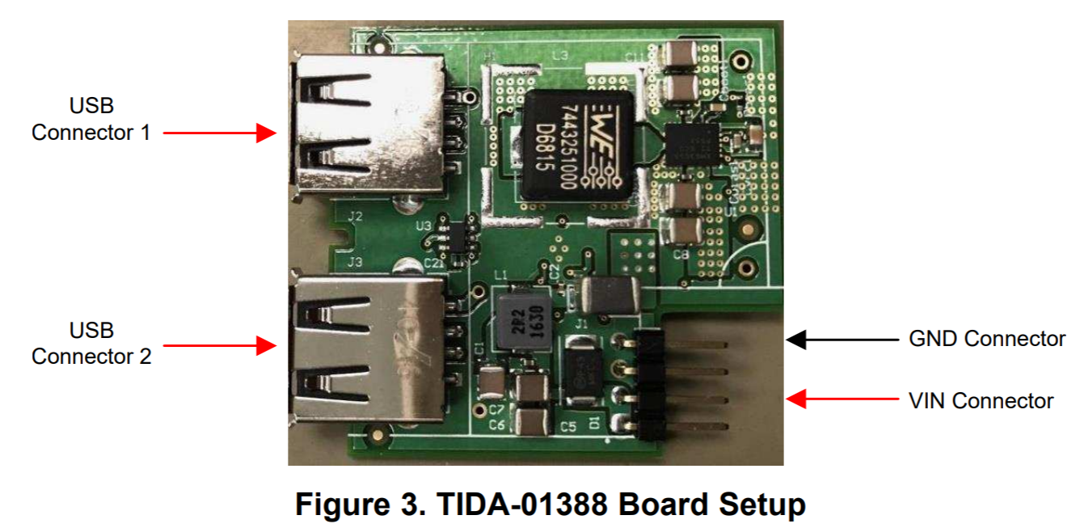
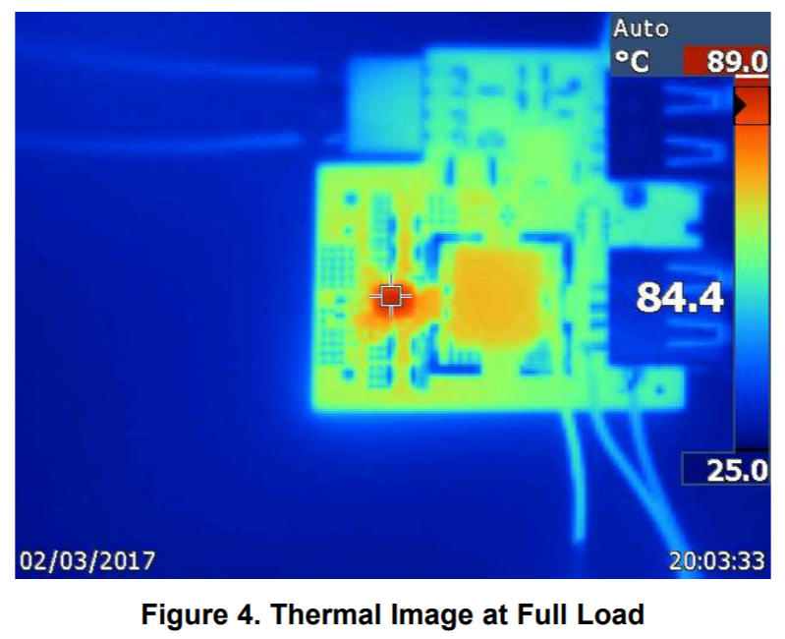
Question: Will 5A converter always support 5A?
Answer: “It depends….”
Ambient Temperature
Efficiency /Power Loss
Board Size
R_{ƟJA}
Thermal Shutdown ?
EXAMPLE DUAL USB DESIGN:
V_{IN} = 12V and V_{OUT} = 5V
I_{OUT} = 2 x 2.1A (4.2A Total), Ta = 22 deg C
Will this work at 125 degree C ambient?
http://www.ti.com/lit/ug/tiducz9/tiducz9.pdf

Slide 51
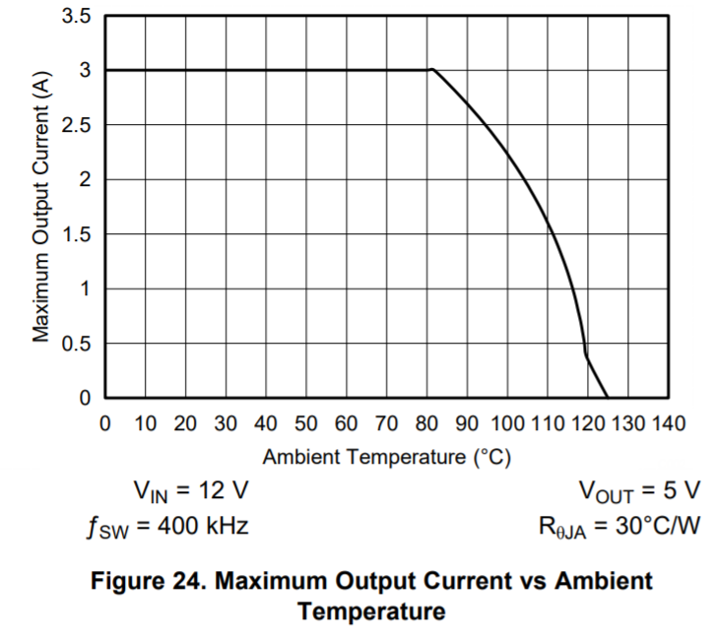
What can you do in terms of Thermals?
Check TI reference design and see the thermal performance
Check Datasheet for Thermal Information
Increase Efficiency
  Lower Switching Frequency
  Choose part with lower Rds_on
Limit the operating current
PCB Layout
  Increase board size
  Copper weight
  Via
Sample Datasheet Info
R_{ƟJA}
http://www.ti.com/lit/ds/symlink/lmr33630.pdf#page=26

Slide 52
Example Design Calculation
LMR33630 SOIC and LMR33630 Hot Rod

Slide 53
LMR33630 Case Study
Scenario:
I have a design with the following specifications:
VIN = 6V to 18V with a typical value of 12V
VOUT = 3.3V
IOUT = 3A
Operating Frequency = 2.1MHz
How does the Hot Rod package compared with SOIC?

Slide 54



LMR33630 Package Comparison
Can the Hot Rod Package handle my thermal requirement?
Should I stick with SOIC with DAP Package?
OR
?

Slide 55


LMR33630 Efficiency Comparison
SOIC
HOTROD
~84%
~88%
At 12V input and 3A Efficiency ~ 84%
At 12V input and 3A Efficiency ~ 88%

Slide 56
LMR33630 Power Dissipation Comparison
PARAMETER | SOIC | HOT ROD
Efficiency | 84% | 88%
Total Power Loss (P_{LOSS} ) | 1.88 W | 1.35W
Inductor DCR (R_{L}) (from EVM) | 25 mΩ | 35mΩ
Power Dissipated DCR | 0.225 W | 0.315 W
Power Dissipated IC (P_{D}) | 1.655 W | 1.035 W
The Hot-Rod Package dissipate less power compared to SOIC part

Slide 57


LMR33630 EVM Board Size Comparison
SOIC
HOTROD
Board area = 3.2 inch x 2.6 inch
= 8.32 inch² = 53.6 cm²
Board area = 3.0 inch x 2.8 inch
= 8.4 inch² = 54.2 cm²

Slide 58



LMR33630 θ_{JA} Comparison
SOIC
HOTROD
θ_{JA} ~ 25 °C/W
θ_{JA} ~ 47 °C/W
Board area = 53.6 cm²
Board area = 54.2 cm²

Slide 59
LMR33630 Expected Temperature
PARAMETER | SOIC | HOT ROD
Power Dissipated IC (P_{D}) | 1.655W | 1.03 W
Junction to Ambient Thermal Resistance (R_{θJA} ) | ~ 25 °C/W | ~ 47 °C/W
Temperature Rise | 1.655 W x 25°C/W = 41.3°C | 1.03 W x 47°C/W = 48.4°C
At 25°C Ambient | ~ 66 °C | ~ 73 °C

Slide 60


LMR33630 EVM MEASUREMENT
SOIC
HOTROD
Measured Case Temperature = 61°C
With Ψ_{JT} = 4.3°C/W
Junction Temperature ~ 68°C
Measured Case Temperature = 67°C
With Ψ_{JT} = 0.8°C/W
Junction Temperature ~ 68°C

Slide 61
Example Summary
R_{θJA} value given in the datasheet thermal table should not be used to measure thermal performance of the IC
The value is only useful to compare packages within TI and our competitors
R_{θJA} curves within the datasheet can be used to predict the temperature of the IC for a given copper size area
Some datasheet will also show derating curves for a specific R_{θJA} value

Slide 62
Thank you

Slide 63


