Slide 1
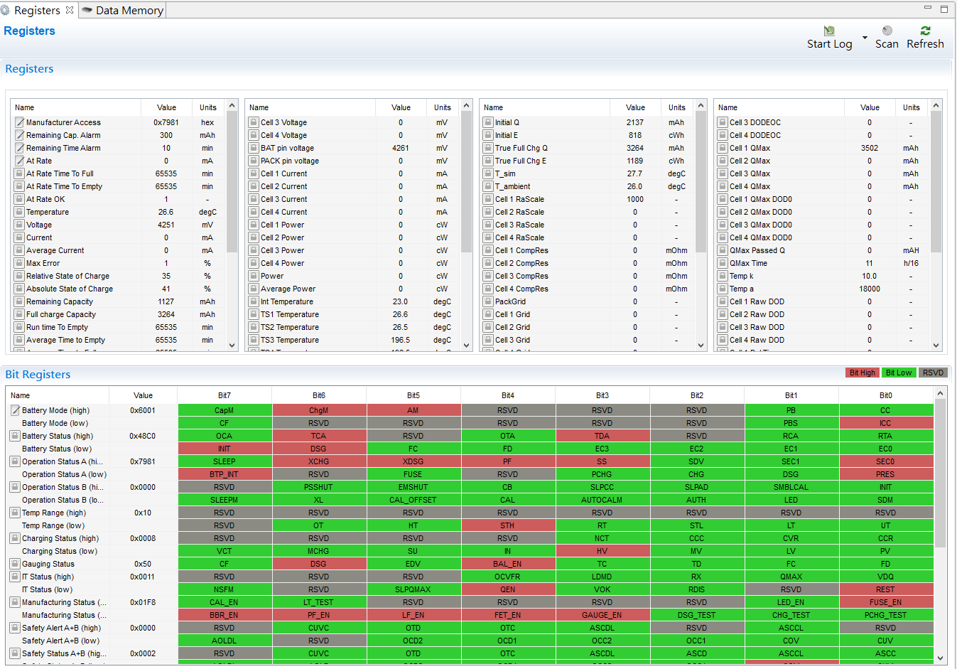
1. Got PF flag

Slide 2
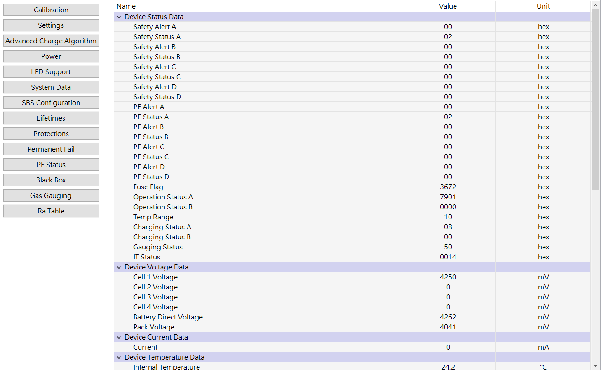
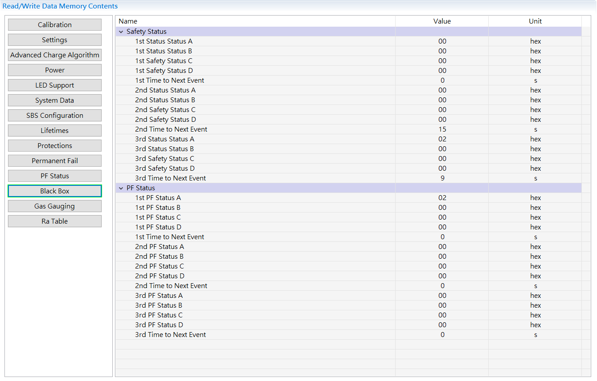
2. Got PF status, alert and block box

Slide 3
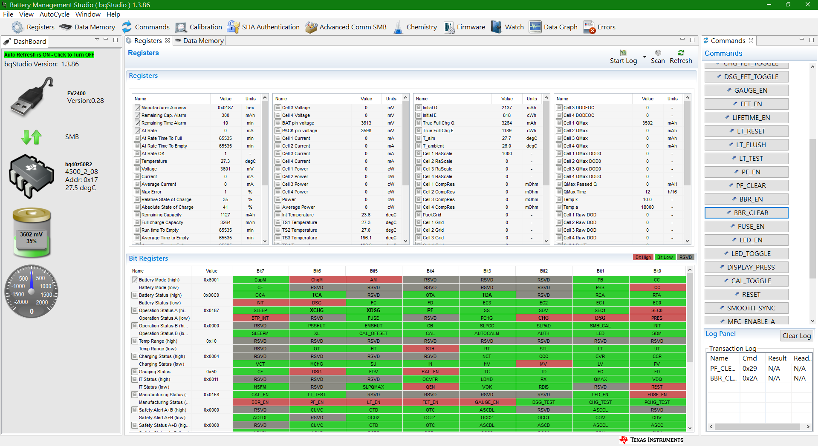
3. Send PF_Clear and BBR_Clear

Slide 4
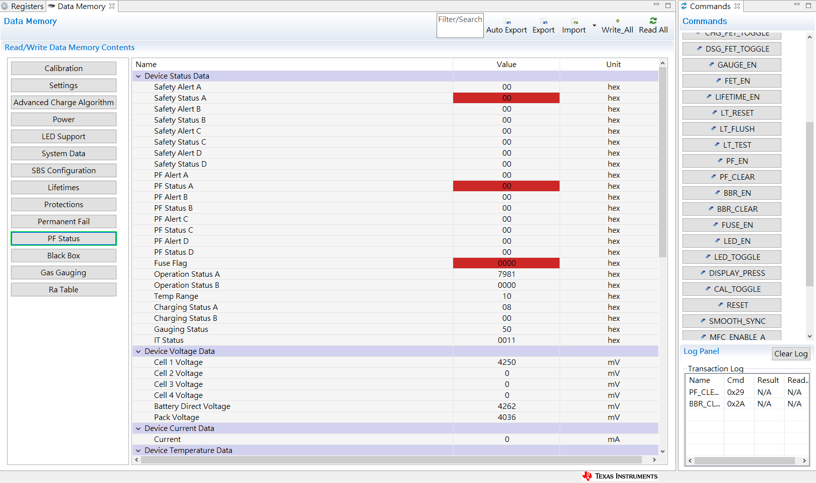
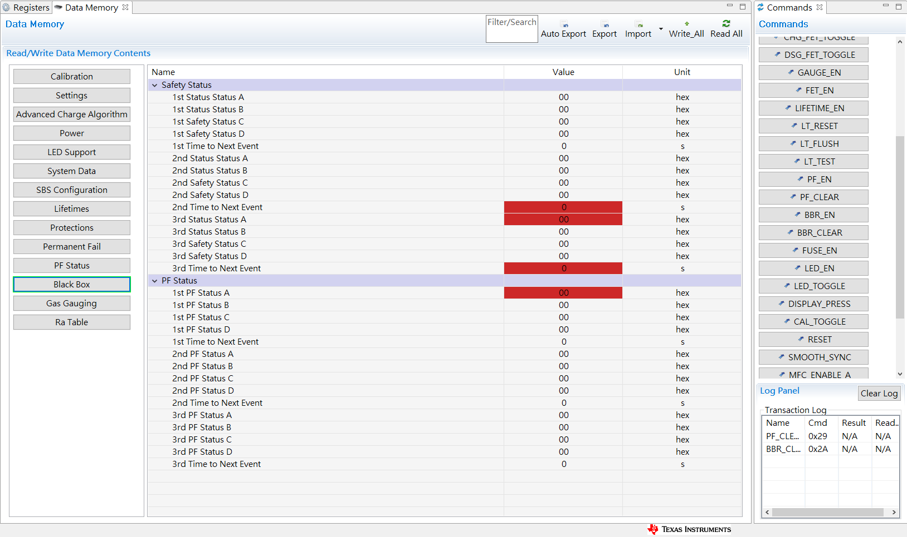
4. After PF_Clear and BBR_Clear, check status, alert and block box

Slide 5
5. PF flag is still there, it cannot be cleared

