Slide 1
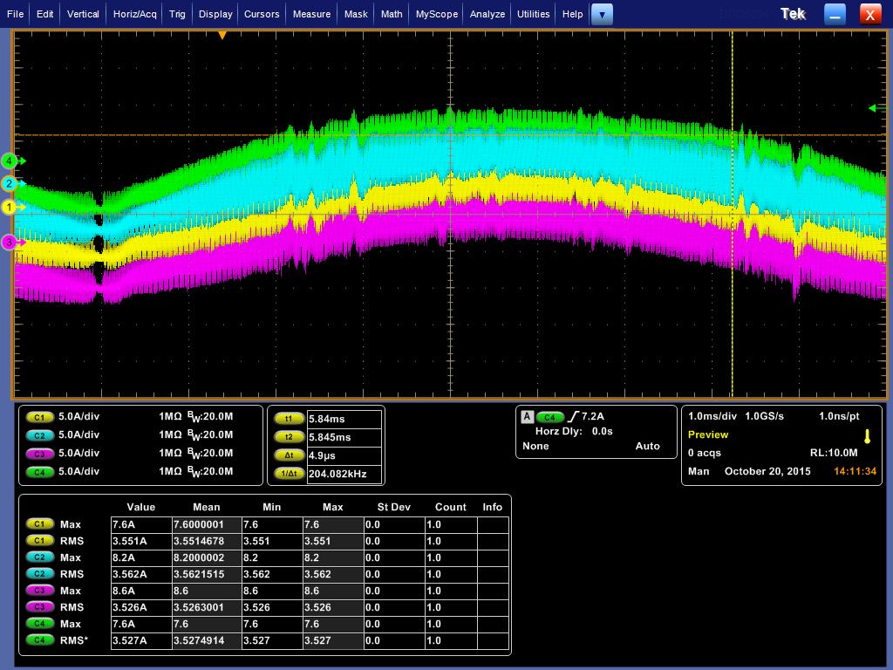
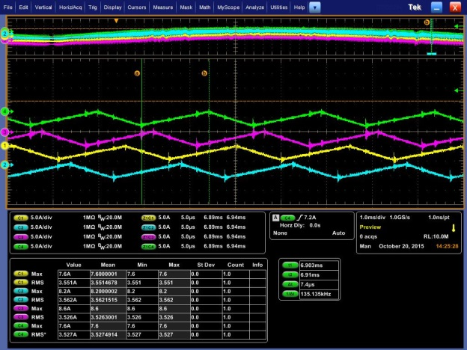
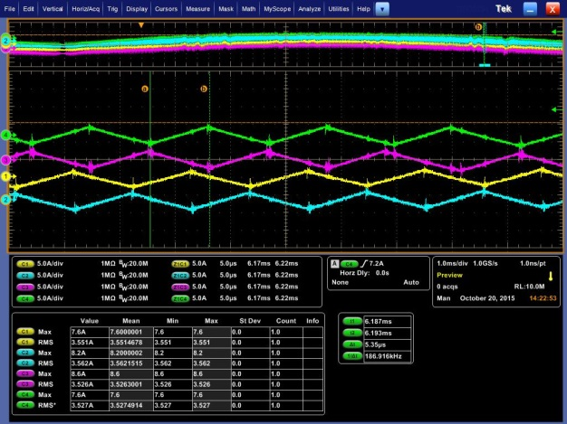
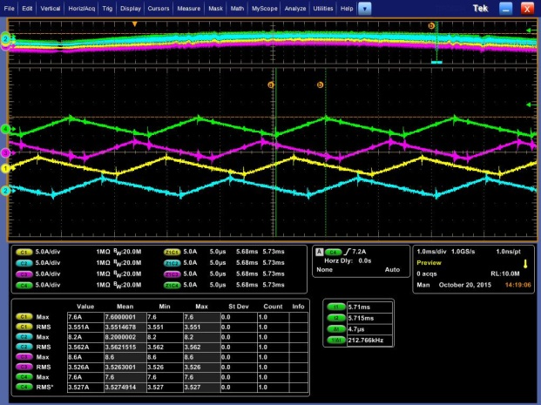
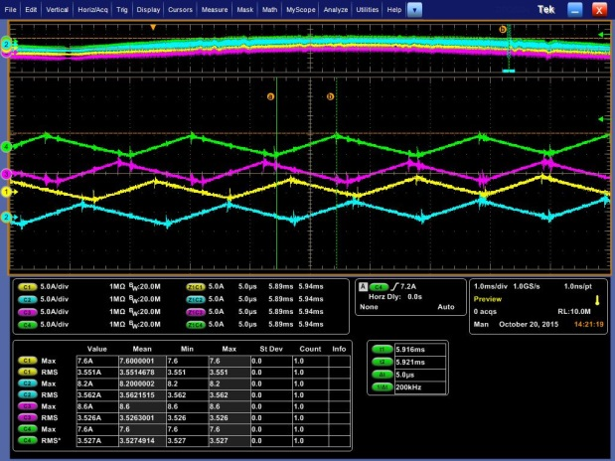
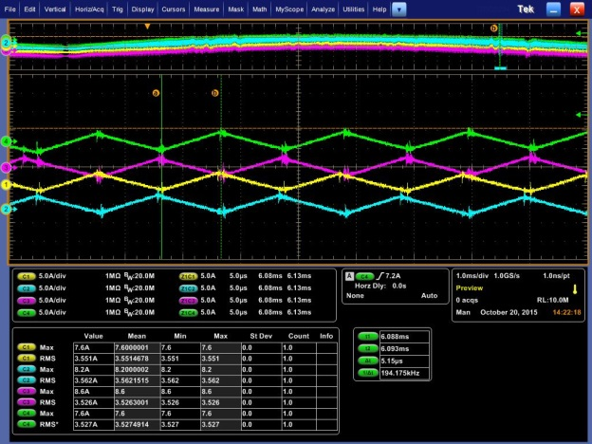
90°Phase shifting
ON Duty:40%⇒60%
L1 A-phase
L1 B-phase
L2 A-phase
L2 B-phase
Ch1. L2 A-phase
Ch2. L2 B-phase
Ch3. L1 B-phase
Ch4. L1 A-phase
zoom
ON Duty:60%
zoom
90°Phase shifting
L1 A-phase
L1 B-phase
L2 A-phase
L2 B-phase
AC240V
Vout=410V
Iin=30A
zoom
ON Duty:55%
zoom
zoom
90°Phase shifting
90°Phase shifting
180°Phase shifting
L1 A-phase
L1 B-phase
L2 A-phase
L2 B-phase
L1 A-phase
L1 B-phase
L2 A-phase
L2 B-phase
L1 A-phase
L1 B-phase
L2 A-phase
L2 B-phase
ON Duty:40%
ON Duty:45%
ON Duty:50%
⇒ON Duty:50%, Phase shifting is not 90°but 180°.

