Slide 1
Scope
My customer have original design using TPS54335A as page 3~page4.
They are investigating the root cause about several returns from market.
(all of those PH pin had shorted to GND).
They will have new project ( bigger biz size).
So, customer simulate actual environment for in-house test ( page2) now.
They found that when electro-magnetic contactor trips , sometimes ( 1time/40times) violate ABS max rating of PH pin in the period of dead time. ( page 6).
Inquiry ( Would you please have your comment)
1 Do you think PH undershoot on Fig 2( page 6 ) leads the failure?
2 I had recommended Osaki to add shottky diode ( low Vf) to keep PH < 1V.
Do you agree? If no, do you have any recommend ? ( I had already asked customer
to improve PCB layout as page 4.) As per Webench sim, stability seems no problem ( page3)

Slide 2
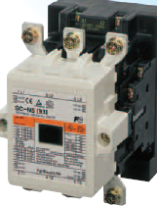
Test diagram
40~50times ON/OFF ( 1time: a few sec on/off )
➔ Customer had get Fig2 with oscilloscope is normal mode after 40times on/off
Electromagnetic Contactor
AC Load
(over 50A)
PH
AC/DC
24V
AC
100V
TPS54335A
MCU
ADC
Control board
Load: 120mA
Equipment on the outdoor equipment

Slide 3
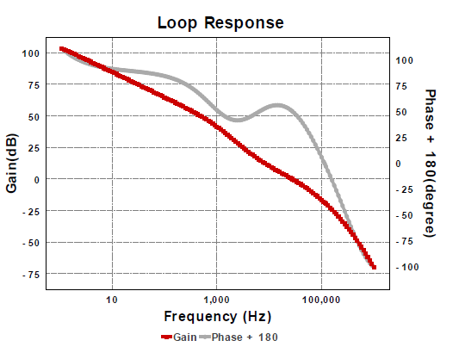
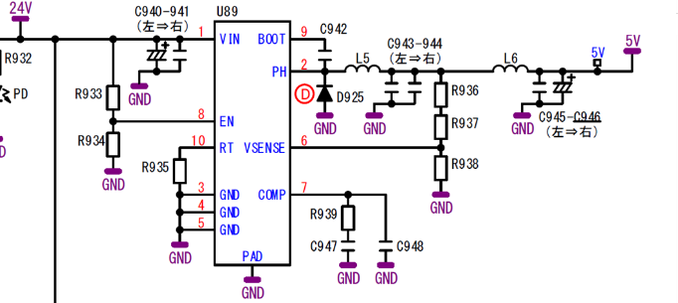
U90:
24Vin
3.3Vout
120mA(typ)
10uF/0.1uF
0.1F
22uH(3A)/47uF
2.4Kohm
12nF
120pF
As per webench , phase margin 51degree/
gain margin is 18 degree and seems no
problem
143K
Fsw=335KHz

Slide 4
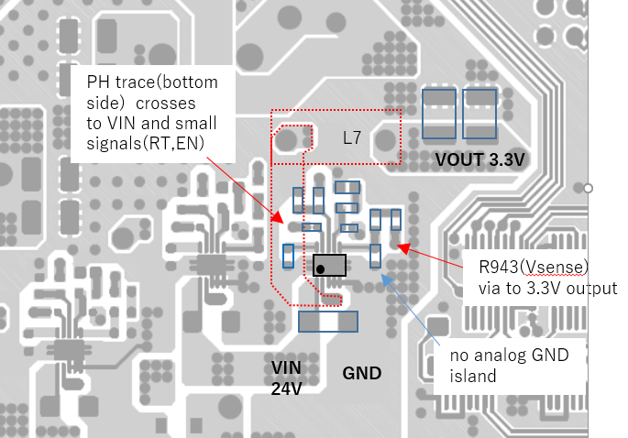
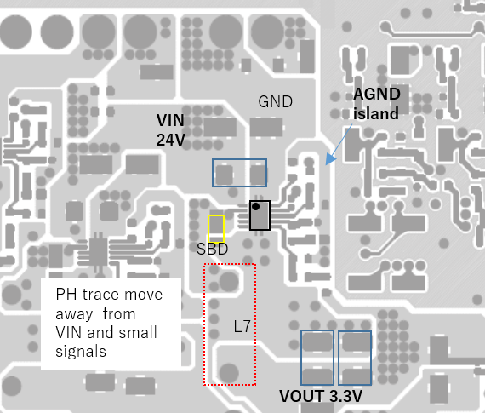
Before ( Original design)
After ( follow EVM layout)
Analog GND
Island to be quiet
PH
PH
R943(Vsense)
trace to Cout
directly
Your comment:
The waveform is normal, there is no need to concern this waveform.
The first layout is not much bad, but the the second is better than the first one, it looks good.
I don't think this layout would lead to the damage, and from the SW waveform, it looks fine.
And for the comp and vsense pin, it seems also fine

Slide 5
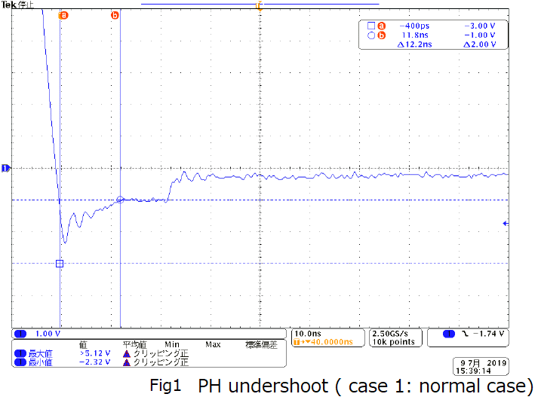
Fig1 Normal case ( I had sent in e2e in the previous post) : Your comment: no problem
10ns
1V

Slide 6
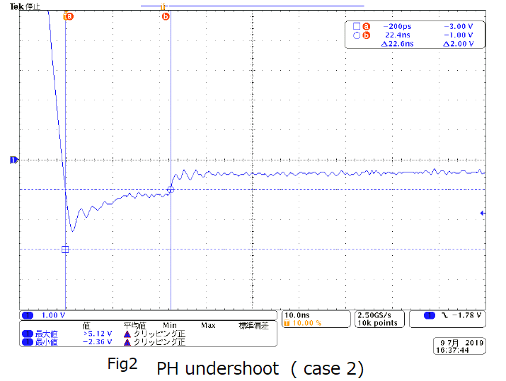
Fig2 “ AC noise “ case( page2 ) : Is it directly lead failure ?
10ns
1V
Dead time
1.8V <10ns
( below 3.5V)
Violate ABS max rating (Over 1V >10ns pulse ) but is it directly cause fail?

