Slide 1
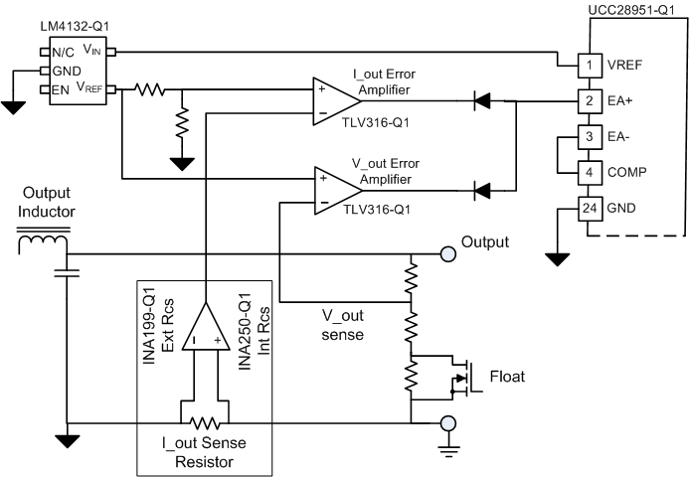
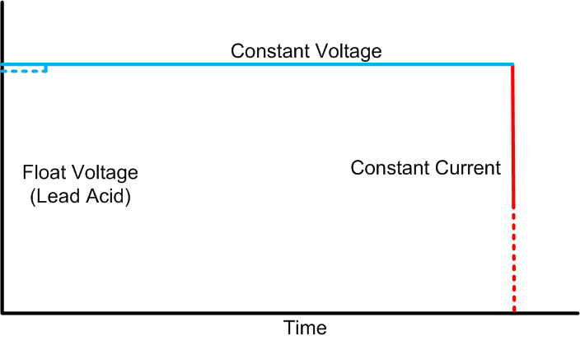
On Board Charger: Error Amplifiers (I and V)
Measure output current
Compare to reference
Output error signal (power demand)
Measure output voltage
Compare to reference
Output error signal (power demand)
Diode ‘or’ errors – lowest error ‘wins’
  Automatic CV / CI transition
Lowest error ‘wins’ and controls the output
Low side sense at 400Vout
High side sense at 12Vout is possible
Float signal from MCU
- Lead Acid only
- +
TI Information – Selective Disclosure
1

